Slide 1
AQA
A Level
Computer Science
Paper 1
Hash tables and dictionaries
Unit 7
Data structures

Slide 2
Objectives
Be familiar with a hash table and its uses
Be able to apply simple hashing algorithms
Know what is meant by a collision and how collisions are handled using rehashing
Be familiar with the concept of a dictionary
Be familiar with simple applications of a dictionary

Slide 3
Searching large data sets
Searching is an extremely common operation in data processing applications
Can you think of examples of large datasets that frequently need to be searched?

Slide 4
Searching methods
What searching methods can you think of?
What state must the dataset be in before a particular searching method can be used?

Slide 5
Sequential and binary search
If a list of items is in random order, the only option is a sequential search
If there are ten million items in the dataset, this could take a long time!
A binary search will be quicker but can only be used if the data is kept in sorted order

Slide 6
Hash table
Luckily, we can create an abstract data structure known as a hash table which will find any record in the dataset almost instantly, no matter how large the dataset
The address of the data item to be stored is calculated from the data itself, using a hashing algorithm

Slide 7
Hashing definition
Large data sets can be organised so each record is assigned a unique address
This unique address is calculated using a hashing algorithm or hash function
The algorithm uses some part of the record (e.g. the primary key) to map the record to a unique destination address
The resulting data structure used to store the data is called a hash table

Slide 8
A simple hashing algorithm
A simple hashing algorithm is to assign, for example, 1000 slots to hold records which each have a 4-digit key
Divide the key by the number of slots and find the remainder, which is the address
Address ← key mod (number of slots)
Calculate the addresses of: 0287, 0999, 1074, 9074, 3287
What is the problem with this algorithm?

Slide 9
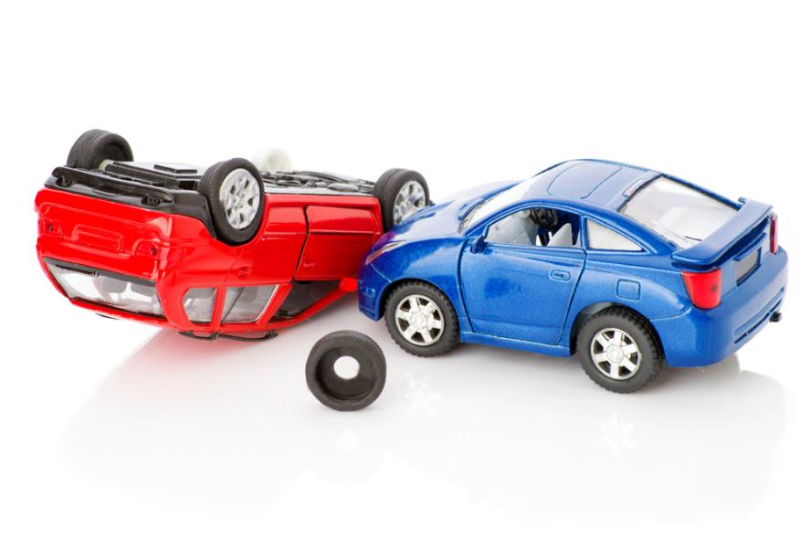
Collisions
A collision happens when an algorithm generates the same address for different primary keys
A collision is sometimes referred to as a synonym
However good the hashing algorithm is, it is impossible to avoid collisions

Slide 10
Collision resolution
There are several methods of dealing with a collision
When storing the items in a table with 1000 spaces
0287, 0999, 1074, 9074, 3287
Where will 1074 be stored?
Can you suggest where we should store item 9074?

Slide 11
Dealing with collisions
The simplest method is to put the item in the next free slot in the table
A disadvantage is that this tends to lead to “clustering” of items in the table
An alternative algorithm is to increment the ‘skip’ value by adding 1,3, 5, 7 etc. instead of repeatedly incrementing by 1 to find a free space
Note that the size of the skip value must be such that all slots in the table will eventually be reached, or part of the table will be unused

Slide 12
Hashing example
Given: 2-digit key; 5 slots = A[5]; collisions go to next free slot
Draw the state of A after adding:
Key | Key mod 5 | A[0] | A[1] | A[2] | A[3] | A[4]
 |  | - | - | - | - | -
14
27
17
44

Slide 13
Hashing example
Given: 2-digit key; 5 slots = A[5]; collisions go to next free slot
Draw the state of A after adding:
Key | Key mod 5 | A[0] | A[1] | A[2] | A[3] | A[4]
 |  | - | - | - | - | -
14 | 4 |  |  |  |  | 14
27 | 2 |  |  | 27 |  | 14
17 | 2 |  |  | 27 | 17 | 14
44 | 4 | 44 |  | 27 | 17 | 14

Slide 14
Worksheet 4
Complete Task 1 on the worksheet

Slide 15
Avoiding problems
As the table fills up (i.e. as the load factor increases), more and more collisions occur
The table size needs to be large enough so that the load factor is not more than about 50%-70% of table size
With a skip factor greater than 1, it may not be possible to store an item even if the table is not full, because not all addresses can be generated
This problem can be avoided by using a prime number as the table size

Slide 16
Searching the hash table
The hashing algorithm is: key mod 11
Assuming that collisions are to go in next free slot, how do we locate an item?
How will you locate item 70?
How will you establish that 58 is not in the table?
0 | 1 | 2 | 3 | 4 | 5 | 6 | 7 | 8 | 9 | 10
33 | 55 |  | 47 | 15 | 70 | 28 | 27 | 81

Slide 17
Hashing - searching
To locate an item:
Address ← apply hashing algorithm to key
IF target is at address, THEN return item
ELSE
IF address is empty, then target is not in list
ELSE move forward in a linear fashion, checking each slot, until
- an empty slot is found → target not here, OR
- the target is found → return target
ENDIF
ENDIF

Slide 18
Other hashing algorithms
There are many hashing algorithms, but they all involve the mod function at some point, as the hash address has to be in the range of table addresses
The ‘mid-square’ and the ‘folding method’ are two examples of hashing algorithm

Slide 19
The mid-square method
First square the item (assume it is numeric)
Extract some portion of the resulting digits
Perform the mod (remainder) step to get an address
Example: Assume a table size of 11, and a number 56 to be stored
56² = 3136
Middle 2 digits = 13
Address = 13 mod 11 = 2

Slide 20
The folding method
Divide the item into equal-size pieces (the last piece may not be of equal size)
Add the pieces together
Perform the mod (remainder) step to get an address
Example: Assume a table size of 11, and a number 34721062 to be stored
34 + 72 + 10 + 62 = 178
Address = 178 mod 11 = 2

Slide 21
Hashing alphanumeric data
Alphanumeric data may be converted to numeric data by using the ASCII code for each character, then applying a hashing algorithm to the resulting series of digits
For example, the word “cab” can be converted to a series of ordinal values, which are then added together:
ord(“c”) + ord(“a”) + ord(“b”) = 99 + 97 + 98
= 294
Address = 294 mod 11 = 8 (in a table of size 11)

Slide 22
Worksheet 4
Complete Task 2 on the worksheet
ASCII Ordinal values:
A | B | C | D | E | F | G | H | I | J | K | L | M | N
65 | 66 | 67 | 68 | 69 | 70 | 71 | 72 | 73 | 74 | 75 | 76 | 77 | 78

Slide 23
Dealing with deletions
Items to be deleted must be replaced with a dummy item or marker, for example the word “Deleted”
When searching for an item which hashes to that spot, if it is not found, the search will continue until it is found or a free space located
If a new item is to be added, it will replace the deleted item

Slide 24
Dictionary
A dictionary is an abstract data type made up of associated pairs
Each pair has a key and a value
The value is accessed via the key
In Visual Basic and Python, for example, a dictionary is a built-in data structure, e.g.
StudentID = {145: “Ken”, 675: “Belinda”, 238: “Mark”, ..}

Slide 25
Uses of a dictionary
What characteristics make a problem suitable for the use of dictionaries?
Suggest real life examples

Slide 26
Uses of a dictionary
A dictionary is a very useful data structure for any application where items need to be looked up, e.g.:
In a computer system, the ASCII or Unicode table
In a translation program, a foreign language dictionary containing words and meanings
Other data structures such as trees and graphs may be implemented using a dictionary
Multiple items with the same key are not allowed, but the value associated with a key could be a list, dictionary or other data structure which can store multiple values

Slide 27
Dictionary operations
What operations would be useful to implement the dictionary data structure?
Think back to the queue, stack and list operations

Slide 28
Implementing a dictionary
Add a new key:value pair to the dictionary
Delete a key:value pair from the dictionary
Amend the value in a key:value pair
Return the value associated with key k
Return True or False depending on whether the key is in the dictionary
Return the length of the dictionary

Slide 29
Dictionary and hashing
The key:value pairs are not held in any particular sequence
The address of the key:value pair is calculated using a hashing algorithm

Slide 30
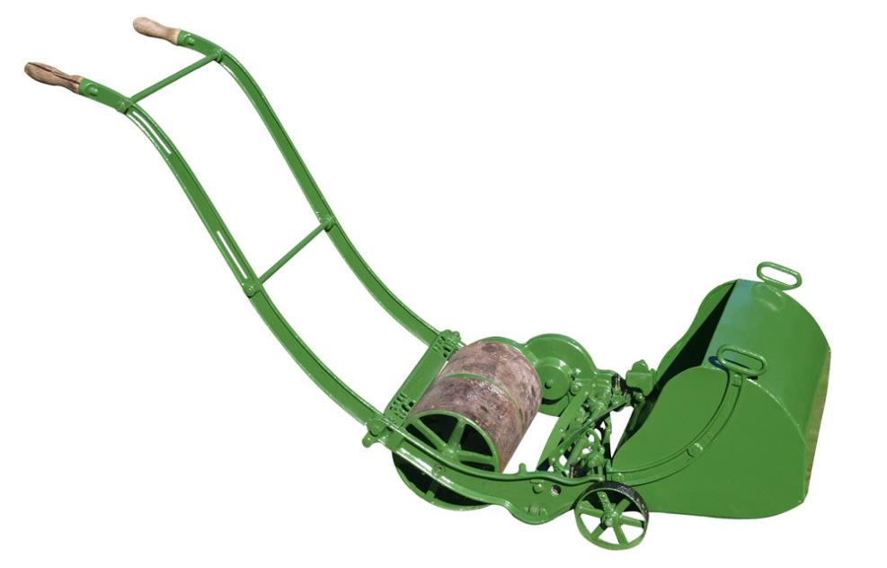
Worksheet 4
Complete Task 3 on the worksheet

Slide 31
Plenary
Define hashing in a single sentence
Why do hashing algorithms use the ‘mod’ function?
What problem is commonly encountered during hashing and how can it be handled?
How are items found in a hash table?
Define a dictionary in a single sentence
What is the connection between hashing and a dictionary?

Slide 32
Extension
Remember, hashing and dictionaries are used when lots of searching is anticipated, so the cost of building the ADT is small in comparison to the saving in searching time
How does deleting from a built-in dictionary data structure work?
How does deleting from a hash table work?

