Slide 2
Objectives
Understand the difference between facts and rules
Describe uses of machine learning
Use training data to create rules that solve problems of categorising data
Discuss the strengths and weaknesses of machine learning

Slide 3
Starter
How can you tell the difference between a cat and a rock?

Slide 4
Starter
How can you tell the difference between a cat and a rock?
Some suggested rules to classify rocks and cats
Rocks | Cats
Jagged edges | Two eyes / oval shapes
No obvious shapes (such as circles / rectangles / triangles) | Ears at top of head / Triangles at top of circle
Similar colour throughout – but random lines may occur | Fur / blurred at the edges
 | Four legs with a joint half way in each one

Slide 5
Facts and rules
A fact for classifying a person might be that:
People have a mouth
A rule that helps to classify a person could be:
People might wear sunglasses
What are five more facts and rules to classify a person

Slide 6
Facts and rules
Examples of facts and rules to identify people
Do your facts and rules identify this dog as a person?
Facts | Rules
People have two eyes | Some people wear hats
People have a mouth | Mouths may be open
People have teeth | Teeth may not be shown
People have a nose | People normally have hair
Noses are the same colour as people’s faces | Hair may also be on some people’s faces

Slide 7
Machine learning
Artificial Intelligence is the artificial creation of human-like intelligence that can learn or think
Machine learning (ML) is a part of AI
In machine learning, the machine will work out the rules for itself
It will be given a large amount of training data to work out these rules
Training
Data
Machine Learning
Rules

Slide 8
Machine learning - Birds
A machine learning algorithm uses training data so that it can create rules for itself
What rules might the algorithm make to identify birds from the following training data?
Training Data
 ✓
 ✓
 ✓
 ✗
 ✓

Slide 9
Machine learning - Birds
Possible rules from the training data:
One eye
Two wings that are both open
Small head with a beak
Problems with the rules:
Birds from the front have two eyes
Birds may have their wings shut, or cannot fly
Machine learning therefore requires lots of data if it is to learn well

Slide 10
Worksheet 2
Complete Task 1 on Worksheet 2

Slide 11
Structured data
In structured data, the data has been organised
For example, a company’s financial data may be organised by month; a weather station’s data may be organised by hour
Unstructured data has not been organised
For example, emails, newspaper articles, messages, social media posts are unstructured
Machine learning is very powerful at finding patterns and information in unstructured data as it learns its own rules

Slide 12
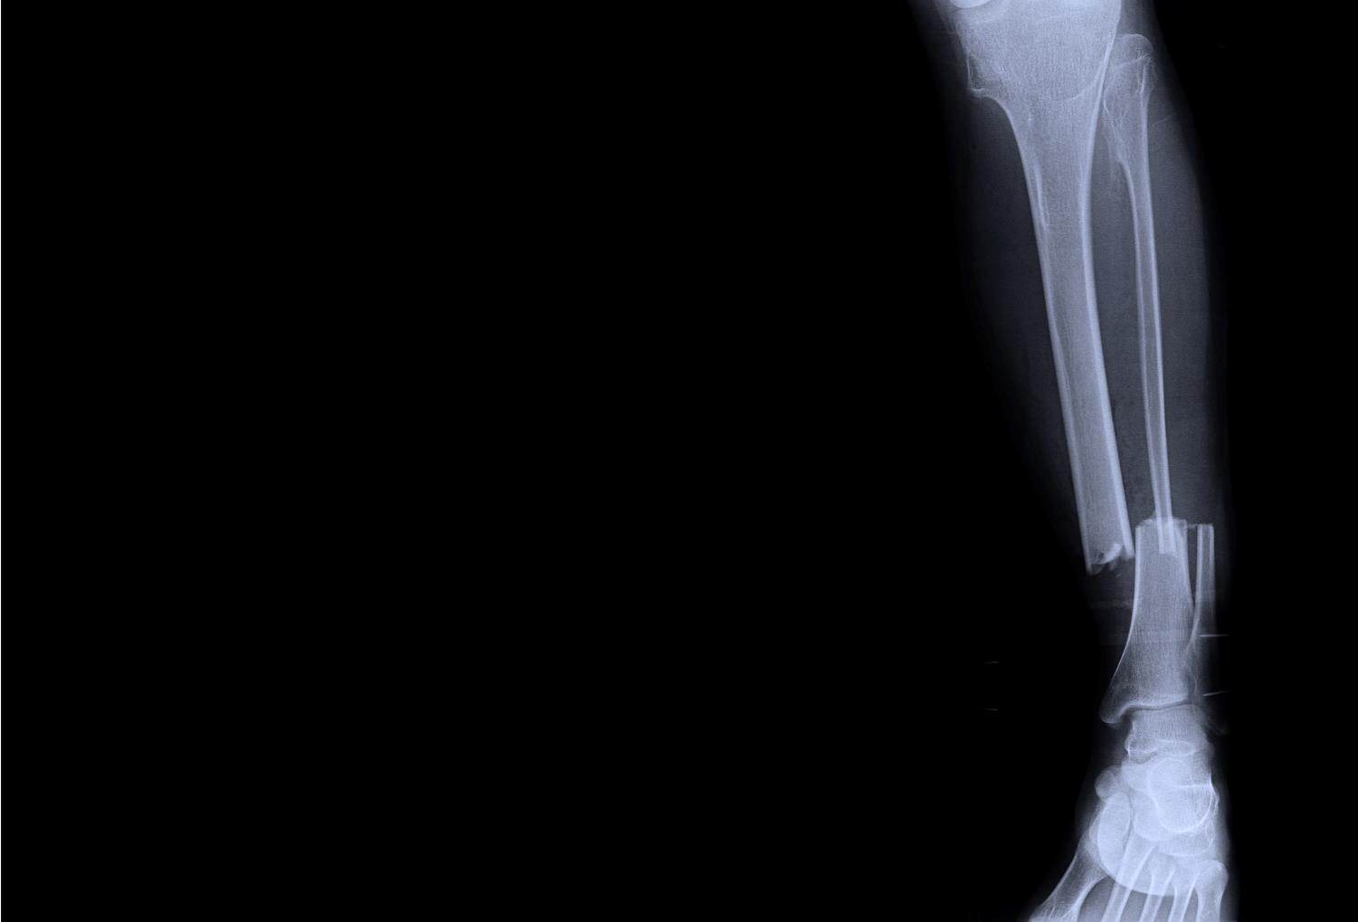
Applications for ML
Machine Learning has many uses
For example, a machine could learn to identify what a traffic jam on a motorway looks like. This could then automatically alert emergency services
Make a list of useful applications where machine learning can classify images

Slide 13
ML and images
Machine learning is used to classify images
Applications include:
Screening medical scans and x-ray images
Quality control on production lines
Detecting hazards for self-drive cars
Face recognition
Fingerprint ID
Robot fruit pickers
Identifying spam email

Slide 14
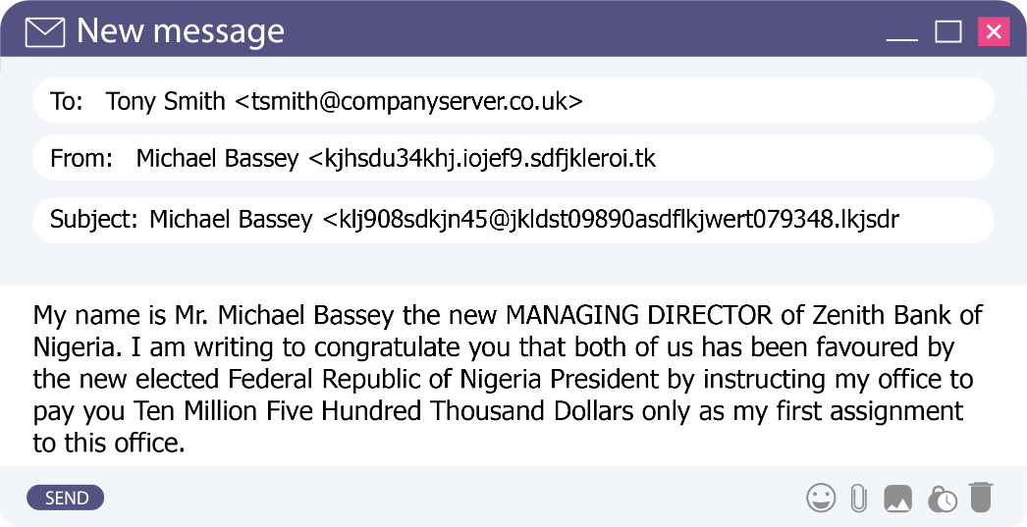
Email and spam
Emails contain both structured and unstructured data
What parts of the email below are structured and unstructured?

Slide 15
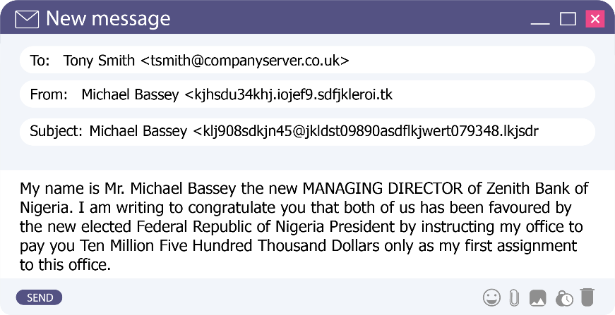
Email and spam
What parts of the email below are structured and unstructured?
What rules do you think that spam filters have learnt that help them to identify this email as spam?
Structured
Unstructured

Slide 16
Email and spam
What rules do you think that spam filters have learnt that help them to identify this email as spam?
Subject just repeats name and email address
Lots of random characters
An uncommon use of capitals
A country linked with high spam rates
Unusual word to describe millions of dollars
A strange choice of word

Slide 17
Worksheet 2
Complete Task 2 on Worksheet 2

Slide 18
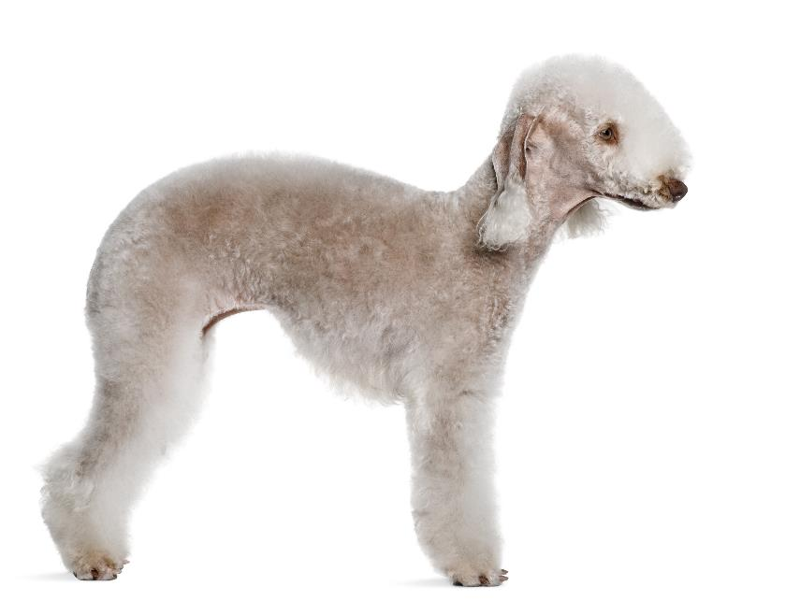
Strengths and weaknesses
Machine learning (ML) has a number of strengths and weaknesses
For instance, we don’t need to create a set of rules for the machine to follow
What other strengths does ML have?
What weaknesses does ML have?
Animal | Certainty
Sheep | 93%

Slide 19
Strengths and weaknesses
Strengths and weaknesses of machine learning
Strengths | Weaknesses
It can find patterns we did not know were there | It is only as good as the training data given to it
It can solve simple questions and leave skilled humans to deal with special or harder cases | It only gives a probability, not a certain answer
The machine improves with experience | Results may need careful interpretation
It can handle unstructured data | Errors can be hard to detect

Slide 20
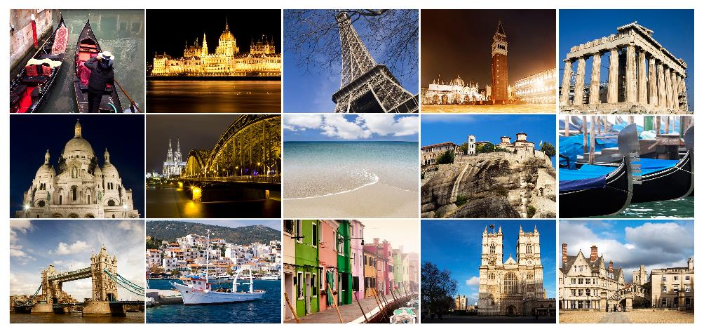
Plenary
A search engine wants to categorise photos of cities so that users can search for them
With a partner, explain how machine learning could be used to classify photos of different cities

Slide 21
Plenary
With a partner, explain how machine learning could be used to classify photos of different cities
Training data would first be used of photos of different cities
The machine learning would then create the rules of which photos were which city
Then any new photos could be classified automatically using the rules
A probability could be given as to how close a match each photo is
The most probable images could be shown first in a search result

