Slide 1
Health and safety
Computer crime and cyber security
3rd Edition

Slide 2
Objectives
Learn about some of the common health and safety problems associated with computer use
Learn ways of avoiding these problems
Learn about Health and Safety law
Learn about the need to dispose of computer equipment in a responsible manner

Slide 3
Are you sitting comfortably? Have you been hunched over your computer for too long?

Slide 4
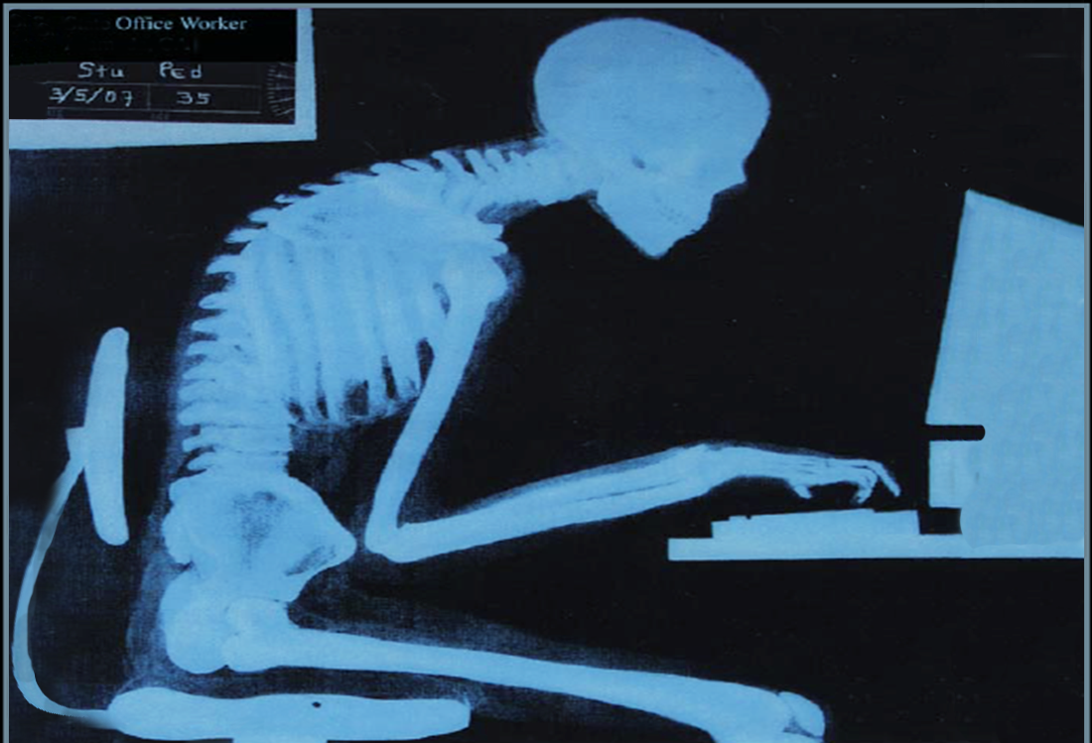

Slide 5
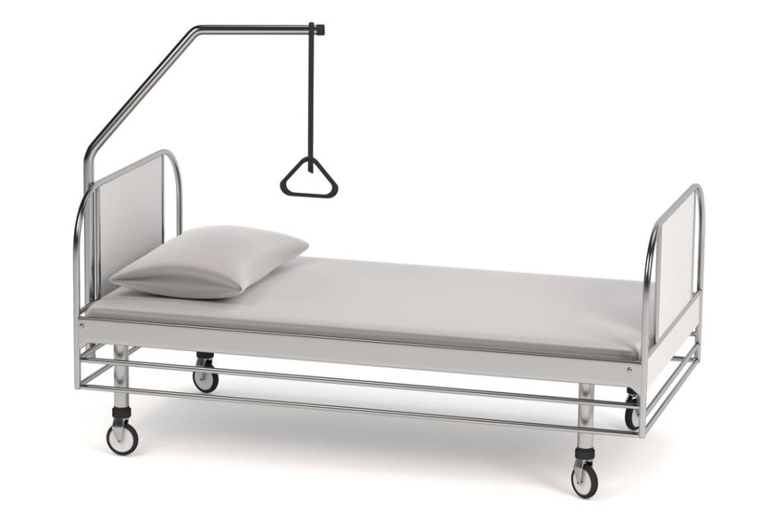
Health and safety issues
What are the possible problems related to using computers for prolonged periods?

Slide 6
Computers and your health
Headaches and eye strain from staring at a screen for too long
What advice would you give to someone who works long hours at a computer to avoid eye strain?

Slide 7
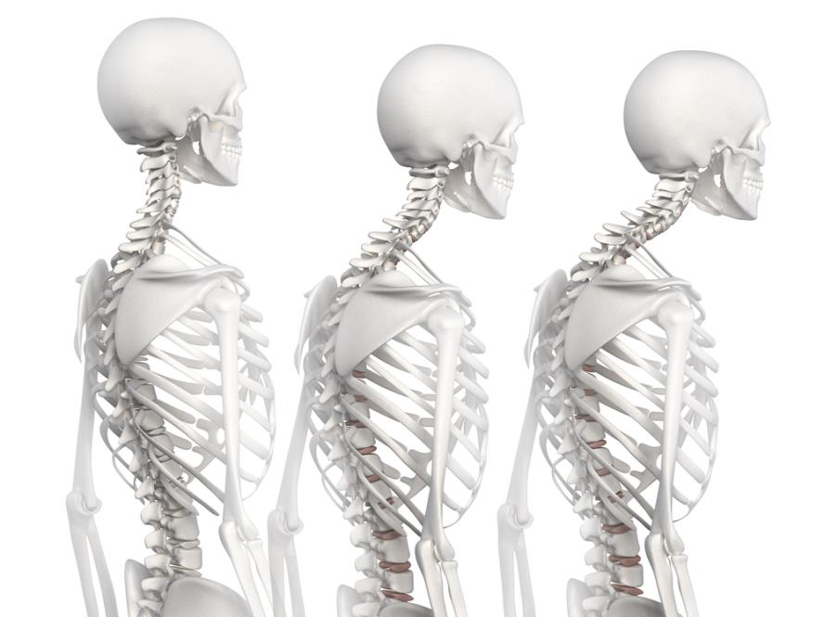
Computers and your health
Back problems can arise from poor posture and sitting in one position for hours at a time

Slide 8
Computers and your health
Repetitive Strain Injury (RSI) is caused by repeating the same actions over and over again
Home and school habits and environments can become an RSI risk for children
There are cases of children as young as 7 with serious RSI conditions
Teenagers with RSI need support in class and exams

Slide 9
Health and safety regulations
The law states that an employer must:
provide tiltable screens
provide anti-glare screen filters
provide adjustable chairs
provide foot supports
make sure lighting is suitable
make sure workstations are not cramped
plan work at a computer so that there are frequent breaks
pay for appropriate eye and eyesight tests by an optician

Slide 10
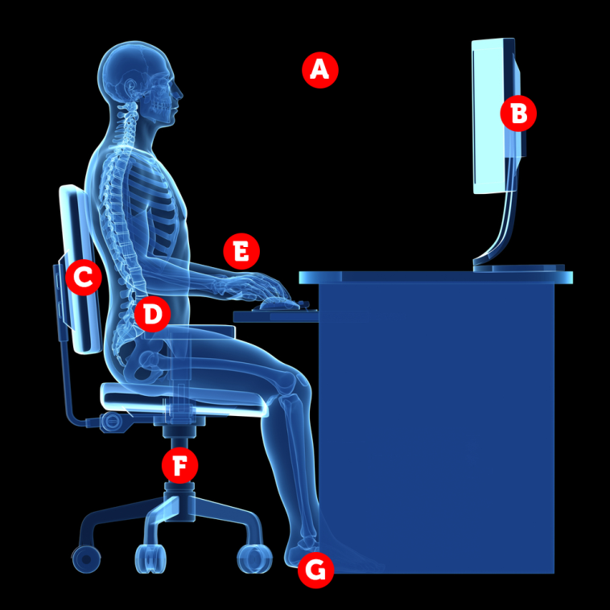
A well-designed workstation
A: 45cm between eyes & screen
B: adjustable screen at or slightly below eye level
C: chair supports lower back and shoulder blades
D: elbow angle between 90–120 degrees, keyboard within easy reach
E: wrist support for mouse hand to prevent wrist strain
F: chair is height adjustable
G: feet should touch the floor – add foot rest if too high

Slide 11
A well-designed environment
Proper lighting
Not too bright or too dim
Reduce glare on the screen
Make sure lights aren’t reflecting directly off your screen
Take regular breaks
Stand, stretch, or just look into the distance every 15 minutes or so

Slide 12
Worksheet 5
Complete Task 1

Slide 13
Health and safety crime
Employers have a duty to:
ensure the health and safety of their workers
ensure the safety of the workplace
avoid risks to the health and safety of non-employees
Employers ignoring these regulations may have to pay a fine, or in the worst cases, face a prison sentence

Slide 14
Other health effects of using computers
Electronic Screen Syndrome
TATT (Tired All the Time) Syndrome
Blue Light Syndrome
Text claw

Slide 15
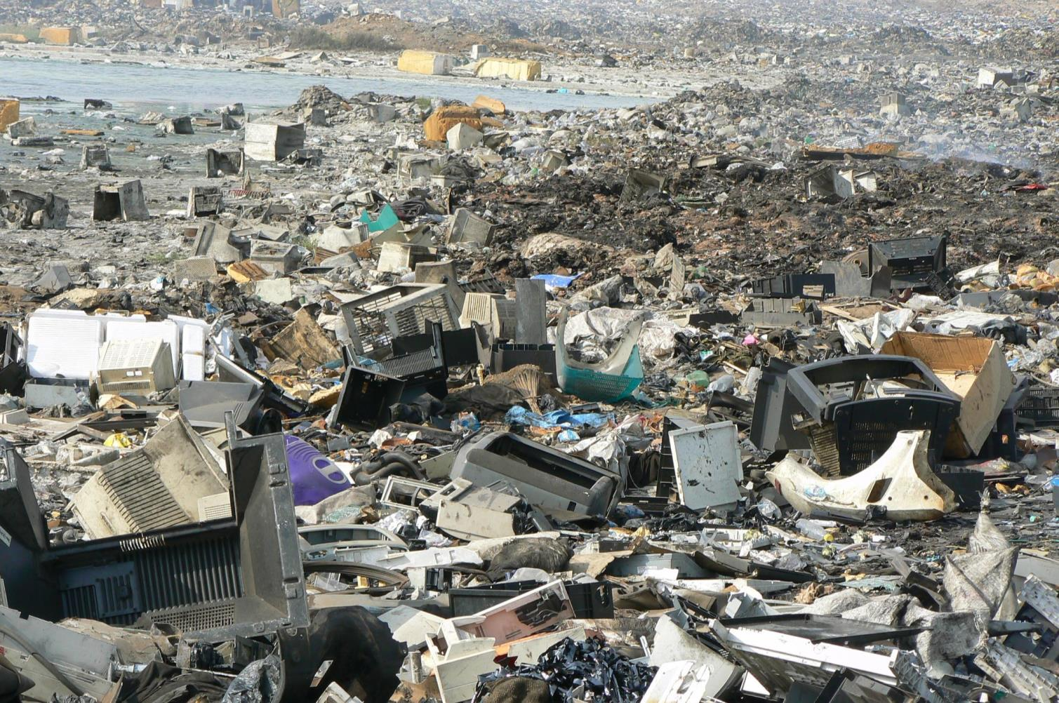
What happens to old computers?

Slide 16
Hazardous waste
Hazardous materials in electronic devices can leach into the earth and get into water supplies
Incinerating them causes pollution in the atmosphere
There are laws governing safe disposal of electronics and ‘e-waste’

Slide 17
Recycling options
Return to the Manufacturer – Some companies offer a part exchange scheme to exchange old products for part payment towards newer products
Professional Waste Disposal – Companies will collect and dispose of your items properly
Donate to charity – A number of non-profit organisations collect items either for re-use or for recycling
Give to family or friends – Help the environment too

Slide 18
Research task
In pairs or small groups, research ways of recycling old computers and phones safely
What are the hazards of giving your old computer to a recycling company or taking it to a rubbish dump?

Slide 19
What about data on old hard disks?
Using a data recovery program, someone can recover files from your hard disk, even if you have deleted them or reformatted your hard drive
What have you got on your computer that you would not want to be recovered by someone else?

Slide 20
Plenary
You have learned:
about some of the common health and safety problems associated with computer use
ways of avoiding these problems
about Health and Safety law
of the need to dispose of computer equipment in a responsible manner

