Slide 2
Learning Objectives
Demonstrate rounding numbers using decimal places and significant figures
Recognise and use expressions in decimal and standard form

Slide 3
Starter
Complete the Starter on Worksheet 1

Slide 4
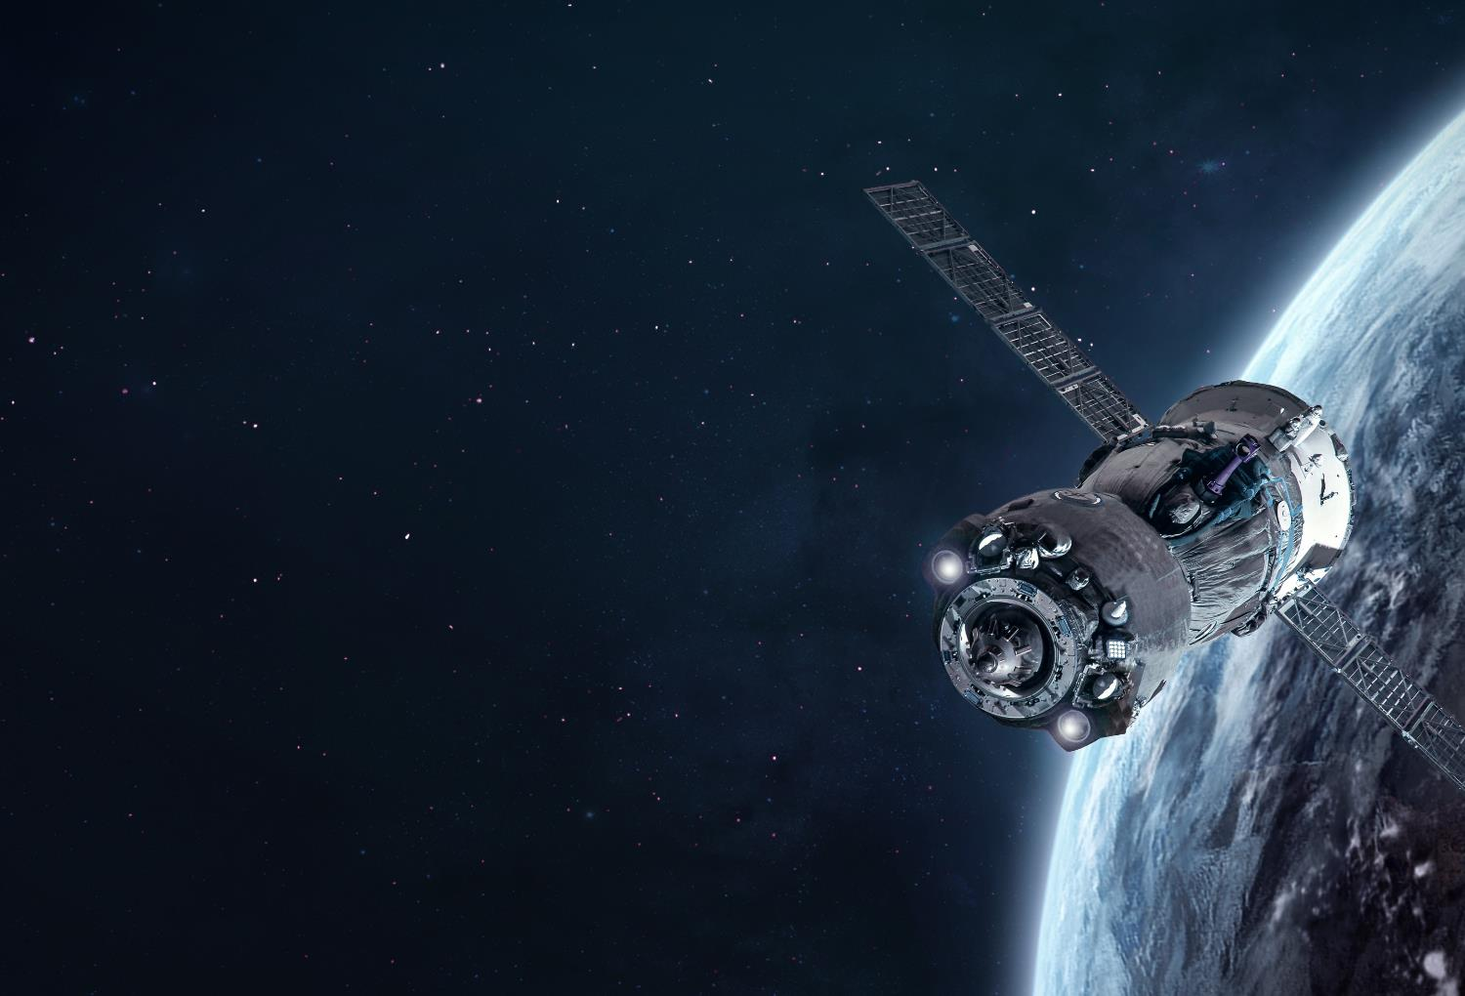
All numbers great and small
Designers and engineers work with very large and extremely small numbers in order to realise an idea
For example, consider the calculations required to build and install a space station
Using standard form makes numbers easier to manage while decimals afford higher levels of accuracy than whole numbers

Slide 5
Decimals
Decimals help achieve a higher level of accuracy within any given unit
Imagine measuring the height of your classmates to ensure a shelf is installed at a suitable height
If you measured their heights in metres without the use of decimals, how useful would the data be?

Slide 6
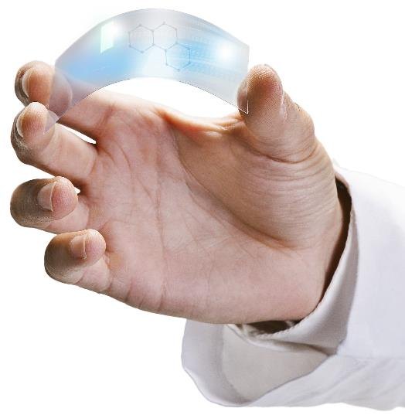
Decimals for detail
The sheet of plastic pictured here has a layer of graphene applied to it
Graphene is a very strong modern material with excellent thermal and electrical conductivity that could transform the design of mobile devices
It is made of a single layer of carbon atoms 0.000000345 mm thick
How would you calculate its thickness in centimeters or metres?
If a millimetre is equal to 1,000,000 nanometres, what is its thickness in nanometres?

Slide 7
Rounding
Rounding helps make numbers more manageable during calculations
Values can be rounded to significant figures (s.f.) or a given number of decimal places (d.p.)
To give the thickness of graphene in mm to 2 s.f. we look for the first non-zero digit from the left, the first significant figure
The 2nd s.f. is 4 and the 3rd is 5
What is the thickness of graphene to 2 decimal places?
How can rounding lead to inaccuracy?
0.000000345 mm becomes 0.00000035 mm

Slide 8
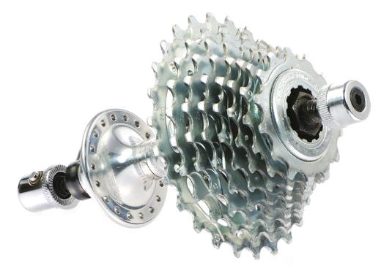
Significant figures
Go through the worked example below:
A bike sprocket set and axle has a total mass of 1.682 g
To write this measurement to 1 s.f.
Find the first and second significant figures
Ignore the rest of the number
Is the result closer to 1, or to 2?
So, 1.682 g ≈ 2 g to 1 s.f. (≈ means approximately equal to)
Give the answer to 2 s.f. and 3 s.f.
1.682 g
1.6

Slide 9
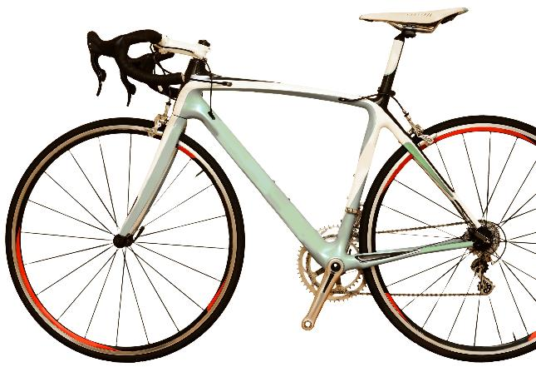
Decimal places
The number of figures after a decimal point gives the number of decimal places
If this aluminium bike has a mass of 8.16 kg and cyclist has a mass of 56.12 kg, calculate the total mass of rider and bike to 1 d.p.
If the frame is redesigned in carbon fibre, the weight is reduced by 1.34 kg – calculate the total mass to 1 d.p.

Slide 10
Decimal places
The number of figures after a decimal point gives the number of decimal places
If this aluminium bike has a mass of 8.16 kg and cyclist has a mass of 56.12 kg, calculate the total mass of rider and bike to 1 d.p.
8.16 + 56.12 = 64.28 ≈ 64.3 kg (1 d.p.)
If the frame is redesigned in carbon fibre, the weight is reduced by 1.34 kg – Calculate the total mass to 1 d.p.
6.82 + 56.12 = 62.94 ≈ 62.9 kg (1 d.p.)

Slide 11
Worksheet task
Complete Task 1 of Worksheet 1

Slide 12
Massive and miniscule
When working with very large or very small values, it’s often useful to write them in standard form
Standard form is a kind of shorthand for numbers that makes calculating numbers of vast and minuscule orders of magnitude easier
Standard form relies on your understanding of indices – what does 10³ mean?

Slide 13
Massive and miniscule
When working with very large or very small values, it’s often useful to write them in standard form
Standard form is a kind of shorthand for numbers that makes calculating numbers of vast and minuscule orders of magnitude easier
Standard form relies on your understanding of indices – what does 10³ mean?
10³ = 10 × 10 × 10 = 1,000

Slide 14
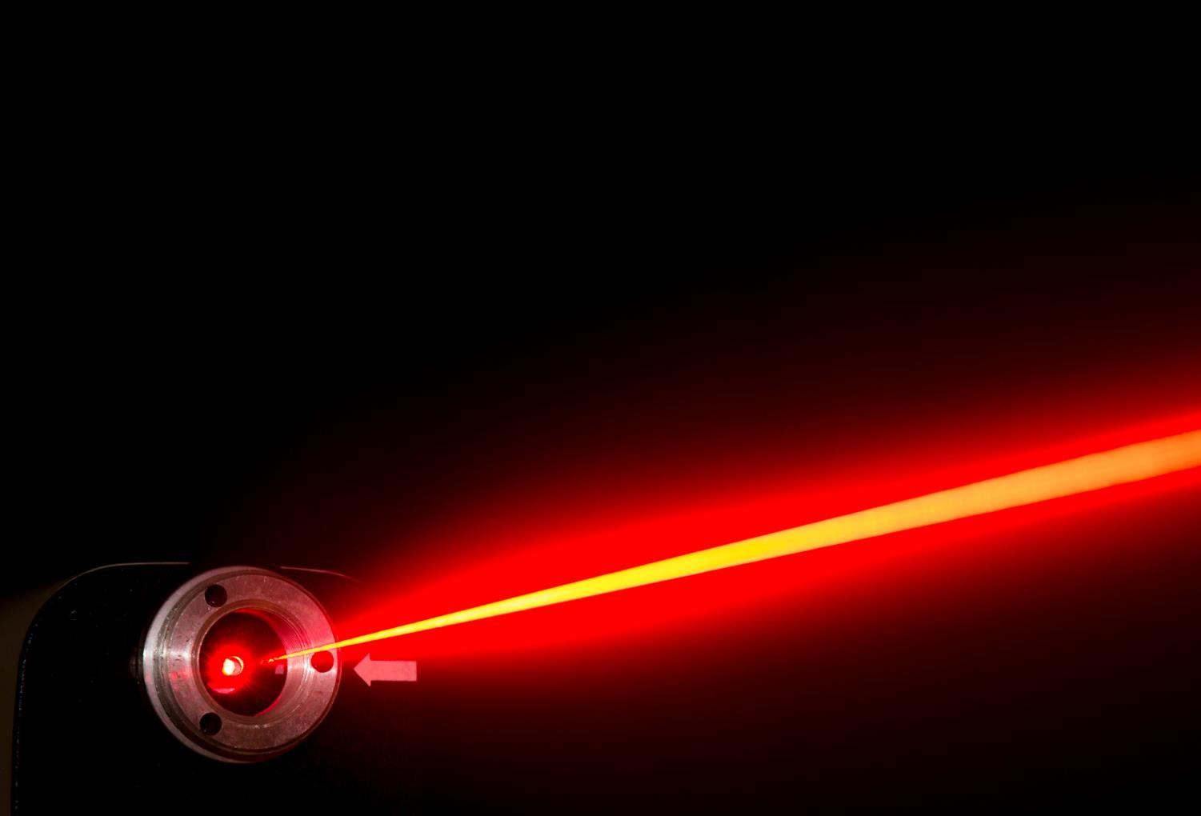
Standard form
Here is an example of a number in standard form
A laser light beam travels at 299,792,458 metres per second
In standard form, 299,792,458 can be written as 3.0 × 10⁸
How many significant figures is this rounded to?

Slide 15
Converting to standard form
A number is in standard form if it is written as a × 10^{n} where 1 ≤ a < 10 and n is an integer
Example 1:
Convert 50,000 into standard form
Example 2:
Convert 3,570 into standard form
 |  |  | a =
50 000 | ÷ 10 |  | 5000
 | ÷ 10² |  | 500
 | ÷ 10³ |  | 50
 | ÷ 10⁴ |  | 5 |  | 50 000 = 5 × 10⁴
 |  |  | a =
3570 | ÷ 10 |  | 357
 | ÷ 10² |  | 35.7
 | ÷ 10³ |  | 3.57 |  | 3570 = 3.57 × 10³

Slide 16
A question of cement
The total mass of cement needed to complete a project is 55,740 kg
Write 55,740 in standard form
Keep dividing 55,740 by powers of 10 until 1 ≤ a < 10
Explain a quick way of converting a number into standard form
 |  |  | a =
55 740 | ÷ 10 |  | 5574
 | ÷ 10² |  | 557.4
 | ÷ 10³ |  | 55.74
 | ÷ 10⁴ |  | 5.574 |  | 55 740 = 5.574 × 10⁴ kg

Slide 17
Working with small numbers
Small numbers can also be written in standard form
Complete the table:
Explain what you notice about the pattern in the powers of 10
What power of 10 is the decimal 0.000001?
What decimal is the same as 10⁻⁸?
Complete the statement:
$\frac{\text{1}}{\text{10ⁿ}}$ = 10?
Decimal | Fraction | Power of ten
100 |  | 10²
10 |  | 10¹
1 |  | 10⁰
0.1 | $$\frac{\text{1}}{\text{10}}$$ | 10?
0.01 | $$\frac{\text{1}}{\text{10² }}$$ | 10?
0.001 | $$\frac{\text{1}}{\text{10}\text{?} }$$ | 10?
0.0001 | $$\frac{\text{1}}{\text{10}\text{?} }$$ | 10?

Slide 18
Working with small numbers
Small numbers can also be written in standard form
The number is still of the type a × 10^{n} where 1 ≤ a < 10
Example
Write 0.0007 in standard form
 |  |  | a =
0.0007 | × 10 |  | 0.007
 | × 10² |  | 0.07
 | × 10³ |  | 0.7
 | × 10⁴ |  | 7 |  | 0.0007 = 7 ÷ 10⁴ = 7 × $\frac{\text{1}}{\text{10⁴}}$ ⇒ 7 × 10⁻⁴

Slide 19
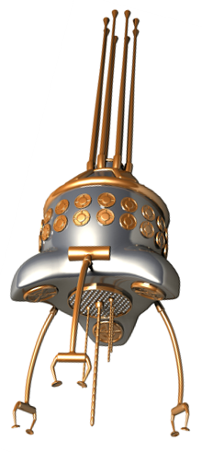
Nanorobots
This is an artist’s impression of a nanorobot
Nanorobots are made of between 100 – 1000 atoms and are so small, they can’t be seen with the naked eye
They have many potentially exciting uses e.g. in medicine they could help diabetics by measuring blood sugar levels and helping the body make insulin
An atom can be 0.0000001 mm in diameter – convert this to standard form

Slide 20
Nanorobots
This is an artist’s impression of a nanorobot
Nanorobots are made of between 100 – 1000 atoms and are so small, they can’t be seen with the naked eye
An atom can be 0.0000001 mm in diameter – convert this to standard form
0.0000001 mm = 1 × 10⁻⁷ mm

Slide 21
Worksheet task
Complete Task 2 of the Worksheet

Slide 22
Plenary
Use these questions to test your knowledge
The Shard is 309.6 metres tall – what is its height written in the following forms?
In km to 1 d.p.
In km to 2 s.f.
In standard form in mm
In standard form in mm to 2 s.f.

Slide 23
Plenary
Use these questions to test your knowledge
The Shard is 309.6 metres tall – what is its height written in the following forms?
In km to 1 d.p. 0.3 km
In km to 2 s.f. 0.31 km
In standard form in mm 3.096 × 10⁵ mm
In standard form in mm to 2 s.f. 3.1 × 10⁵ mm

