Slide 1
Lesson 4: User input
Year 8 – Programming – Mobile app development
Notes:
Last updated: 11-05-2021
Resources are updated regularly — the latest version is available at: ncce.io/tcc.
This resource is licensed under the Open Government Licence, version 3. For more information on this licence, see ncce.io/ogl.

Slide 2
Lesson 4: User input
Objectives
In this lesson, you will
Use user input in a block-based programming language
Use decomposition to break down your app project into more manageable steps
Use a block-based programming language to order instructions in a sequence
Use variables in a block-based programming language

Slide 3
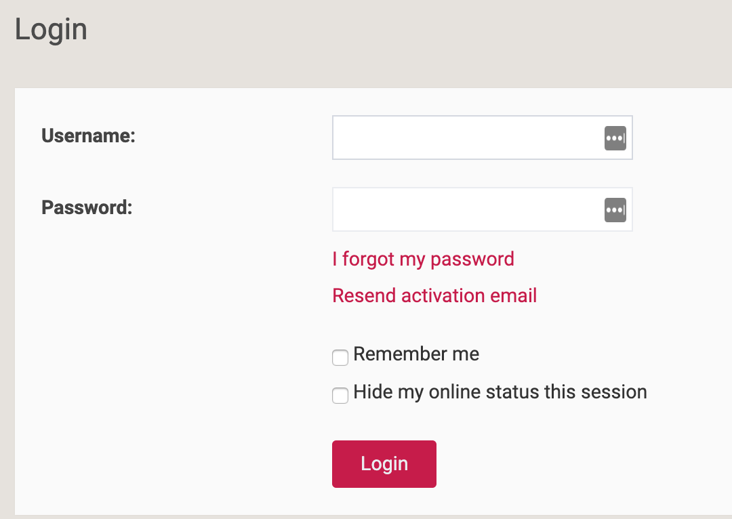
User input
Starter activity
It is common for software applications to obtain data from the user.
Questions
What data is being collected?
How is it being collected?
At what point does the user submit the data?
Think/pair/share.
Notes:
When thinking about what data is being collected, the question is concerned with the semantics (username and password), not the type of data (string, number, yes/no)

Slide 4
User input
Starter activity
Text boxes (allowing for the user to input a text string)
Checkboxes (allowing for the user to indicate a yes or no response)
Button (linked to an event that will capture and process the data when it is clicked)

Slide 5
getText()
Activity 1
getText ("id") is a built-in subroutine that collects the text entered into a textbox; “id” is to be replaced with the name given to the text box.
You can use an event handler to determine when to collect the data and what to do with it once it has been collected and linked with a variable.
Notes:
The learners should know what an event handler is as they have experience from the previous lessons of using the “onEvent” blocks, however it is worth highlighting this to the learners.

Slide 6
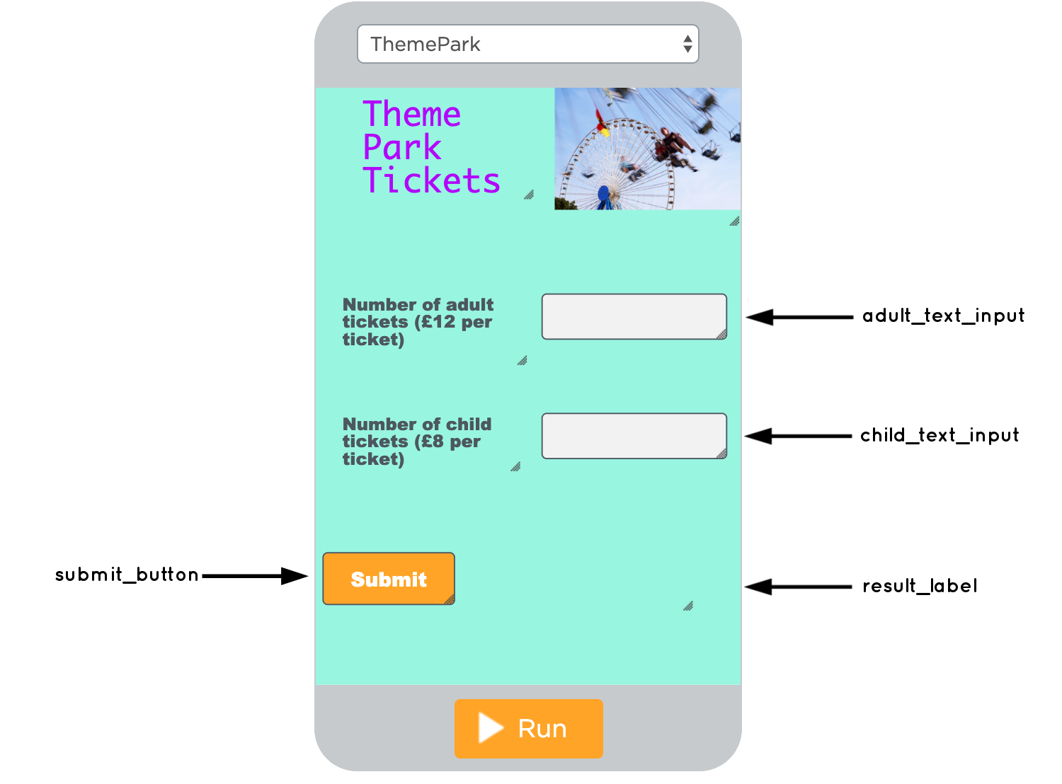
Theme park tickets app
Activity 1
The purpose of this app is to allow the user to enter in the number of adult and child tickets required.
Once the user selects the submit_button, the data will be captured and processed and total will be displayed in the result_label.

Slide 7
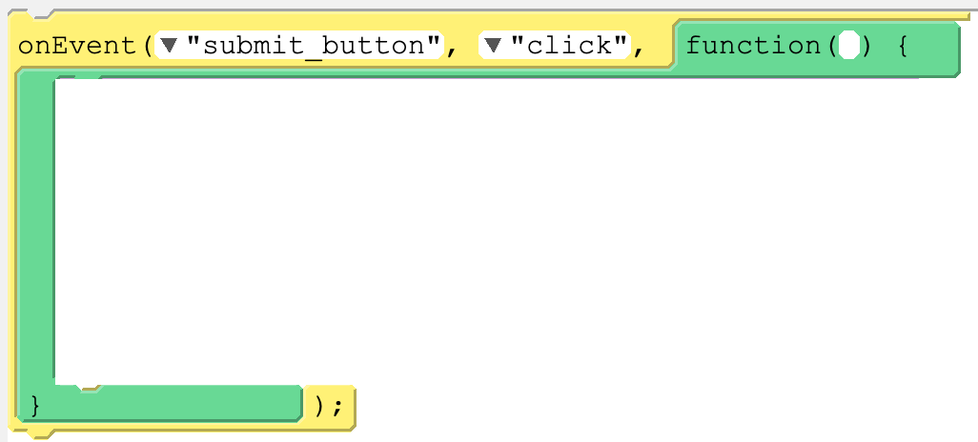
Theme park tickets app
Activity 1
Place the blocks in the correct order to form a working segment of code.

Slide 8
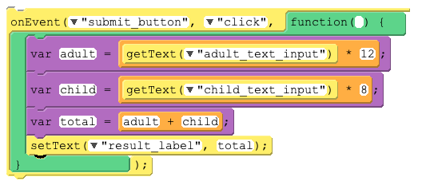
Solution
Activity 1

Slide 9
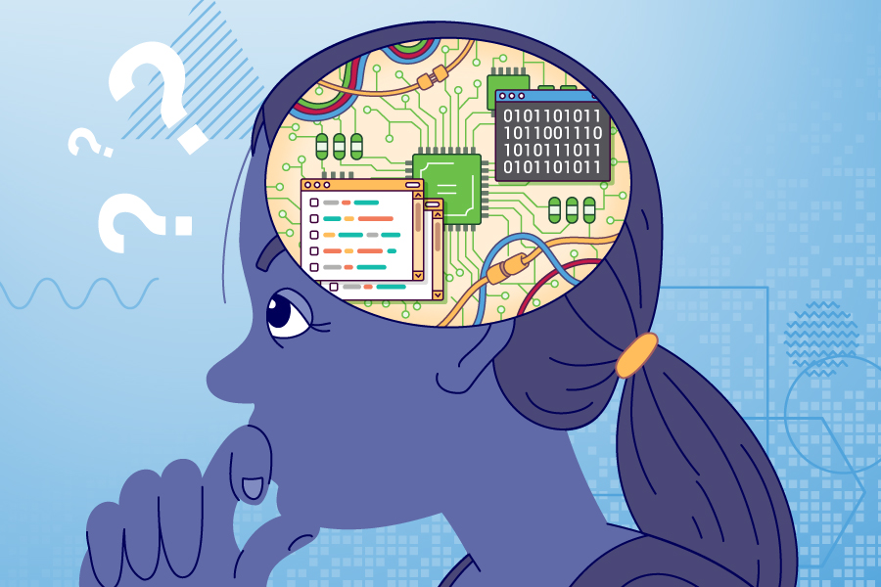
Decompose the problem
Activity 2
Decomposition is breaking a problem down into more manageable chunks.
Programming an app for a mobile device is a daunting task to undertake.
Decomposing the problem helps us make the task less daunting and more achievable.

Slide 10
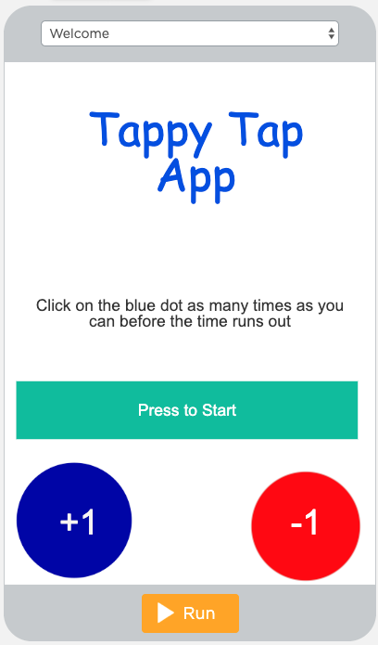
Decomposition example (Tappy Tap App)
Activity 2
Step | Further decomposition
Screens | Create three empty screens to work with and give each an appropriate name.
Welcome screen | Design the welcome screen by adding images, labels, and buttons. Code button so that when clicked it moves to the game screen.
Game play
Results screen
Open your project diary and spend ten minutes decomposing your app project with your partner.

Slide 11
Decomposition example (Tappy Tap App)
Activity 2
Step | Further decomposition
Screens | Create three empty screens to work with and give each an appropriate name
Welcome screen | Design the welcome screen by adding images, labels, and buttons. Code button so that when clicked it moves to the game screen.
Game play | Add title label and blue dot image. Code blue dot to move to random position on screen when clicked. Add score variable that increments Code screen to move automatically to the results screen after five seconds.
Results screen | Add score label. Add code to pass the score into the score label. Add play again button and code it to go to the welcome screen.
Open your project diary and spend ten minutes decomposing your app project with your partner.
Notes:
This slide is hidden as it is provides more guidance and scaffolding than the previous slide. It is optional as to whether or not you feel it is necessary to display this to the learners.

Slide 12
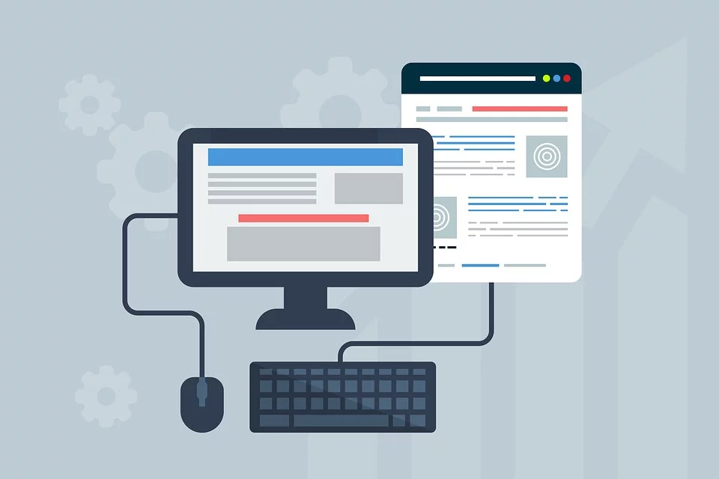
Develop your app
Activity 2
Now that you have decomposed the problem and have designs for the screens, you are ready to start developing your app.
Sign in to code.org with your credentials (username and password)
Select Projects and click on the App Lab
Name your project with the same name as the app title
Notes:
Image source: https://pixabay.com/illustrations/webdesign-design-web-website-3411373/

Slide 13
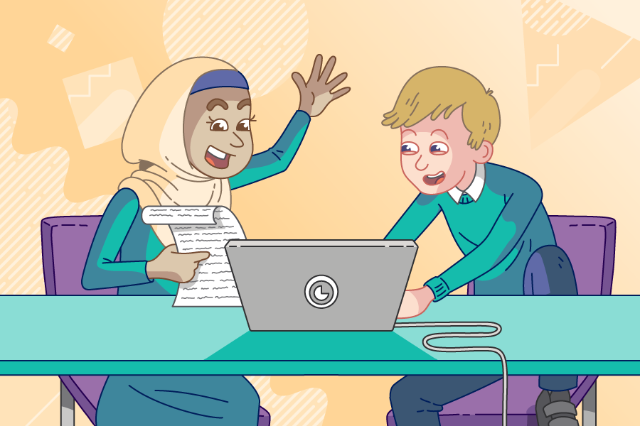
Pair programming reminder
Activity 3
While you are developing your project, you and your partner will take turns to be the driver and the navigator. You will swap roles regularly as directed by your teacher.
The driver: Your role is to control the keyboard and mouse and place the code block in the correct places.
The navigator: Your role is to help support the driver by watching for any mistakes, reading the instructions to the driver, or seeking support if needed.

Slide 14
App development
Activity 3
How to be successful with pair programming:
Teamwork
Driver: focus on the code and workspace
Navigator: watch the code being entered by the driver, look at previous work and examples, and research the problem
Both partners must be contributing equally.

Slide 15
Your project diary: Milestone 1
Activity 4
In your pairs, you now need to reflect on what you have achieved this lesson.
Add a screenshot of your code or design window.
Describe what you have achieved this lesson and any problems you had to overcome.
Write down what you need to focus your attention on in the next lesson.
Notes:
Instruct the learners to open their project diaries and navigate to the slide “Diary Milestone 1”. They will need to place their screenshot and writing on this slide

Slide 16
Next lesson
Summary
In this lesson, you…
Looked at how to handle user input from a text box
Decomposed your project
Make a start developing your project
Next lesson, you will…
Develop your app further

