Slide 1
Cambridge
IGCSE
Computer Science
Section 2
Validation and verification
Unit 8: System design and databases
3

Slide 2
Objectives
Understand the need for validation and verification checks to be made on input data
Be able to give examples of range checks, length checks, type checks and check digits
Devise algorithms to validate data entered by a user

Slide 3
Validating user input
Data input by the user is always prone to error
It is very easy, when typing in a name or a number, to hit the wrong key or get two digits round the wrong way

Slide 4
Validating user input
Have you ever had to type in a 16-digit number, or a long, unfamiliar name? Validation is the process, carried out by a computer, of checking that data input is reasonable

Slide 5
Validation checks
It is not possible to make sure that all data entered by a user is completely correct
A name could be spelt wrongly, a price transposed or a date entered incorrectly:
Jon Smith instead of John Smith
12.99 instead of 21.99
14/06/2015 instead of 14/08/2015
However, validation checks can be applied to reduce the number of errors made

Slide 6
Range check
If you know that a numerical value has to be within a certain range, the computer can check this
For example:
The maximum daily temperature in a certain month is always between +10°C and +40°C

Slide 7
Type check
A type check can be made to ensure, for example, that
An integer value contains only digits
A name contains only alphabetical characters and the symbols ’ or –
A car number plate contains only letters, digits, hyphens or spaces

Slide 8
Length check
Some data can contain only a certain number of characters
For example, you could set a rule that a password entered must be between 6 and 12 characters
A credit card number must be exactly 16 digits
An airport code can only be three characters

Slide 9
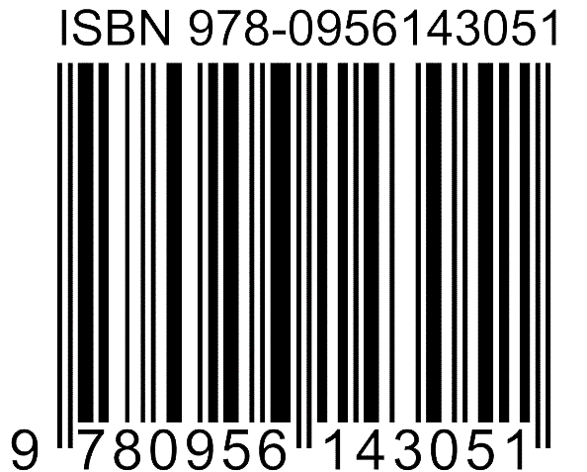
Check digit
A check digit is an extra digit appended to the end of a product code, a barcode or an International Standard Book Number (ISBN), for example
The check digit is calculated from the other digits in the code
If the code, including the check digit, is entered incorrectly, an error will be detected in almost all cases

Slide 10
A check digit calculation
The following algorithm may be used to calculate the check digit for a 6-digit number:
Assign weights to each digit of 1,3,1,3,1,3
Multiply each digit by its weight
Add the results together
Divide the result by 10
If the remainder is zero, the check digit is zero
Otherwise, subtract the remainder from 10 and the result is the check digit
The check digit is then appended to the number to form, for example, a product code

Slide 11
Calculating the check digit
First 6 digits of product code:
264371
ISBN | 2 | 6 | 4 | 3 | 7 | 1
Weight | 1 | 3 | 1 | 3 | 1 | 3
Multiplication | 2 | 18 | 4 | 9 | 7 | 3
Addition | Add all the numbers |  |  |  |  |  | 43
Remainder | Find the remainder when divided by 10 |  |  |  |  |  | 3
Subtraction | Subtract the result from 10 |  |  |  |  |  | 7

Slide 12
To check the check digit
There is an easy way to check that the check digit is correct
To check the product code 2643717 is valid, perform the calculation again, assigning a weight of 1 to the check digit.
If the result is divisible by 10, the check digit is correct
Product code: 2 6 4 3 7 1 7
Weights: 1 3 1 3 1 3 1
Multiply and add: 2 + 18 + 4 + 9 + 7 + 3 + 7 = 50

Slide 13
Worksheet 3
Now try Tasks 1, 2 and 3 on the worksheet

Slide 14
Validating input data
A simple algorithm to validate input data will read data from the user, apply a validation check and if it is not valid, ask the user to enter the data again
This process is repeated until valid data is entered
Write an algorithm to ask the user for a menu choice, which must be between 1 and 5
If an invalid entry is made, ask the user to enter their choice again

Slide 15
Validation algorithm
OUTPUT “Please enter your choice (1-5)”
INPUT choice
WHILE choice < 1 OR choice > 5
OUTPUT “Invalid choice – must be between 1 and 5”
INPUT choice
ENDWHILE
Amend the algorithm so that if the user enters more than two invalid choices, the program drops out of the loop and outputs the message “Program ending”

Slide 16
Amended algorithm
validChoice ← False
count ← 0
OUTPUT “Enter choice (1-5)”
WHILE (validChoice = False) AND (count < 3)
INPUT choice
count ← count + 1
IF choice < 1 OR choice > 5 THEN
OUTPUT “Invalid choice – must be between 1 and 5”
ELSE
validChoice ← True
ENDIF
ENDWHILE
IF validChoice = False THEN
OUTPUT “Program ending”
ENDIF

Slide 17
Worksheet 5
Now try Task 4 on the worksheet

Slide 18
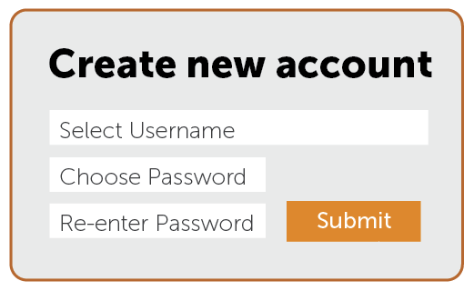
Verification
Verification is the process of entering data twice, and comparing the two entries
If they don’t match, the data has to be entered again
Verification is often used when setting a new password
Why?

Slide 19
Worksheet 5
Now try Task 5 on the worksheet

Slide 20
Plenary
Validation is a method of helping to ensure accuracy of input data
You should be able to give examples of range checks, length checks, type checks and check digits
You need to be able to devise and trace through algorithms to validate data entered by a user
Verification of input data is a different process of checking for accuracy
The data is input twice and the two versions compared

