Slide 1
A Level History

Slide 2
Breadth Study: Component 1 Spain in the Age of Discovery, 1469 - 1598
Aim: To promote an understanding of significant historical developments over a 100 year period.
Assessment: Exam – 2 hours 30 mins; 40%.
Form: Structured essays
Topics of Study:
Royal authority and governmental powers: Ferdinand and Isabella, Charles V and Philip II.
Relations with European powers
Social tensions: urban and rural divisions
Religious persecution and the Spanish Inquisition: Christians, Jesuits, Muslims and Jews
Trade and exploration
The New World and the Conquistadores
Cultural ‘Golden Age’ and intellectual developments
Rebellions and revolts
European and Caribbean wars

Slide 3
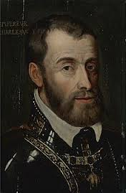
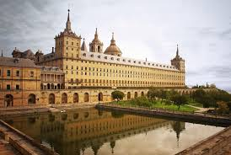
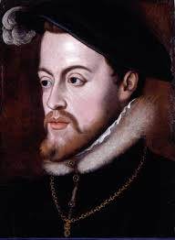
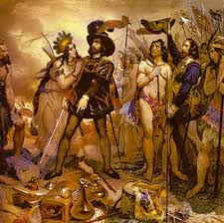
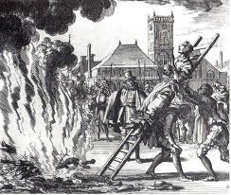
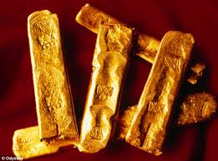

Slide 4
Depth study: Component 2 Wars and Welfare: Britain in Transition, 1906 - 1957
Aim: To test understanding of a significant period of history in depth, focusing on change and development.
Assessment: Exam - 2 hours 30 minutes
Form: Structured essays and document analysis; 40%.
Topics of Study:
The Liberal Reforms and poverty in Britain
Political movements: Liberalism, Conservativism and the Labour Party.
The Suffrage Movement
Ireland
Britain during the First World War
Post-war Britain: domestic and international change.
Industrial relations and the General Strike
Mass media and communications: radio, cinema and leisure.
The ‘Hungry Thirties’: Britain during the Great Depression.
The Abdication Crisis of Edward VIII
Britain during the Second World War
Post-war Reconstruction and the Welfare State
1950s Britain: affluence and tension
CND and unilateralism

Slide 5
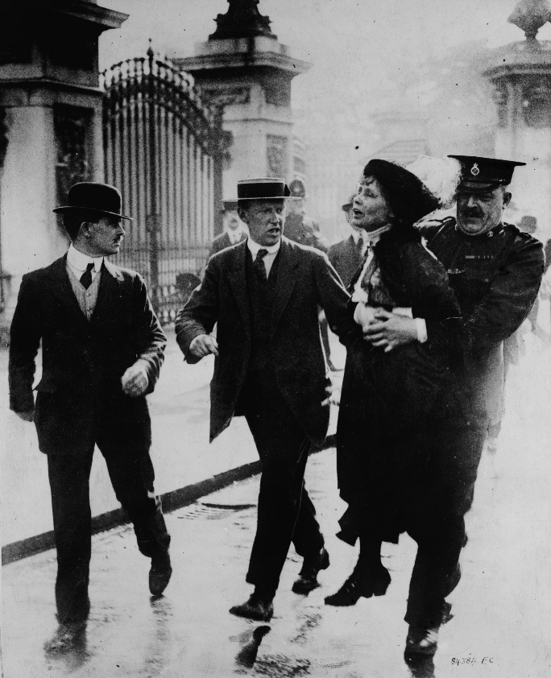
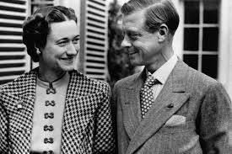
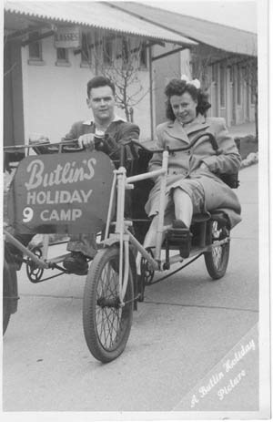
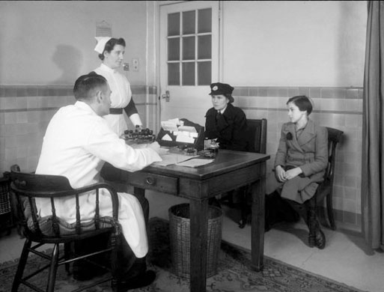
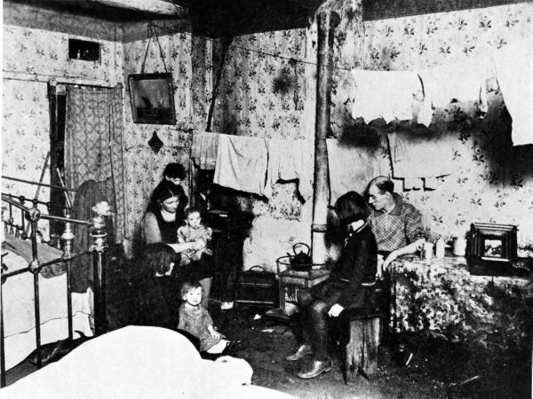
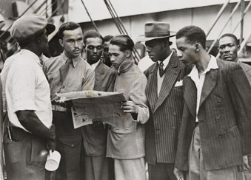

Slide 6
Component 3: Historical Enquiry
This unit results in a Personal Study of 4,000-4,500 words.
20% of A Level
Freedom of choice!

Slide 7
Expectations and Requirements
Strong work ethic
Enthusiasm and sustained interest
Debate and discussion
Essay writing skills
Source analysis skills
Judgement
Objectivity
Desire to read around the subject

Slide 8
Any questions?
If you have any questions about the A Level History course, please do not hesitate to contact me via the Firefly Forum or directly on the email address below:
jwalker@warminsterschool.org.uk
Mrs. J. Walker, Head of History and Politics

