Slide 1
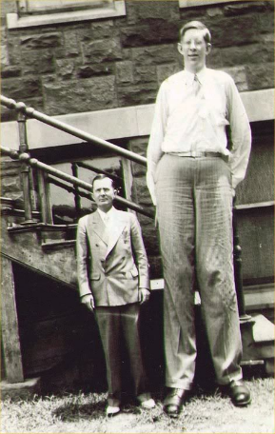
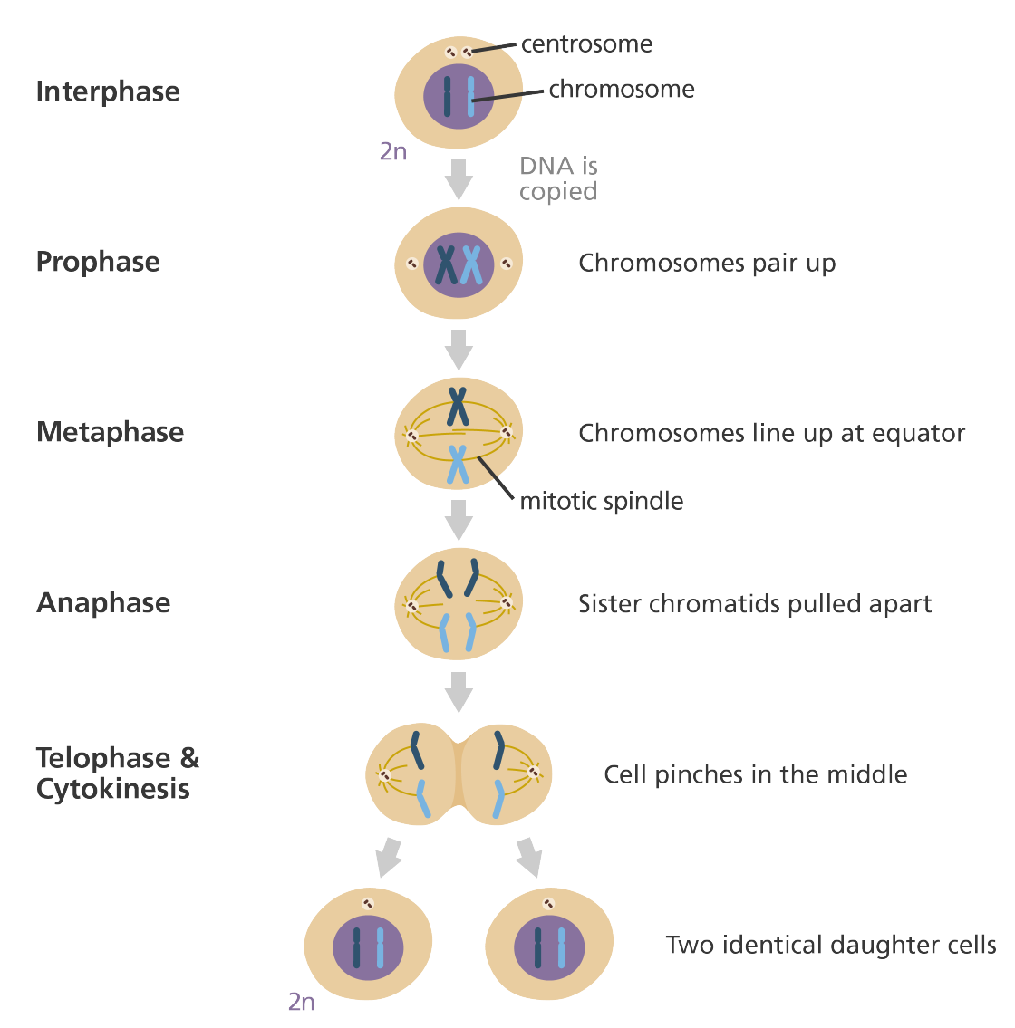
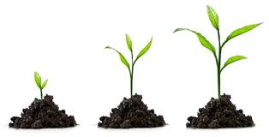
Biology Topic 2 Summary Sheet
CB2b - Growth in Animals
Percentile charts are used to track the growth of babies and children to identify how they are growing compared to others their age. A child on the 50th percentile line means that 50% of children of a similar age are smaller in mass and 50% are bigger.
CB2a – Mitosis
When we grow, age or are injured tissue is repaired and new cells have to be made. These new cells are produced during the cell cycle.
There are two phases in the cell cycle:
INTERPHASE – new cell organelles are made and DNA is
replicated (copied).
2. MITOSIS – cells splits into two daughter cells.
Cell Differentiation
Once we have made new cells by mitosis then they have to change and become a specialised cell carry out a specific function. This process is called DIFFERENTIATION. These cells start as STEM CELLS in humans, and MERISTEM CELLS in plants.
46 (23 pairs) chromosomes DIPLOUD
CB2d – Stem Cells
There are 2 types of stem cells: ADULT and EMBRYONIC stem cells.
92 (46 pairs) chromosomes
Embryonic stem cells | Adult stem cells
Differentiate into any cell. Have to be destroyed to be used | Limited to what they can differentiate into. Used to treat leukaemia. Can be extracted from a patient under general/local anaesthetic.
CB2c - Growth in Plants
There are 3 stages to plant growth:
At the tip of roots and shoots are MERISTEM cells. They divide by MITOSIS . This happens throughout the whole of the life of a plant.
The new cells increase in length. This is called ELONGATION.
The new elongated cells DIFFERENTIATE into specialised plant cells that have different functions e.g. leaf palisade cell, root hair cell, xylem cell or a guard cell.
However, if stem cells divide uncontrollably in the body after they have replaced damaged cells, they can cause cancer!
46 (23 pairs) chromosomes

Slide 2
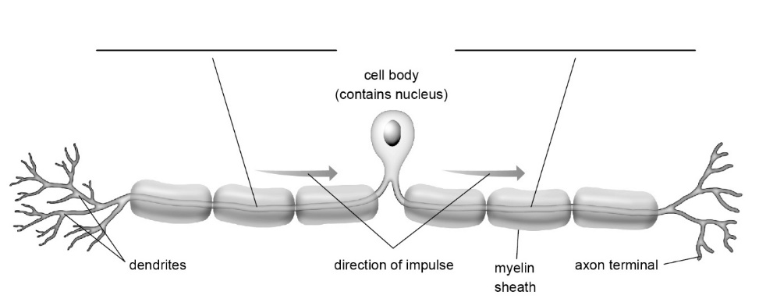
Biology Topic 2 Summary Sheet
CB2e – The Nervous System
Below is a sensory neurone. It carries impulses from receptor cells to the CNS. The impulse follows the pathway
DENDRITE → DENDRON → AXON → AXON TERMINAL. At the axon terminal the impulse is transmitted to another neurone.
Dendron's and axons are LONG to allow FAST NEUROTRANSMISSION over long distances.
There is also a fatty layer surrounding these parts = the MYELIN SHEATH. This eclectically insulates a neurone so the impulse doesn’t lose energy and instead can jump between the gaps, speeding up transmission.
CB2e – The Nervous System
The CENTRAL NERVOUS SYSTEM controls our body. It is made up of the BRAIN and the SPINAL CORD.
Anything that our body is sensitive to is called a STIMULUS e.g. temperature, light, sound, pain.
Stimuli are detected by RECEPTOR CELLS. Receptor cells are found in our sense organs which are our eyes, nose, mouth, ears and skin.
Receptor cells create and electrical signal called an IMPULSE. Impulses travel all around our body by a process called NEUROTRANSMISSION.
They travel along cells called NEURONES.
There are different types of neurone:
SENSORY NEURONE – carry impulses from a receptor cell to the CNS
RELAY NEURONE – carry impulses through the CNS
MOTOR NEURONE – carry impulses from the CNS to an effector e.g. muscle to make it move.
dendron
axon
CB2f – Neurotransmission Speeds
There are 2 types of responses that the neurones can be involved in :-
VOLUNTARY REFLEX and INVOLUNTARY REFLEX
Voluntary
Stimulus → Receptor cells → Sensory neurone → CENTRAL NERVOUS SYSTEM → Motor neurone → Effector → Response
Involuntary
Stimulus → Receptor cell → Sensory neurone → RELAY NEURONE → Motor neurone → Effector → Response
The pathway of a reflex is called a REFLEX ARC. It DOES NOT INVOLVE THE BRAIN and protects us from harm as they are very fast.

Slide 3
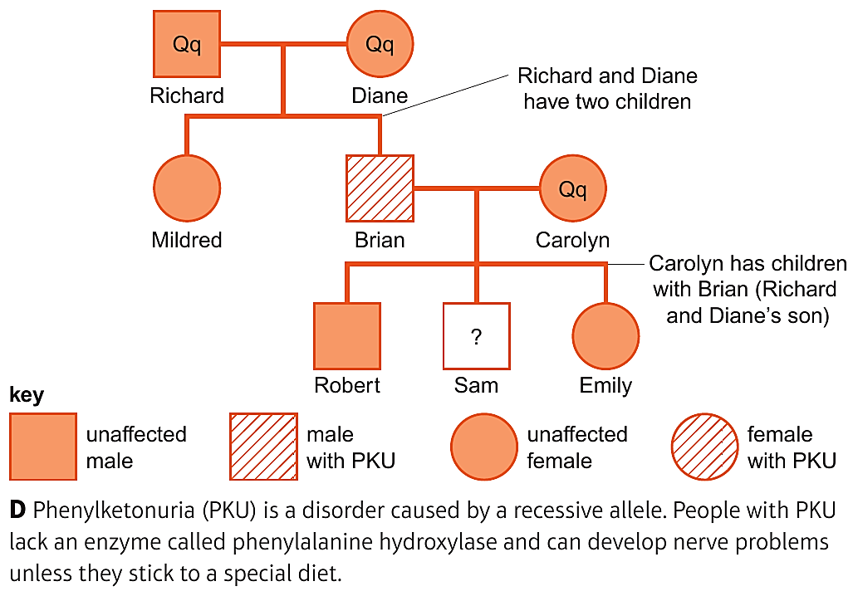
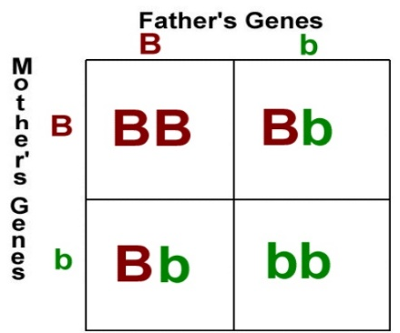
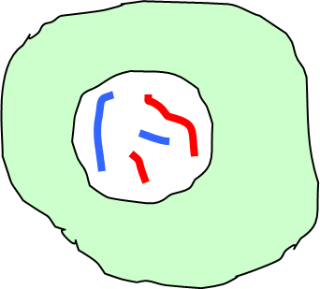
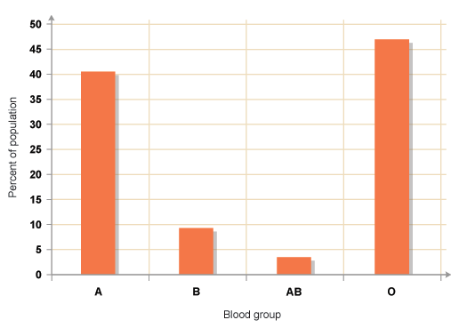
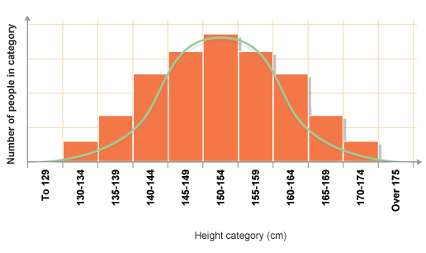
Biology Topic 3 Summary Sheet
CB3bd – Inheritance
PUNNETT SQUARES are another way to show inheritance. The boxes show the possible genotypes. The punnet square below shows the probability of a child being born with brown (BB or Bb) or green (bb) eyes.
A FAMILY PEDIGREE CHART shows how GENOTYPES and their resulting PHENOTYPES are inherited in families.
CB3c – Alleles
Different forms of the same gene are called ALLELES.
In a nucleus of a body cell, there are two copies of every
gene. Each copy of a gene may be a different allele.
HOMOZYGOUS = both alleles are the same
HETEROZYGOUS = alleles are different
Some alleles can be more DOMINANT than others.
This means this will be the characteristic that is shown, not the RECESSIVE allele.
The alleles are an organisms GENOTYPE. What the organism looks like is its PHENOTYPE.
CB3e – Mutations
A mutation is a CHANGE IN THE SEQUENCE OF BASES IN DNA. Mutations can be caused by factors such as radiation, chemicals in cigarette smoke and UV light from Sun.
These mutations change the order of AMINO ACIDS, this then changes
the protein produced.
Sometimes these mutations can be beneficial or produce no change at all. However most of the time they are harmful = cause CANCER.
Both of these can be used to show GENETIC DISORDERS, for example cystic fibrosis (CF) caused by recessive allele. People who inherit two RECESSIVE alleles have the disorder. People who inherit one DOMINANT and one recessive allele are CARRIERS.
CB3a – Meiosis
Meiosis – one cell divides into 4 non identical HAPLOID gametes.
Gametes are your sex cells (sperm and egg cells).
CB3f – Variation
Variation can be GENETIC or ENVIRONMENTAL. It can also be grouped in two different ways:
DISCONTINUOUS; data is limited to a range of values e.g. eye colour or blood group
CONTINUOUS; data can be any value in a range e.g. height.
Chromosomes split into two diploid daughter cells.
Chromosomes double
Continuous variation often forms a bell shaped curve, this is known as a normal distribution.
Diploid cell.
4 haploid cell.

Slide 4
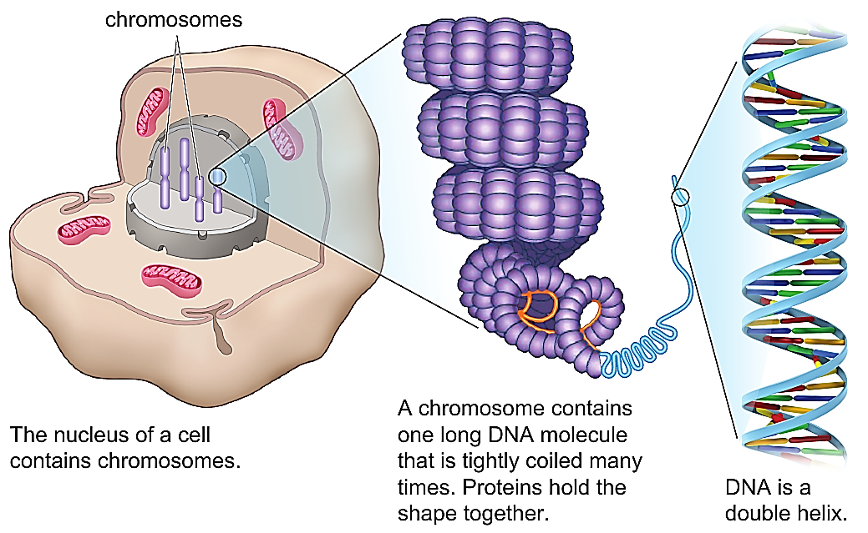
Core practical: Explain how DNA can be extracted from fruit
Biology Topic 3 Summary Sheet
CB3bi – DNA
There are four bases in DNA:
Adenine, Thymine, Guanine, Cytosine
They are complimentary bases. A pairs with T, C pairs with G.
DNA is a double-helix shape held together by weak hydrogen bonds.
METHOD
Dissolve 3g of salt in 100cm³ of water in a large beaker.
Add 10cm³ of washing up liquid and stir gently.
Mash in a mortar and pestle 50g of kiwi.
Put the mashed kiwi in a beaker and add the washing up solution.
Place beaker in a water bath at 60ºC for 15 minutes.
Filter the mixture and collect the filtrate in a boiling tube.
Add two drops of protease enzyme solution.
Tilt the boiling tube slightly and pour in ice-cold ethanol.
A white precipitate layer should form between the ethanol and the filtrate. This is DNA.
WHY? Salt makes DNA more likely to clump together
WHY? Detergent breaks down the cell and nuclear membranes
Control variables: temperature of the water bath, time the solution is left in the water bath.
Dependent variable: amount of DNA collected
Independent variable: ripeness/size of the kiwi
WHY? Protease breaks down the proteins in the cell
WHY? DNA is insoluble in ethanol

