Slide 1
Computer misuse
Computer crime and cyber security
3rd Edition

Slide 2
Objectives
Learn about the Computer Misuse Act – which makes certain activities illegal
Look at examples of computer misuse
Understand what is meant by hacking
Understand what is meant by malware
Learn ways to protect yourself from malware and hacking

Slide 3
What does the law say?
It’s illegal to look at or modify someone else’s files without permission
Computer Misuse Act 1990

Slide 4
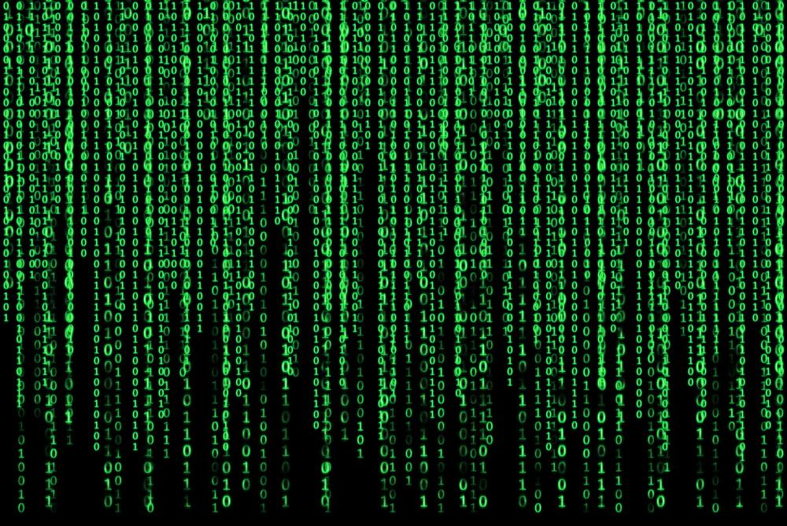
Hacking
Definition: Hacking is illegally accessing or modifying computer files without permission

Slide 5
Why do hackers do it?
Think of some examples for each of the reasons below:
Some do it for pure mischief, or for a challenge
To steal money
To steal or modify information
For political reasons, to expose wrongdoing, or to get revenge on people with opposing views

Slide 6
How do hackers do it?
Taking advantage of security weaknesses in older computer software such as Windows XP, which no longer receives automatic anti-virus updates from Microsoft
Taking advantage of obvious / common usernames and passwords
Tricking people into downloading malware onto their computer, which in turn gives the hacker access to view and modify your files

Slide 7
What is malware?
Malware stands for “malicious software”
It is a small program which enters a computer or network through a downloaded file or vulnerability in a network
Malware might:
gather personal or sensitive data from your computer
modify or delete files on your computer

Slide 8
Logic bombs
A logic bomb tells the computer to execute a set of instructions at a certain date and time or under certain specified conditions
Used by, for example, blackmailers or disgruntled employees seeking revenge

Slide 9
Ransomware
Ransomware is software illegally installed on a computer so that the user cannot access their files until a ransom is paid
In 2017 the NHS and tens of thousands of other organisations around the world suffered a ransomware attack called “Wannacry”
It was halted by an “accidental hero”, a 22-year-old IT security blogger from Devon, who inadvertently activated a “kill switch”

Slide 10
What is a computer virus?
A virus is a type of malware
A computer virus replicates and installs itself without your consent
A virus can be spread to another computer through email or file sharing

Slide 11
Common types of malware
Browser
Hijacks some browser functions, for example your default search page, or diverts you to particular websites. Also called Spyware
File infector
The virus infects a particular file. It may completely or partially overwrite the file
Macro virus
Embedded in the template files (for example, of Word or Excel). The virus spreads if the file is opened on a different computer

Slide 12
Which of these are signs of malware?
A new toolbar appears on your browser
You receive a fraudulent email
Your homepage has changed unexpectedly
You are on a genuine website and your browser alerts you it has blocked a pop-up window
Your computer suddenly runs a lot slower
You see a lot of pop-up adverts even when you’re offline
Your browser alerts you to update to a newer version
Your computer hard disk is doing overtime but you’re not doing anything

Slide 13
Which of these are signs of malware?
A new toolbar appears on your browser TRUE
You receive a fraudulent email FALSE (however, if your email account appears to have sent an email without your permission, this is likely a virus)
Your homepage has changed unexpectedly TRUE
You are on a genuine website and your browser alerts you it has blocked a pop-up window FALSE (many genuine websites use popup windows)
Your computer suddenly runs a lot slower TRUE
You see a lot of pop-up adverts even when you’re offline TRUE
Your browser alerts you to update to a newer version FALSE (this is normal – and you are encouraged to keep your software up to date – just check the alert is genuine!)
Your computer hard disk is doing overtime but you’re not doing anything TRUE

Slide 14
How do you avoid malware?
Avoid clicking on everything, e.g. offers that seem too good to be true (on both websites and email)
Don’t visit illegal sites, such as those that let you download copyright material
Make sure your browser is configured to always ask before running files and downloading automatically
Keep your browser software up-to-date
Install up-to-date antivirus and anti-spyware software

Slide 15
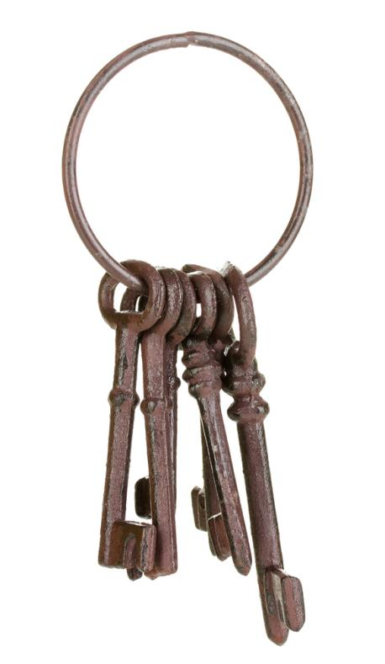
Hackers steal passwords!
In 2016 hackers stole the login details of 272 million passwords from Gmail, Hotmail and Yahoo
17% of people used the password “123456”

Slide 16
Password protection
The most commonly used password is “password1”
Suggest some guidelines for choosing a good password
Why should you not use the same password for everything?
Why should you change your passwords occasionally?

Slide 17
Plenary
You have learned:
about the Computer Misuse Act 1990
to recognise examples of computer misuse
what is meant by hacking
what is meant by malware
ways to protect yourself from malware and hacking

