Slide 2
Learning objectives
Demonstrate how to use fractions and ratios

Slide 3
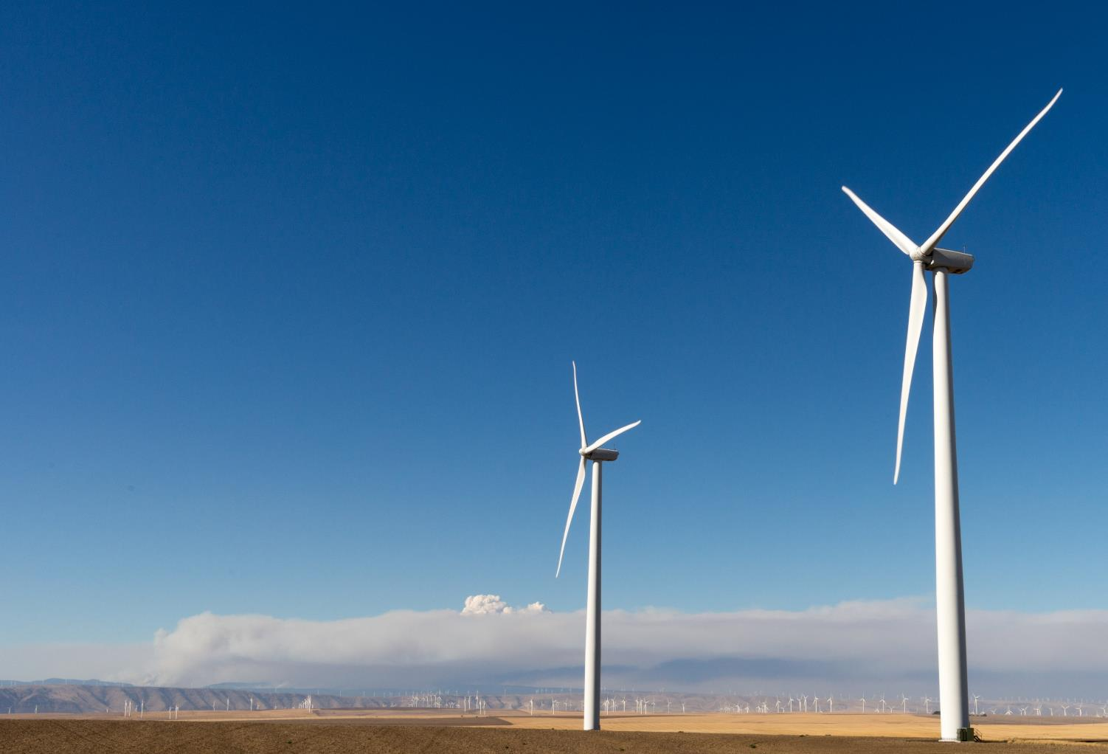
Starter
Renewable energy sources, like onshore wind farms, now produce nearly a third of the UK’s total electricity production
If renewables generate 100 Terawatt-hour (TWh) of electricity each year, how much electricity does the UK produce every year?
How do you write one third as a fraction and as a ratio?

Slide 4
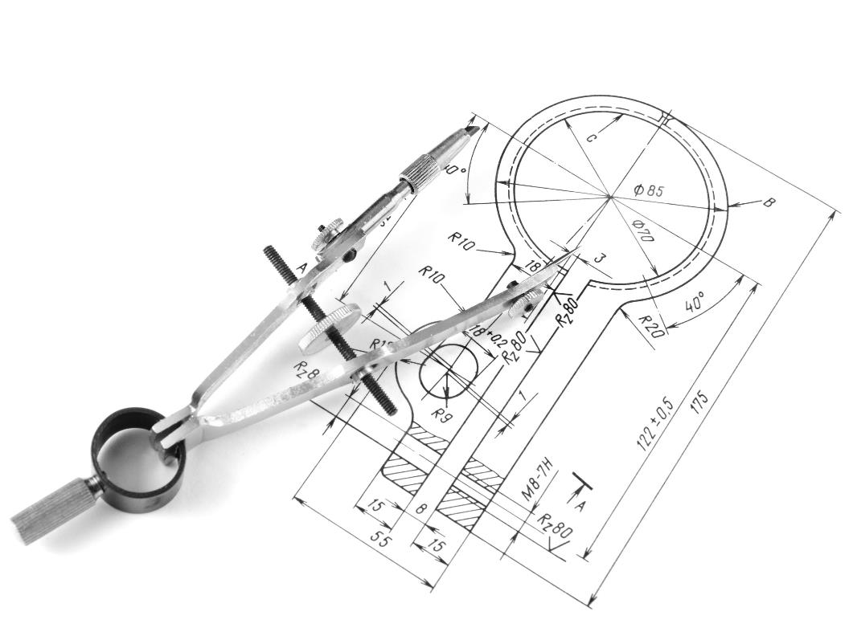
Ratio
Ratio is commonly used to describe the relationship between two quantities or measurements
Ratios are used to represent the scale on technical drawings to make drawing easier
Imagine drawing an architectural plan at full size or 1 : 1 – what problems would you face?

Slide 5
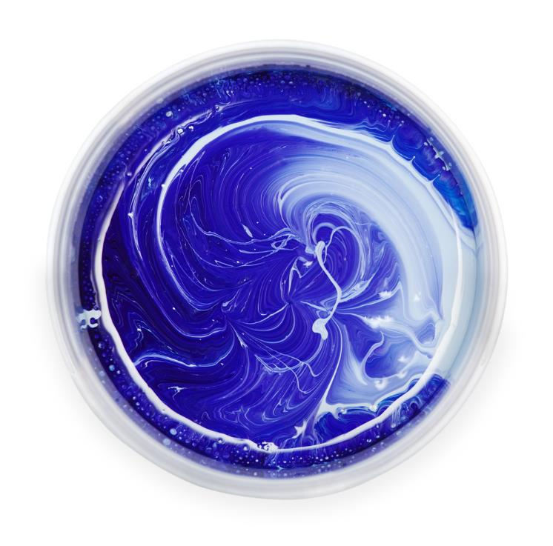
Ratios for quantities
Paints, inks and dyes are mixed in different ratios to produce a particular colour
For example, to make light blue, 100 ml of blue paint is mixed with 50 ml of white paint
The ratio of blue paint to white paint is 100 : 50
How can this ratio be simplified?

Slide 6
Ratios for quantities
Paints, inks and dyes are mixed in different ratios to produce a particular colour
For example, to make light blue, 100 ml of blue paint is mixed with 50 ml of white paint
The ratio of blue paint to white paint is 100 : 50
How can this ratio be simplified?
100 : 50
÷ 50
÷ 50
2 : 1

Slide 7
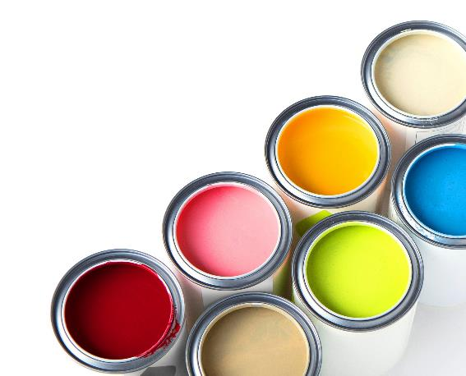
Colour mixing
Work out the simplest ratio in which the following paint colours could be represented
10 ml yellow and 20 ml red
100 ml blue and 300 ml red
30 ml white and 2 ml blue and 2 ml red
200 ml yellow and 25 ml red and 5 ml blue

Slide 8
Colour mixing
Work out the simplest ratio in which the following paint colours could be represented
10 ml yellow and 20 ml red 1 : 2
100 ml blue and 300 ml red 1 : 3
30 ml white and 2 ml blue and 2 ml red 15 : 1 : 1
200 ml yellow and 25 ml red and 5 ml blue 40 : 5 : 1

Slide 9
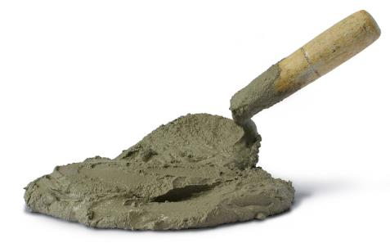
A concrete issue
A builder mixes some mortar to point a wall
To mix the mortar, 1 bag of cement (25 kg) is added to 6 bags of sand (25 kg of sand per bag)
However, the wrong number of bags are delivered to the site and the builder is left with 10 bags of cement and 10 bags of sand
What is the maximum weight of mortar the builder can make at the correct ratio? Give your answer to 1 d.p.

Slide 10
A concrete issue
10 bags of cement and 10 bags of sand must be mixed in a 1 : 6 ratio to make mortar
The number of bags of sand will be the limiting factor
10 bags of sand need 1$\frac{2}{3}$ bags of cement
Total weight of mortar = (10 × 25 + 1$\frac{2}{3}$ × 25) kg = 291$\frac{2}{3}$ kg ⇒ 291.7 kg (1 d.p.)
Cement |  | Sand
1 |  | 6
1 ÷ 6 or $\frac{1}{6}$ |  | 1
$\frac{1}{6}$ × 10 = $\frac{10}{6}$ ⇒ 1$\frac{2}{3}$ |  | 10
÷ 6
÷ 6
× 10
× 10

Slide 11
Gear ratios
The relationship between a set of gears is often described as a ratio or velocity ratio (VR)
The ratio is based on the number of teeth on one cog compared to the number of teeth on the other
The formula to work out the velocity ratio is:
The drive gear (input) is the one that turns the other cogs
The driven gear (output) is the last gear that is being measured in a system

Slide 12
Calculating gear ratios
Work out the gear ratio of a simple gear train where the drive gear has 16 teeth and the driven gear has 8
The formula is:
This states that if the driven gear rotates once, the drive gear will rotate twice
What is the gear ratio of a 100 tooth drive gear and a 60 tooth driven gear?

Slide 13
Blended fabrics
A manufacturer needs to make 1,000 football shirts
The shirts are made of nylon and Lycra in the ratio of 4 : 1 by weight
Each shirt weighs 250 g
Calculate the weight of nylon and Lycra needed to make 1,000 shirts
Give your answer in kg

Slide 14
Blended fabrics
First calculate the weight of 1,000 football shirts: 250 x 1,000 = 250,000 g
The fabric is made of nylon and Lycra in the ratio of 4 : 1
This gives 5 parts in total as 4 + 1 = 5
$\frac{250,000}{5}$ = 50,000 g per part
Nylon makes up 4 parts, 4 × 50,000 = 200,000 g or 200 kg
Lycra makes up 1 part, 1 × 50,000 = 50,000 g or 50 kg

Slide 15
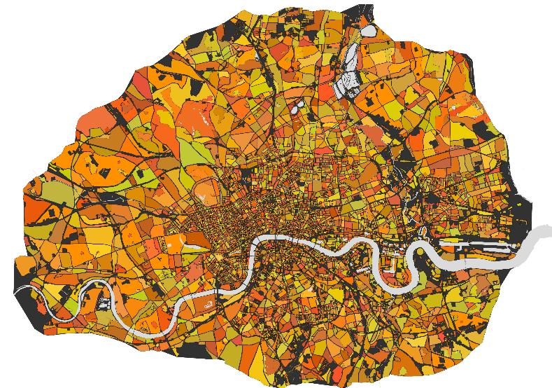
The size of London
A scale factor is used on maps to show the relationship between distances on the map and those in real life
A map states 1 cm = 250 m
What is the scale factor in this case? Give your answer as 1 : N
Use the scale shown on this map to estimate the width of London, in km
5 km

Slide 16
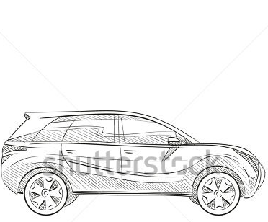
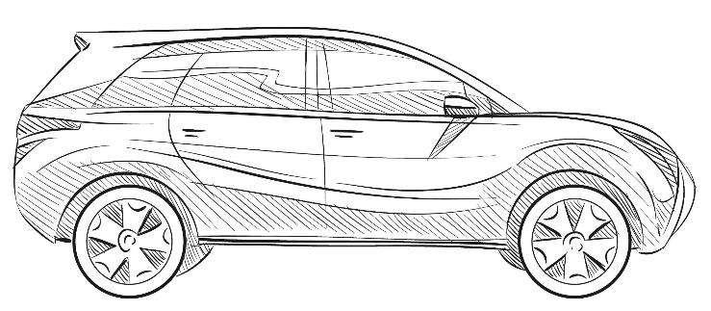
What’s the scale?
A student makes a sketch of a car
The rule shows the actual size of their drawing
If the average car is 6 m long, estimate the scale factor of the drawing to a real car
Give your answer in the form of 1 : N

Slide 17
Worksheet task
Complete Task 1 of Worksheet 2

Slide 18
Just a fraction
A fraction measures part of a whole
We often talk about a half, a quarter, three quarters or a third – these are all fractions
Fractions are used in data analysis and as a method of dividing and measuring materials
Here, if you take one of the available slices you have 1 out of 10 slices, or $\frac{1}{10}$
If you take another, you will have $\frac{2}{10}$ slices
Simplify this fraction

Slide 19
Pac-man
Study the Pac-man below
If Pac-man was a circle, what fraction of the Pac-man is missing and how much remains?

Slide 20
Pac-man
Study the Pac-man below
If Pac-man was a circle, what fraction of the Pac-man is missing and how much remains?
Pac-man’s mouth is 1 quarter so, 1 – $\frac{1}{4}$ = $\frac{3}{4}$ remains

Slide 21
Folding paper
A student finds a piece of A1 paper
They fold the paper in half to make A2 paper
They fold it in half again to make A3, and so on
They fold it 5 times in total
What size paper do they make?
What is the final area of paper, as a fraction of the original A1 piece?

Slide 22
Increasing numbers
A company employs 108 engineers this year
The company has one fifth more than the previous year
Work out many engineers were employed the previous year
Solution:
If there were n engineers in the previous year then there must be n + $\frac{n}{5}$ engineers this year
There were 90 engineers last year
$$\frac{6n}{5}$$ | 108
$$\frac{n}{5}$$ | 108 ÷ 6 = 18
n | 18 × 5 = 90
÷ 6
× 5

Slide 23
Worksheet task
Complete Task 2 of the Worksheet

Slide 24
Fractions and ratio
Fractions can be converted to ratios and vice versa
There are the same number of black squares to white squares on this flag, so the ratio is 1 : 1
Half of all of the squares are black
The fraction of squares that are black is $\frac{1}{2}$
However, if the ratio of black squares to white squares was 1 : 2
What is the fraction of a) black squares? b) white squares?

Slide 25
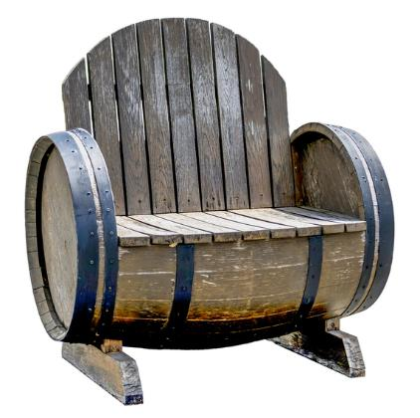
A question of taste
A survey shows the reactions of a target market to this upcycled chair
600 people surveyed
480 found the chair comfortable
How many people found it uncomfortable?
What fraction of people found the chair comfortable?
What was the ratio of people who found it comfortable to those who did not?

Slide 26
Plenary
Work in pairs to answer the questions below
$\frac{2}{3}$ of 150 people questioned in a survey said they preferred one design of table to the other How many people preferred the other design?
Approximately 5% of natural gas used for supplying houses in the UK is hydrogen, the rest is methane If a house uses 500 m³ of gas a year, what volume of this is a) hydrogen? b) methane?
The ratio of boys to girls in a user group is 3 : 2. There are a total of 25 students in the group, so how many are girls?

Slide 27
Plenary
Work in pairs to answer the questions below
$\frac{2}{3}$ of 150 people questioned in a survey said they preferred one design of table to the other How many people preferred the other design? 50 people
Approximately 5% of natural gas used for supplying houses in the UK is hydrogen, the rest is methane If a house uses 500 m³ of gas a year, what volume of this is a) hydrogen? 25 m³ b) methane? 475 m³
The ratio of boys to girls in a user group is 3 : 2. There are a total of 25 students in the group, so how many are girls? $\frac{2}{5}$ are girls, so $\frac{2}{5}$ x 25 = 10 girls

