Slide 1
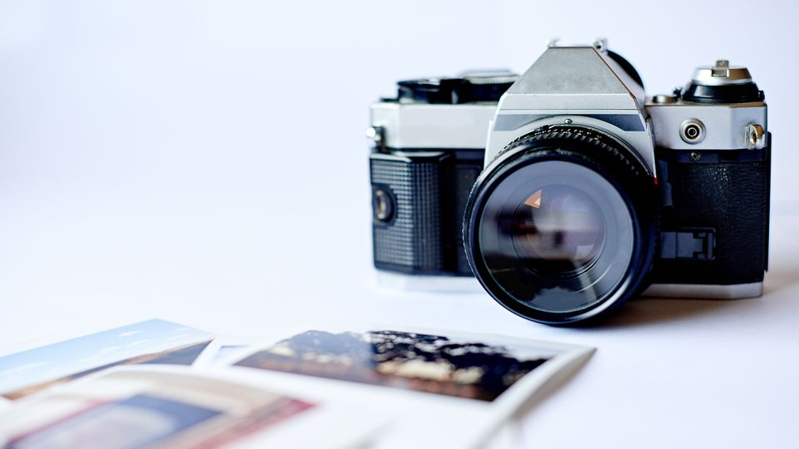
Reading Visual Images
Pre – A Level Photography

Slide 2
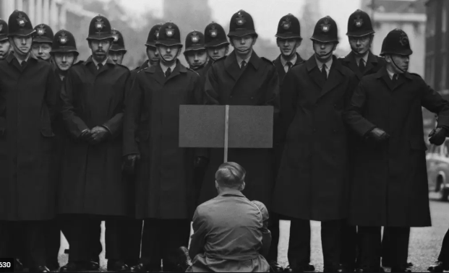
Reading Visual Images
What does a picture or an image tell you?
Reading visual images, is an introduction to analysing and interpreting photographs as social data.
Who controls what the image is saying?
You will look at how photographs provide visual evidence and how they can illustrate and support our ideas about society.

Slide 3
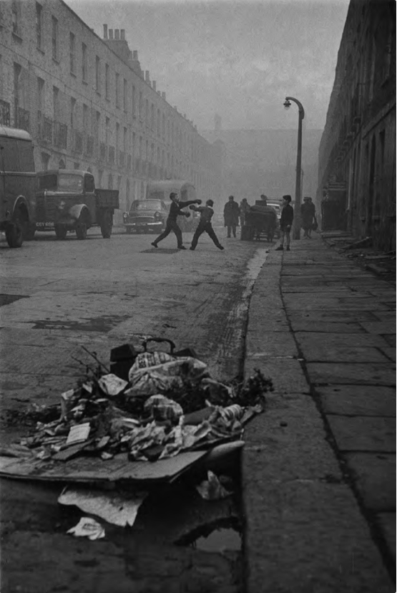
Task1.
Navigate to the Open University website using the link below.
Create an account using your Warminster school email address and complete the online course – you must email me the certificate gained at the end of the course.
Task2.
Using your new found skills you must complete a written analysis of one of the picture on the following page.
250 words minimum.
https://www.open.edu/openlearn/people-politics-law/politics-policy-people/sociology/reading-visual-images/content-section-0?active-tab=description-tab

Slide 4
Bradford, 1978. Don McCullin
Boys Boxing near Caledonian Road. Don McCullin

