Slide 1
AQA
AS Level
Computer Science
Paper 2
Network topology
Unit 6
Communication: Technology and consequences

Slide 2
Objectives
Describe star and bus topologies for a local area network
Differentiate between physical and logical network topologies
Explain the operation of physical star and logical bus network topologies
Describe the advantages and disadvantages of each topology

Slide 3
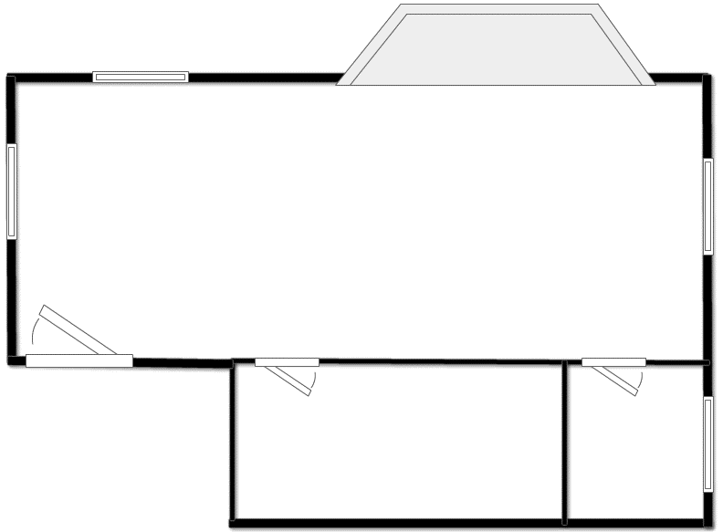
Home network
Wireless
router

Slide 4
School Local Area Network
Server
Switch
Router

Slide 5
Local Area Networks (LANs)
One computer, not connected to any other computing device is called a ‘standalone’
As soon as you connect two or more computers together they form a network
All networks fall into one of two categories:
Local Area Network (LAN)
Wide Area Network (WAN)

Slide 6
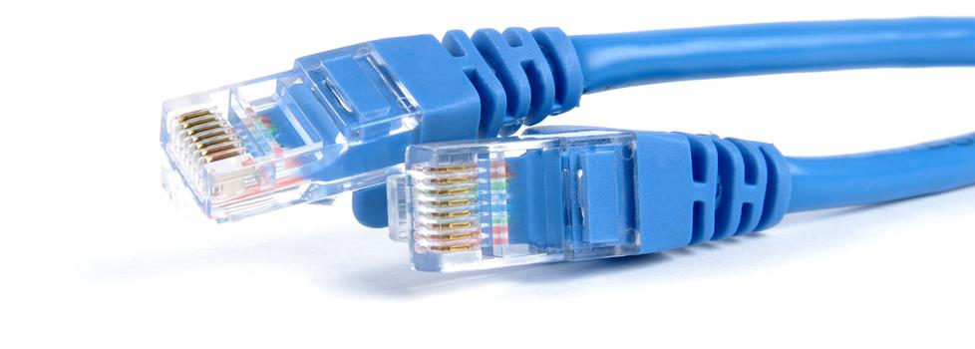
Local Area Networks (LANs)
Local Area Network: two or more computers connected together within a small geographical area, for example confined to one building or site
Can you think of some obvious advantages of having computing devices connected in a LAN?

Slide 7
Network topologies
A network topology is the arrangement of the various computing devices which make up a computer network
Bus topology: an arrangement where nodes are connected in a daisy chain by a single central communications channel
Star topology: an arrangement where a central node or hub provides a common connection point for all other nodes

Slide 8
Bus network topology
Backbone cable
Terminator
Terminal
Server

Slide 9
Operation of a bus network
All nodes are connected to a single backbone cable
Each end of the backbone is connected to either a terminator or a computer which stops signals ‘bouncing back’
Each node is passive
Data is sent in one direction at a time only
Only one computer can transmit successfully at any one time
Carrier Sense Multiple Access (CSMA/CD) technology is used to enable nodes to transmit on the same cable

Slide 10
Bus network
What are the advantages and disadvantages of a bus network?
Advantages | Disadvantages

Slide 11
Bus network
Advantages | Disadvantages
Inexpensive to set up | Main cable is a point of failure
Devices can easily be added | Limited cable length
Good for small networks | Performance degrades with heavy use, owing to data “collisions”
 | Poor security

Slide 12
Carrier Sense Multiple Access
CSMA with Collision Detection (CSMA/CD) detects two nodes attempting to transmit simultaneously
Both nodes cease transmission and wait a random amount of time before reattempting
CSMA with Collision Avoidance (CSMA/CA) is used with wireless networks

Slide 13
Star network topology
Switch / Hub

Slide 14
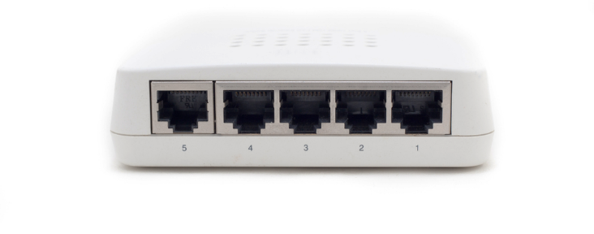
Operation of a star network
Computers are connected to a central node. This is often either a hub or a switch
A switch sends each communication to the specific computer it is intended for
A hub broadcasts the message to every computer on the LAN

Slide 15
MAC addressing
Every networked device contains a Network Interface Card (NIC)
Each NIC is attributed a unique Media Access Control (MAC) address hardcoded in manufacture
3B-84-D8-A3-5C-7F
A switch holds all of the MAC addresses for each device connected to it and uses these to direct packets of data to the correct device

Slide 16
Star network
What are the advantages and disadvantages of a star network?
Advantages | Disadvantages

Slide 17
Star network
Advantages | Disadvantages
Easy to isolate problems | Can be expensive to set up because of the length of cable required
Good performance | Central device is point of failure
More secure if a switch is used as data is sent only to the recipient

Slide 18
Physical vs logical topology
Bus or Star?
Server
Switch
Router

Slide 19
Physical vs logical topology
The physical topology of a network defines how the devices are physically connected
The logical topology defines how the devices communicate across the physical topologies
A network wired in star topology can behave logically as a bus network by using a bus protocol and appropriate physical switching

Slide 20
Worksheet 2
Now do the questions in Tasks 1 and 2 of the worksheet

