Slide 1
Food tests using reagents

Slide 2
Testing foods using reagents
Many food tests use chemical reagents to identify particular substances in foods. Different reagents test for different substances.
The tests listed below are used to test foods for different nutrients. Click on each button to find out more and answer a question on each of the tests.
Iodine test
Benedict’s test
Biuret test
Ethanol test

Slide 3
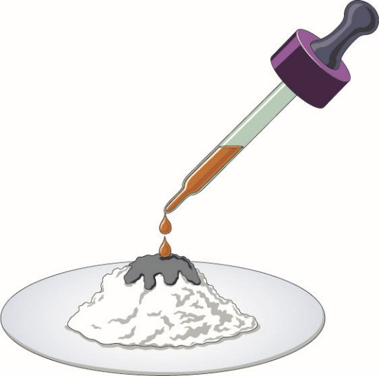
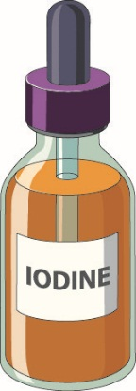
Iodine test
Iodine can be used to identify starch in foods.
Safety:
Wear eye protection.
Wash any splashes with water to avoid staining.
A solution of iodine in potassium iodide is yellow–orange.
When dropped onto a solid or liquid food that contains starch, the solution turns blue–black.
Select the button below to answer questions about using iodine to test for starch.
Question
Notes:
Teaching notes
Three clicks to introduce three bullet points, then select ‘Questions’.

Slide 4
Iodine test – question
The following table shows the results from an iodine test on some different foods.
Using the test results, identify which foods contain starch.
Food | Test result | Contains starch?
potato | blue–black
beef mince | orange
ripe banana | orange
unripe banana | blue–black
bread | blue–black
butter | orange
☑
☒
☒
☑
☑
☒
Home
Notes:
Teaching notes
Click to introduce answers, then select ‘Home’.

Slide 5
Benedict’s test
Benedict’s test identifies reducing sugars, such as glucose and fructose.
Safety:
Wear eye protection.
Avoid scalding from very hot water by handling tubes with heat-resistant gloves or tongs.
Mix equal volumes of food solution and Benedict’s solution in a test tube.
Place the tube into a water bath at 95 °C for a few minutes.
The resulting colour change indicates how much reducing sugar is in the food.
Results
Notes:
Teaching notes
Three clicks to introduce three bullet points, then select ‘Results’.

Slide 6
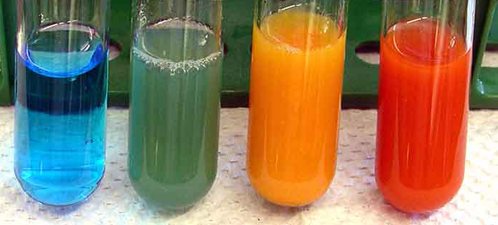
Benedict’s test results
Benedict's solution starts out this colour.
Blue (no colour change): Food contains no reducing sugar.
Green:
Food contains little reducing sugar.
Orange:
Food contains some reducing sugar.
Red:
Food contains lots of reducing sugar.
Question
Notes:
Teaching notes
Four clicks to introduce colour change notes, then select ‘Questions’.

Slide 7
Benedict’s test – question
The table shows the results of a Benedict’s test on some different foods.
Using the test results, identify how much reducing sugar is contained in each of these foods.
Food | Test result | How much reducing sugar?
potato | green
sports ‘energy’ drink | red
egg | blue
bread | orange
a little
a lot
none
some
Home
Notes:
Teaching notes
Click to introduce answers, then select ‘Home’.

Slide 8
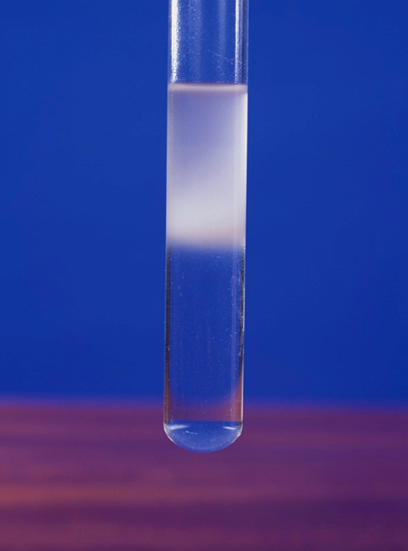
Ethanol test
Ethanol can be used to identify fats and oils in foods.
Safety:
Wear eye protection. Ethanol is flammable. Do not use near an open flame.
Half-fill a tube with ethanol. Add some crushed or liquid food and mix.
Pour some of the mixture into a tube of water and mix.
Any fat or oil dissolved in the ethanol will rise to form a cloudy suspension near the top of the tube.
Question
Notes:
Teaching notes
Three clicks to introduce three bullet points, then select ‘Questions’.

Slide 9
Ethanol test – question
The following table shows the results from an ethanol test on some different foods.
Using the test results, identify which of the tested foods contain oil or fat.
☑
☒
☑
☒
Food | Test result | Contains oil or fat?
cheese | cloudy layer
lemon juice | clear
pastry | cloudy layer
bread | clear
Home
Notes:
Teaching notes
Click to introduce answers, then select ‘Home’.

Slide 10
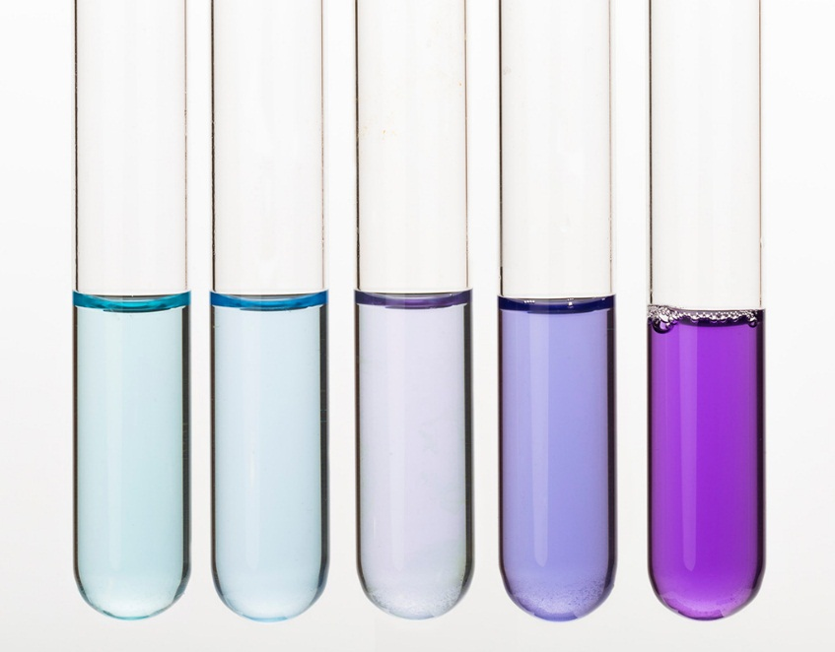
Biuret test
The Biuret test indicates the presence of protein.
Safety:
Wear eye protection. Potassium hydroxide can be harmful to skin and eyes.
Mix equal volumes of food solution and dilute potassium hydroxide solution in a test tube.
Add a few drops of copper sulfate solution and mix.
The amount of change in colour, from blue to lilac (pale purple) indicates how much protein is present.
Question
Notes:
Teaching notes
Three clicks to introduce three bullet points, then select ‘Questions’.

Slide 11
Biuret test – question
The following table shows the results from a Biuret test on some different foods.
Using the test results, state whether the tested foods contain lots of protein, a little protein or no protein.
Food | Test result | How much protein?
beef mince | purple
apple | pale blue
lentils | purple
bread | very pale purple
lots
none
lots
a little
Home
Notes:
Teaching notes
One click to introduce answers, then select ‘Home’.

