Slide 1
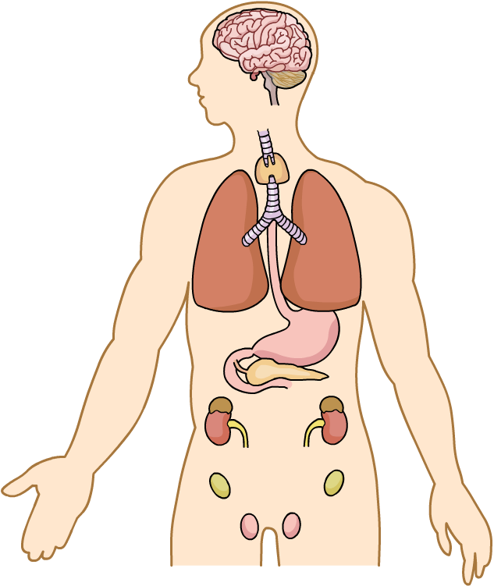
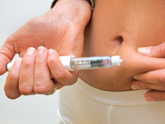
Biology Topic 7 Summary Sheet (1)
Some of the conditions inside your body have to be kept the same (constant). If not, you can become ill or even die. This is called HOMEOSTASIS.
CB7a – Hormones
We have some tissue in areas of our body called ENDOCRINE GLANDS. These glands produce chemicals called HORMONES which also send messages around the body.
CB7e – Control of Blood Glucose
This diagram shows the control of glucose concentration in the blood. Glucose is a sugar we get from our food.
Pituitary gland makes growth hormone, FSH and LH.
Thyroid makes thyroxine
A) What happens when we eat?
Blood GLUCOSE level increases.
INSULIN is released from the PANCREAS into the blood.
Insulin makes the LIVER turn excess glucose into GLYCOGEN.
Glucose levels in blood decrease to normal.
Adrenal glands make adrenalin
Pancreas makes
insulin and glucagon
Ovaries (females) make oestrogen and progesterone. Progesterone is made by an empty egg cell called the COPRUS LUTEUM.
Testes (males) make testosterone
B) What happens when we don’t eat? (HIGHER)
Blood GLUCOSE level decreases.
GLUCAGON is released from the PANCREAS into the blood.
Glucagon makes the liver turn excess GLYCOGEN into GLUCOSE.
Glucose levels in blood increase to normal.
As the number of people with Type 2 diabetes has increased, so has the average body mass. We say the two factors are CORRELATED.
Scientists think that the more fat you have on your body, the more likely they are to develop Type 2.
They use something called BODY MASS INDEX (BMI) to decide if a person has the correct mass for their height.
TYPE 1 DIABETES
Pancreas does not produce insulin.
Insulin has to be injected into the fat layer beneath the skin before you eat a meal. Also need to eat low sugar diet and exercise.
TYPE 2 DIABETES
Insulin produced but has no or little effect as cells become RESISTANT to it
Controlled by careful low sugar diet, regular exercise and medicines.
BMI = mass (kg)
height (m)²
Or we can calculate WAIST : HIP RATIO. This is:
waist measurement ÷ hip measurement. It should be less than 1.

Slide 2
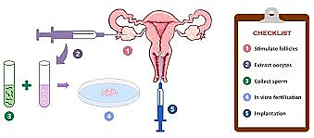
Biology Topic 7 Summary Sheet (2)
CB7c – Methods of Contraception
CB7d – Hormones and the Menstrual Cycle (Higher)
Method of contraception | How it prevents fertilisation
Male condom | Placed over erect penis, prevents sperm entering the vagina. A BARRIER.
Diaphragm | Placed over entrance to the uterus, prevents sperm entering the uterus. A BARRIER.
Hormone pill or implant placed under the skin | Releases hormones to prevent ovulation and thickens mucus at the cervix making it difficult for sperm to pass through.
CB7d – Hormones and the Menstrual Cycle (Higher)
There are many reasons why a couple may fail to have a child. Some of these problems van be overcome with A.R.T. (ASSISSTED REPRODUCTIVE TECHNOLOGY) This uses hormones to increase the chance of pregnancy.
IVF (see diagram →)
Clomifene therapy - increases concentration of
LSH and FH in the blood.
Day (1- 5) Menstruation. Uterus lining breaks down and a unfertilised egg cell is lost during a ‘period’ of bleeding.
Day (6-12) – an egg cell develops in an ovary.
Day (13-15) Ovulation. An egg cell is released from an ovary and is moved by cilia along the oviduct.
Day (16-19) If the woman has sex during these days then fertilisation is likely leading to pregnancy.
Day (5-28) Uterus lining thickens up again to receive a fertilised egg. If an egg is not fertilised then after day 28 the whole cycle starts again)
Extract eggs
Mix with sperm
Fertilisation in a dish forms embryos
Embryos inserted into uterus.

