Slide 1
‘What if’ scenarios
Spreadsheet modelling
3rd Edition

Slide 2
Objectives
Use a spreadsheet to model outcomes
Use functions including Max, Min and If
Name a cell
Sort data into different sequences
Try out different ‘What if’ scenarios to achieve a goal
Display formulae in a spreadsheet

Slide 3
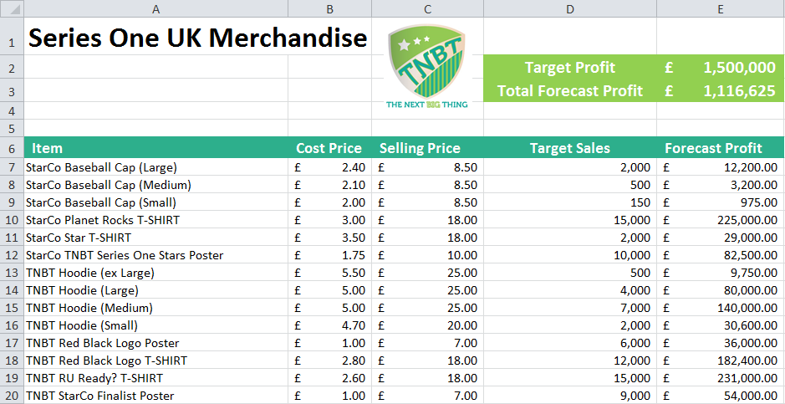
Open the spreadsheet Merchandising TBNT UK that you worked on in the last lesson. (Your figures may be different from the ones below.)

Slide 4
Increasing merchandising profits
Use your research on merchandise to add three new products to your spreadsheet
Estimate some possible sales figures for these products
How will you arrive at a reasonable estimate?

Slide 5
‘What if’ scenarios
One of the great advantages of using a spreadsheet is that you can try out different options
‘What if’ we charge more for T-shirts?
‘What if’ we lower the price on hoodies and sell twice as many?
What other scenarios can we try?

Slide 6
Which item gives the most profit?
Finding the product that produces the maximum profit will help us decide where to put in the maximum effort!
Use a function Max to find the maximum profit figure
Name this cell Max_Profit by entering the name to the right of the formula bar

Slide 7
The ‘IF’ function
The result of an ‘IF’ function depends on a condition which you specify
=IF(Condition,value if true,value if false)
In cell F7, enter an IF function
=IF(E7=Max_Profit,"Max profit","")
Copy this function down the column
Why did we need to name the cell containing the maximum profit?

Slide 8
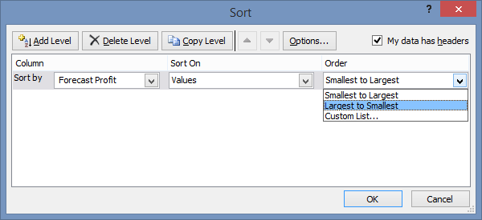
Sorting data
Sort by different columns of data
Sort in ascending or descending order

Slide 9
Worksheet 3
Now try Tasks 1-3 on Worksheet 3

