Slide 1
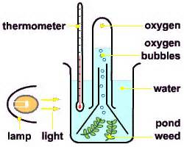
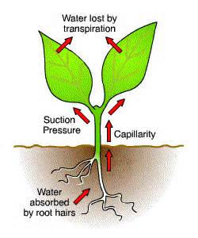
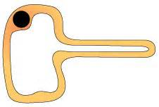
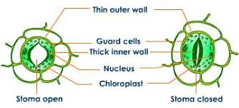
Biology Topic 6 Summary Sheet
CB6b Factors that Affect Photosynthesis
3 limiting factors will affect the RATE (speed) of photosynthesis:
Temperature
Light intensity
Carbon dioxide concentration
These can make photosynthesis faster or slower. We can measure this by counting the number of oxygen bubbles made
by a water plant in a minute.
CB6a Photosynthesis
All organisms need ENERGY. Plants and algae can trap energy transferred by light from the Sun. This energy is then transferred to GLUCOSE in a process called PHOTOSYNTHESIS.
sunlight energy
Carbon dioxide + water Glucose + oxygen
CB6a Photosynthesis – leaf adaptations
The PALISADE CELLS trap most light so most photosynthesis happens here. They contain lots of chloroplasts containing green chlorophyll to this.
CB6d Osmosis and Active Transport
Water moves into a plant by OSMOSIS across a semi-permeable membrane– from an area of high concentration to low concentration (down a concentration gradient). Active transport moves minerals against the concentration gradient. This requires lots of energy.
AIR SPACES are inside the leaf so that gases can move through to cells.
The stomata are opened and closed by specialised GUARD CELLS.
In the light, water flows into pairs of guard cells, making them rigid. This opens the stomata.
At night, water flows out of the guard cells. They lose their rigidity and the stoma shuts.
CB6d Transpiration and Translocation
The flow of water and minerals into a root, up the stem via XYLEM VESSELS and out of the leaves is called TRANSPIRATION.
Plants make sucrose sugar from the glucose made during photosynthesis.
Sucrose travels UP AND DOWN the plant stem in the SIEVE TUBES of PHLOEM tissue. This process is called TRANSLOCATION
The bottom layer of the leaf contains tiny holes called STOMATA . They allow the gases involved in photosynthesis to enter and leave the leaf.

Slide 2
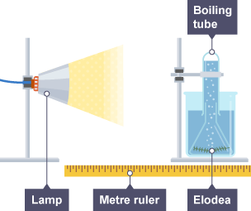
Core practical : Investigating the effect of light intensity on the rate of photosynthesis.
Biology Topic 6 Summary Sheet
CB6b Factors that Affect Photosynthesis
3 limiting factors will affect the RATE (speed) of photosynthesis:
Temperature
Light intensity
Carbon dioxide concentration
These can make photosynthesis faster or slower. We can measure this by counting the number of oxygen bubbles made
by a water plant in a minute.
METHOD
Set up the apparatus as in the diagram.
Leave for five minutes for the pondweed to acclimatise to the new light intensity.
Count the number of bubbles given off in one minute, use a timer to do this.
Move the light 10 cm further back. Repeat steps 1 to 3 until 60 cm is reached.
FINDINGS
The further the light moves from the plant, the light intensity decreases. This causes plants to photosynthesise less/slower which leads to fewer oxygen bubbles produced by photosynthesis.
Equipment Used:
Control variable – the size of pondweed, volume of water,, the temperature.
Independent variable – the light intensity (how close the light is)
Dependent variable –. The number of oxygen bubbles given off (the rate of photosynthesis).

