Slide 1
IB History
SL and HL

Slide 2
Course Outline
20th Century World History
SL and HL
Prescribed Subject: Case Studies
World History Topics
Historical Investigation
History of Europe (HL)

Slide 3
Prescribed Subject – Rights and Protest
The Civil Rights Movement in the United States (1954–1965)
Apartheid in South Africa (1948–1964)
Origins of discrimination
The nature of discrimination
The role of key individuals and groups

Slide 4
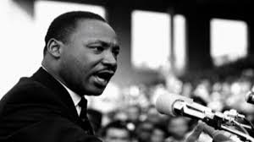
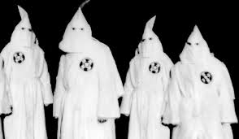
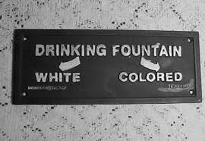
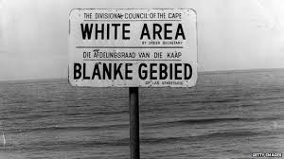
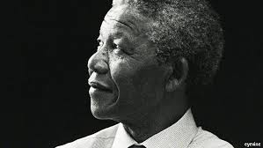
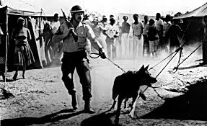

Slide 5
World History
Causes and effects of C20th Warfare
Origins, nature and the consequences of warfare
Authoritarian States
Origins and rise of authoritarian leaders, the consolidation of their rule and the nature of their regimes.

Slide 6
Current topic areas studied:
Causes and Effects of C20th Warfare
Authoritarian States
The Spanish Civil War
The Second World War
The Chinese Civil War
The Falklands / Malvinas War
The USSR under Lenin and Stalin
Germany under Hitler
China under Mao
Spain under Franco
Cuba under Castro

Slide 7
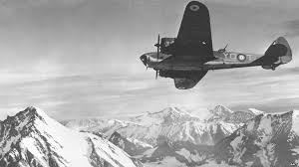
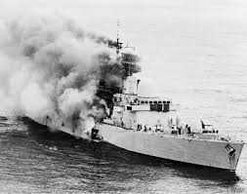
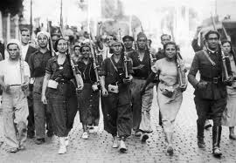
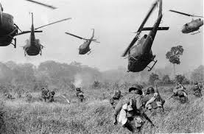

Slide 8
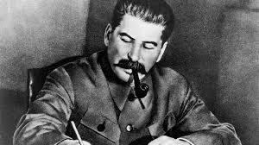
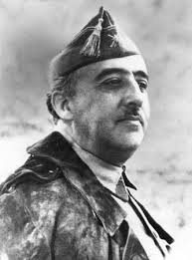
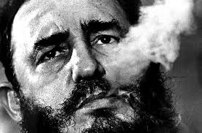
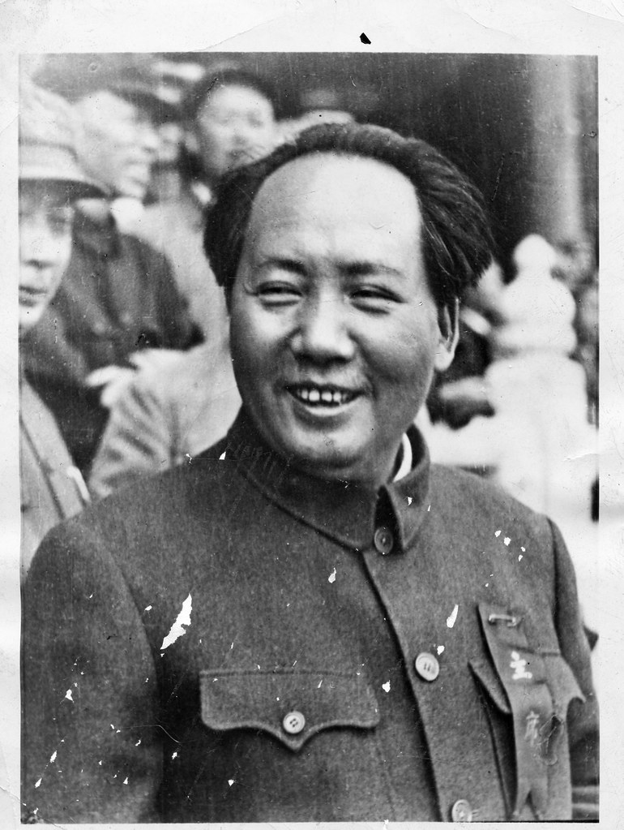

Slide 9
Higher Level: The History of Europe
Europe
Topics flexible
Additional paper

Slide 10
Historical Investigation
Personal choice
Evaluation of sources; Investigation; Reflection
Application of skills
2,200 words

Slide 11
Assessment
Examinations
Paper 1 – SL and HL
Paper 2 – SL and HL
Historical Investigation – SL and HL
Paper 3 – HL only

Slide 12
Any questions?
If you have any questions about the IB History course, please do not hesitate to contact me via the Firefly Forum or directly on the email address below:
jwalker@warminsterschool.org.uk
Mrs. J. Walker, Head of History and Politics

