Slide 1
AQA
AS Level
Computer Science
Paper 2
Client-server and peer-to-peer
Unit 6
Communication: Technology and consequences

Slide 2
Objectives
Explain peer-to-peer and client-server networking
Describe situations where peer-to-peer and client-server networking might be used
Describe the advantages and drawbacks of cloud computing

Slide 3
Network architecture
There are two types of network architecture:
Client server
Peer-to-peer

Slide 4
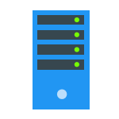
Client-server or Peer-to-peer?
Server

Slide 5
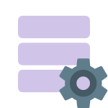
A client-server network
The server is a powerful computer which provides services or resources required by any of the clients
A client is a computer which requests the services or resources provided by the server
Query
Search
Client
Data
Server
Response

Slide 6
Client-server architecture
Terminals are known ‘clients’ of the central server
Server

Slide 7
Role of the client
The client sends requests to the server
Waits for a reply
Receives the reply

Slide 8
Role of the server
The server waits for requests from the clients
It may need to pass the request (e.g. for a web page) to another server – in which case, it becomes the “client”

Slide 9
Client-server networking
Features of a client-server network include:
A central server is used to manage security
Some files are held on the central server
Some processing tasks are performed by the server
Clients issue requests to the server for services such as email, file storage, backup and printing
Suitable for many different types of organisation, small and large
Can require specialist IT staff to administer the network

Slide 10
Client-server architecture
File
Server
Print
Server
Mail
Server
Web
Server
Database
Server

Slide 11
Multiple servers
There can often be many specialised servers, especially in a large client-server network.
Each one will be dedicated to a certain task:
Web server
Print server
Mail server
File server
Database server

Slide 12
Peer-to-peer architecture
A peer-to-peer network has no central server

Slide 13
Peer-to-peer networking
Features of a peer-to-peer network include:
Suitable for a small companies with fewer computers
No central server controls files or security
All computers can easily see files on all other computers
All computers can communicate with each other without going through a server
If a computer is switched off, data cannot be retrieved

Slide 14
Worksheet 3
Complete Task 1, Questions 1 and 2

Slide 15
Architecture summary
Client server | Peer-to-peer
3. User IDs, passwords and access levels centrally controlled | 1. Files and programs stored on individual computers
5. Used in many small, medium-size and large organisations | 2. Suitable for a home computer network
7. Can be expensive to set up and to manage | 4. Cheap to set up and maintain
9. Backup is centralised and usually automated | 6. Each computer on the network can act as both client and server
10. No access to other users’ files | 8. Can be used for sharing of music and streaming coverage of live events

Slide 16
Peer-to-peer on a WAN
The P2P configuration can also be used for file-sharing websites
BBC iPlayer, for example, uses P2P networking
This means that with thousands of people downloading, data can be passed between computers rather than just from the server
Peer-to-peer networks are often used for the illegal distribution of copyright material such as music and films, as they are very difficult to close down

Slide 17
Peer-to-peer file sharing
A file request can return several parts of the same file from multiple copies on multiple computers
Request query: “AnotherBrickInTheWall.mp3”
Millions of computers

Slide 18
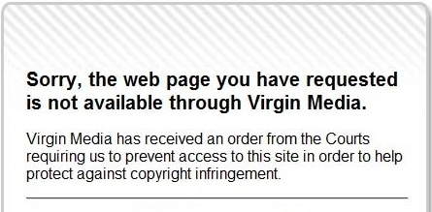
The issues of peer-to-peer networking
What cases of internet based piracy are you aware of?
Some have made big media headlines over the past few years

Slide 19
What is Cloud computing?
“The cloud” is simply an imaginative term for Internet computing, using remote servers run by organisations such as Dropbox, Microsoft, or thousands of other specialist software companies

Slide 20
Cloud computing
Instead of maintaining their own networks, many organisations now rely on cloud computing to share both software and files at different sites
What are the advantages?

Slide 21
Advantages of cloud computing
Some software does not have to be downloaded to the user’s computer. All the software and data files are held by the software manufacturer “in the cloud”
Software and data is accessible from any computer anywhere in the world
The data is automatically backed up so there is no danger of losing it
The software and data does not occupy space on the user’s hard drive

