Slide 2
Learning objectives
Be able to apply knowledge learnt to exam style questions with Design and Technology contexts

Slide 3
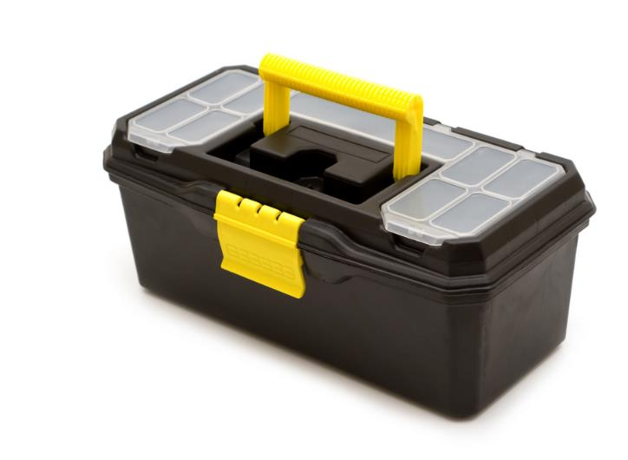
Starter
The image shows a toolbox that is used by many different types of craftspeople
The capacity of the main compartment can be approximated to 45 × 25 × 24 cm
Calculate the capacity of the main compartment in litres
The toolbox has a footprint of 45.5 cm × 25.5 cm – calculate the area of the toolbox's footprint

Slide 4
Starter
The capacity of the main compartment = 45 × 25 × 24 = 27,000 cm³ = 27 litres
The toolbox’s footprint = 45.5 × 25.5 = 1,160.25 cm²

Slide 5
Market survey
A headphone company asked a group of students about connectivity options
One question asked whether Bluetooth or corded was preferable
84 people said they preferred Bluetooth – this was 60% of the whole group questioned
35% said that they preferred corded
The rest were undecided
How many people were questioned in the survey?
How many people were undecided?

Slide 6
Market survey
The total number of people questioned: 84 people represent 60% of the total 84 ÷ 60 represents 1% of the total = 1.4 1.4 × 100 represents 100%
140 people were questioned
The number of people who were undecided: 100% − 60% − 35% = 5%
5% = 5 ÷ 100 × 140 = 7 people

Slide 7
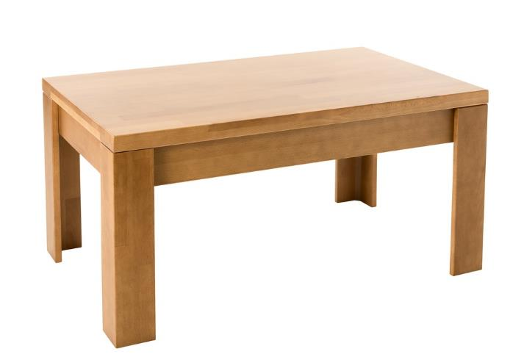
Wood veneer
A student wishes to cover a table top in oak veneer
The table top surface measures 1.85 m × 1.10 m
Oak veneer costs £25.00 per m²
What is the area of veneer required?
How much does it cost to cover the table top to the nearest penny?
The student is advised to buy 10% extra for trimming – how much extra will this cost?

Slide 8
Wood veneer
What is the area of veneer required? The area of the table top = 1.85 m × 1.10 m = 2.035 m²
How much does it cost to cover the table top? Oak veneer costs £25.00 per m² so the price will be: 25 × 2.035 = £50.88, to the nearest penny
How much will the extra 10% cost? 10% of 2.035m² = 0.204m²
0.204 x 25 = £5.10
However, if you answer this last
part by looking just at the cost, the
answer will be:
10% of 50.88 = £5.09
Which is correct?

Slide 9
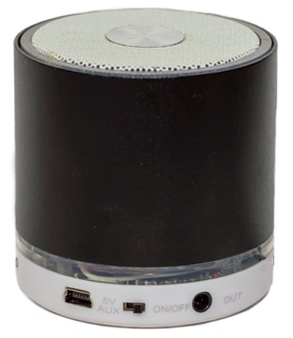
Portable speakers
A company makes budget portable speakers
The cost of manufacturing a speaker has a fixed set up cost of £800
The materials for each speaker cost £3.50
How much does it cost to make: a) 100 speakers b) 500 speakers?
What happens to the cost of making each speaker as more are manufactured?

Slide 10
Portable speakers
The cost of making 100 speakers = 800 + (100 × 3.50) = £1,150
The cost of making 500 speakers = 800 + (500 × 3.50) = £2,550
The cost of each speaker is the total cost divided by the number of speakers
For 100 speakers, $\frac{1,150}{100}$ = £11.50
For 500 speakers, $\frac{2,550}{500}$ = £5.10
As the number of speakers increases, the cost of manufacturing each speaker decreases

Slide 11
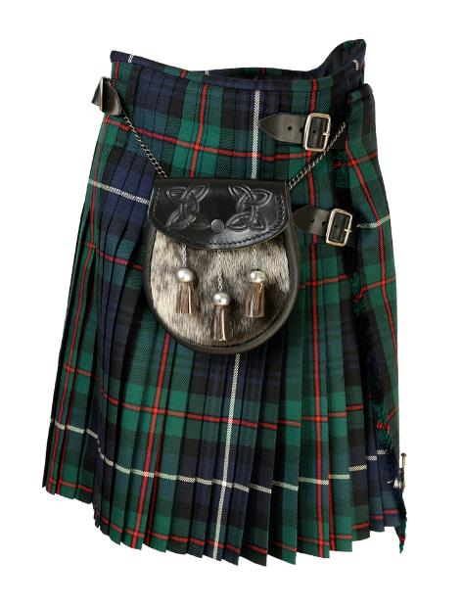
The whole nine yards
A kilt is a traditional Scottish pleated garment that can use up to 9 linear yards of tartan fabric
A high quality kilt uses 5 m² of fabric
Fabric is sold at £32 per m²
A tailor has been asked to make three identical kilts for a wedding
How much does the fabric cost to make the three kilts?
The fabric costs 20% of the final selling price – how much does each kilt cost?

Slide 12
The whole nine yards
The cost of fabric to make the three high quality kilts 3 kilts require 3 × 5 = 15 m² of fabric 15 × 32 = £480
The fabric costs 20% of the final selling price – how much does each kilt cost? The cost of fabric is: 480 ÷ 3 = £160 £160 is 20% of the final price 160 ÷ 20 is 1% of the final price = £8 8 × 100 is 100% of the final selling price Final selling price = £800

Slide 13
Dilution ratio
Many dyes, stains and paints need to be diluted before application on different materials
A water-based wood stain needs 80% water to 20% stain
What is the simplest ratio of water to stain?
A test solution is made up with 100 ml of water – How much stain is required to make the correct ratio?
If 6 litres of stain solution is required, calculate the volume of water and stain needed, in millilitres

Slide 14
Dilution ratio
What is the simplest ratio of water to stain? The ratio is 4 to 1 or 4 : 1
How much stain is required to make the correct ratio? 100 ÷ 4 = 25 ml
If 6 litres of stain solution is required, work out the volume of water and stain needed, in ml 4 : 1 is 5 parts so 6,000 ÷ 5 = 1,200 ml stain and 4,800 ml water

Slide 15
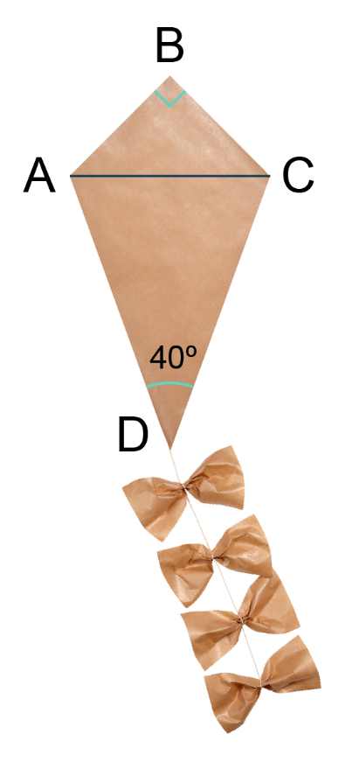
Let’s fly a kite
A kite design is made up of two isosceles triangles, as shown in the diagram
AB = BC and AD = CD ∠ADC = 40°
Work out the angle of ACB Give reasons for your answers
Work out the sizes of the following angles: a) ∠ACD b) ∠BAD Giving reasons for your answers
What is the sum of all angles within the kite?

Slide 16
Let’s fly a kite
Work out the angle of ACB ∠ACB = ∠BAC (triangle is isosceles) = (180 − 90) ÷ 2 (angles in a triangle sum to 180°) = 45°
Work out the sizes of the following angles: a) ∠ACD = 180 − 40 = 140 $\frac{140}{2}$ = 70º DAC is an isosceles triangle, so the two base angles (∠DAC and ∠DCA) are equal b) BAD = 115º It is the sum of ∠BAC (45°) and ∠DAC (70°)
What is the sum of all angles within the kite? 360º Angles in a quadrilateral sum to 360°

Slide 17
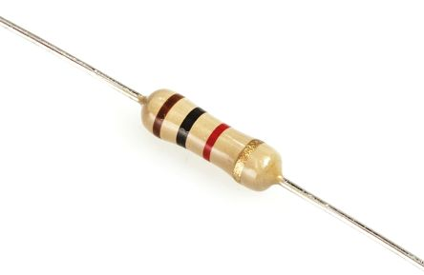
Tolerance
This image shows a resistor which has coloured bands that state its value of resistance
The gold band means it has a tolerance of 5%
Work out the maximum and minimum resistance of the 1 KΩ resistor pictured
Another resistor has a maximum value of 363 Ω and minimum value 297 Ω − Work out the resistor’s value and its tolerance %

Slide 18
Tolerance
Work out the maximum and minimum resistance of the 1KΩ resistor pictured 1K Ω = 1000 Ω 5% of 1000 = 0.05 × 1000 ⇒ 50 Ω 1000 − 50 = 1050 Ω maximum and 1000 − 50 = 950 Ω minimum
A resistor has a maximum value of 363 Ω and minimum value of to 297 Ω − Work out the resistors value and its tolerance % The mid-point between 297 and 363 = $\frac{297+363}{2}$ = 330 Ω 330 − 297 = 33 (and 363 − 330 = 33)
Find what percentage 33 Ω is of 330 Ω:
$\frac{\text{33}}{\text{330}}$ × 100 = 10% tolerance

Slide 19
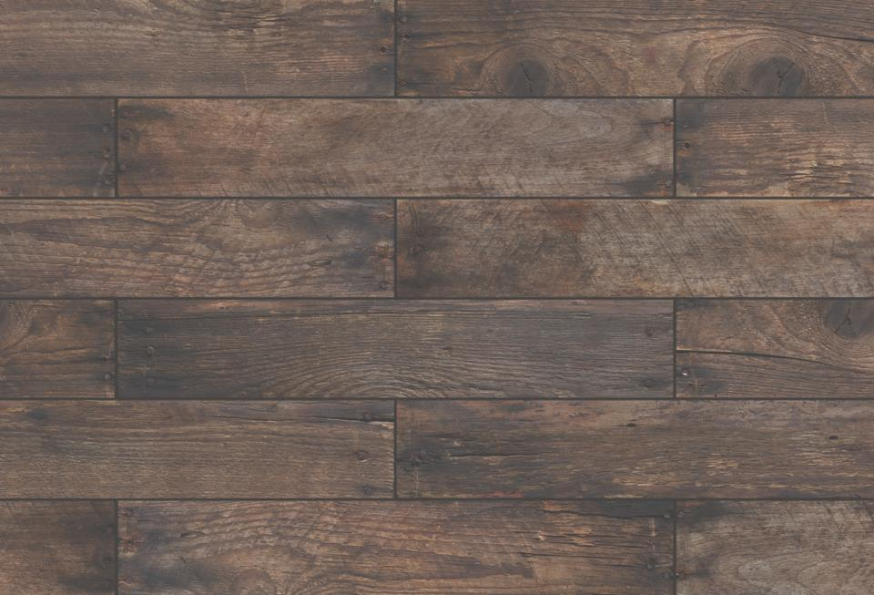
Pallet shed
This image shows a wooden shed wall made from recycled pallets
A 1 litre tin of varnish is purchased for £12.90
The varnish used has a coverage of 1 litre per 15 m²
Each pallet plank has an average area of 80 cm x 8 cm
How many planks can be varnished before the tin runs out? Give your answer to 3 significant figures
Giving your answer to the nearest penny, how much does it cost to varnish the whole shed which has an area of 42 m²?
How many tins are required and how many millilitres of varnish are left over?

Slide 20
Pallet shed
How many planks can be varnished before the tin runs out? Give your answer to 3 significant figures 80 × 8 = 640 cm² per plank The tin covers 100 × 100 × 15 = 150,000 cm² 150,000 ÷ 640 = 234.375 ⇒ 234 planks (to 3 s.f.)
Or (80 ÷ 100) x (8 ÷ 100) = 0.8 x 0.08 = 0.064m² per plank
15 ÷ 0.064 = 234.375 ⇒ 234 planks (to 3 s.f.)
Giving your answer to the nearest penny, how much does is cost to varnish the whole shed which has an area of 42 m²? 42 ÷ 15 = 2.8 tins needed (3 tins must be purchased) £12.90 × 3 = £38.70 total
How many millilitres of varnish are left over? 3 tins are required and 0.2 of 1 litre is left over = 200 ml

Slide 21
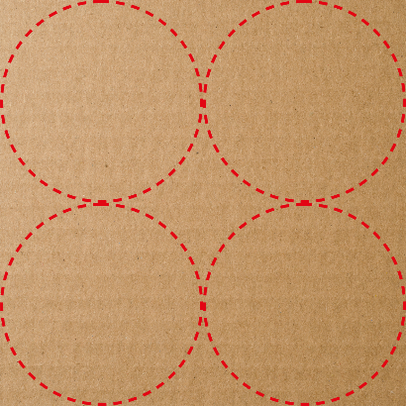
Stamping and blanking
Stamping and blanking is performed on many different materials
This card design consists of a square with side length of 100 mm from which 4 identical circles are cut using a die
The circles fill the square as pictured
The area of a circle is given by πr², where r is the radius of the circle
Work out the following: a) the radius of each circle b) the area of one of the circles c) the area of the waste part of the card Give all your answers to 4 significant figures

Slide 22
Stamping and blanking
a) the radius of each circle Diameter of one circle: 100 ÷ 2 = 50 mm Radius of one circle: 50 ÷ 2 = 25 mm
b) the area of one of the circles Area of a circle = πr² = 3.14 × 25² = 1,962.5 cm² = 1,963 mm² (to 4 s.f.)
c) the area of the waste part of the card = (100 × 100) − (1,962.5 × 4) = 10,000 − 7,850 = 2,150 mm² (to 4 s.f.)

Slide 23
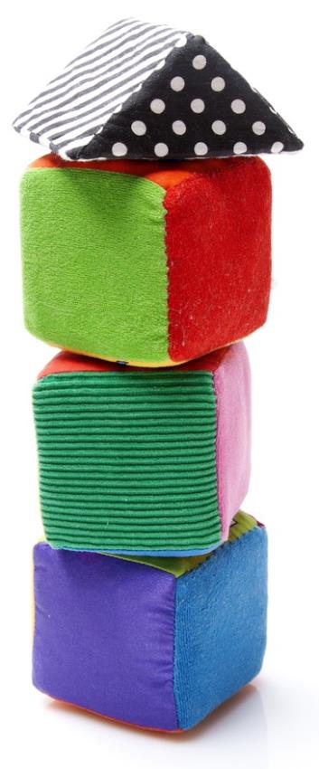
Material matters
Market research is carried out on 120 parents to see which material they preferred for a new child’s toy
The results are shown in this pie chart:
How many people preferred a) fabric 1 b) fabric 3 or 4?

Slide 24
Material matters
How many people preferred a) fabric 1? 14% of 120 = 0.14 × 120 = 16.8 or 17 people
b) fabric 3 or 4? 36% and 23% = 59% 0.59 × 120 = 70.8 or 71 people

Slide 25
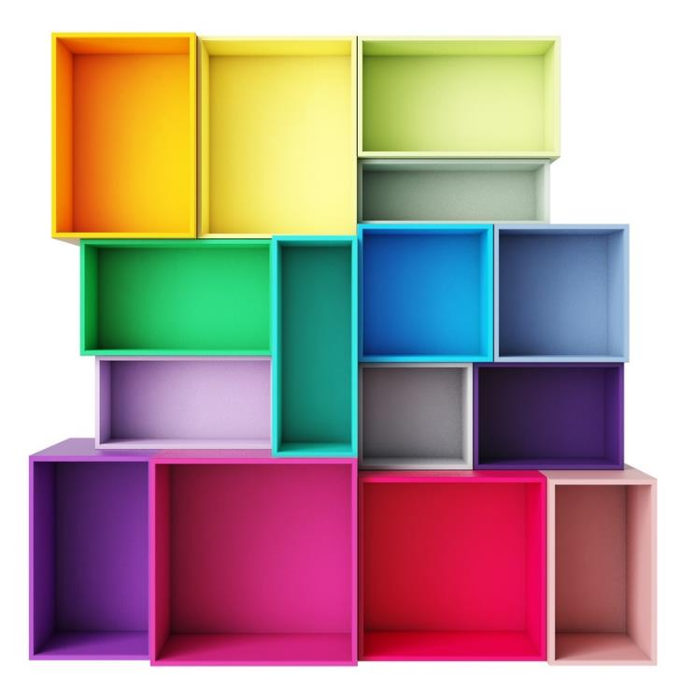
A question of units
A cabinet maker has built several large coloured boxes, and now works out the volume of each box
One box has dimensions of 50 cm × 30 cm × 100 cm
Which of the following is the volume of this box in mm³? A. 0.015 B. 180 C. 150,000 D. 1.5 x 10⁸

Slide 26
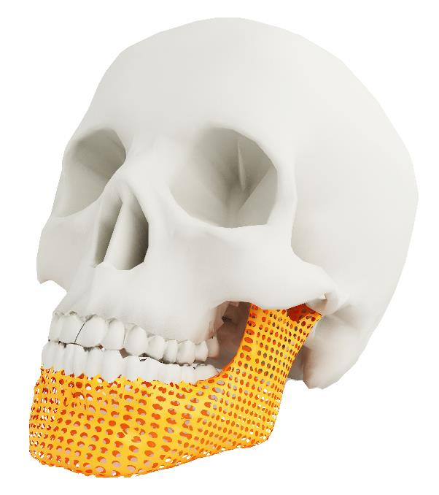
No brainer
The jaw on this skull has been 3D printed
The volume of PLA polymer used to make the jaw is 15.6 cm³, or ml
The plastic fibre used by the printer has a diameter of 3 mm
Work out the length of fibre used when printing the jaw in metres, to 2 decimal places

Slide 27
No brainer
Work out the length of fibre used when printing the jaw
15.6 cm³ of fibre = 15.6 × 10 × 10 × 10 mm³, = 15,600 mm³
The PLA has diameter of 3 mm so the radius of the cross section is 1.5 mm The cross sectional area = πr² = 3.14 × 1.5² = 7.065 mm²
The length of fibre = $\frac{15,600}{7.065}$ = 2,208 mm, or 2.21 m (to 2 d.p.)
Volume of prism = Area of cross section × length
Length = $\frac{Volume of prism}{Area of cross section}$

Slide 28
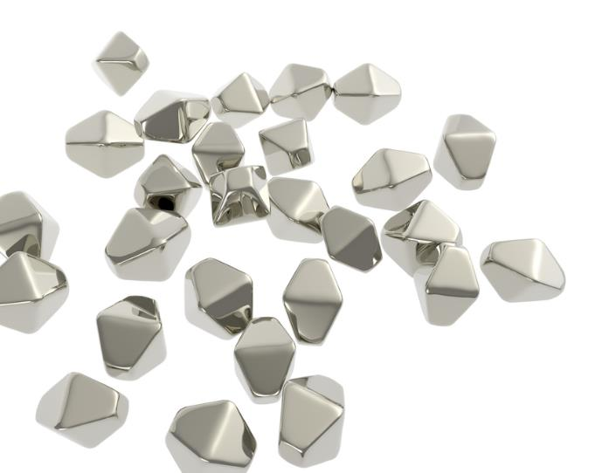
Nanoparticles
Titanium nanoparticles can be as small as 0.00000001 m across (1 × 10⁻⁸)
They have many uses, for example in medicine, cosmetics, and making paper
Write their size, in metres, in standard form
If an atom has a diameter of 1 × 10⁻¹º m, how many atoms would fit into the width of a nanoparticle?

Slide 29
Nanoparticles
Write their size, in metres, in standard form 0.00000001 m = 1 × 10⁻⁸ m
If an atom has a diameter of 1 × 10⁻¹º m, how many atoms would fit into the width of a nanoparticle? 1 × 10⁻⁸ ÷ 1 × 10⁻¹º atoms = 100

Slide 30
Primary survey
Three colour designs for an LED torch are considered
$\frac{1}{5}$ of users said they prefer red
$\frac{1}{3}$ of users said they prefer yellow
What fraction prefer blue?

Slide 31
Primary survey
$\frac{1}{5}$ of users said they prefer red
$\frac{1}{3}$ of users said they prefer yellow
What fraction prefer blue? $\frac{1}{5}$ + $\frac{1}{3}$ = $\frac{3}{15}$ + $\frac{5}{15}$
1 − $\frac{8}{15}$ = $\frac{15}{15}$− $\frac{8}{15}$
= $\frac{7}{15}$ prefer blue

Slide 32
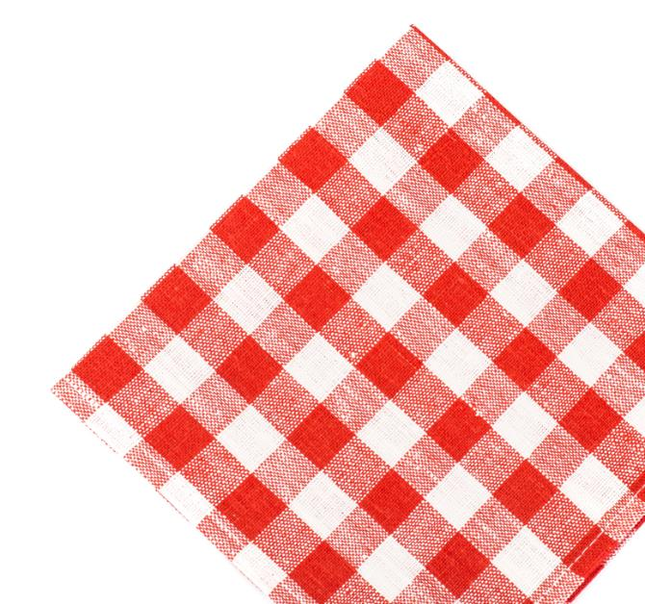
Nesting and cutting
A piece of cloth of size 1 m × 1 m has squares 15 cm × 15 cm cut from it
What is the maximum number of squares that can be cut from the piece of cloth?
What percentage of cloth is wastage?

Slide 33
Nesting and cutting
What is the maximum number of squares that can be cut from the piece of cloth? 15 × 6 = 90, so 6 fit across the width and length 6 × 6 = 36 squares can be cut
What percentage of cloth is wastage? 100 × 100 = 10,000 cm² 90 × 90 = 8,100 cm² 10,000 − 8,100 = 1,900 cm² or 0.19 m² 0.19 ÷ 1.0 × 100 = 19% waste

Slide 34
Plenary
Complete Tasks 1 and 2 of Worksheet 6

