Slide 2
Learning objectives
Understand how to handle data through design and technology contexts
Be able to plot, draw and interpret graphs
Be able to translate graphs between graphical and numerical form

Slide 3
Starter
Name the different types of graphs and charts and discuss what types of data they are best used for

Slide 4
A question of taste
People are often asked for their opinions and views
In a poll, students were asked whether they liked a design for new Design and Technology workshops
Their results are shown in the table below
How many people were questioned in the poll?
What percentage of people were unsure about the design?
Number who liked it | Number who didn’t like it | Number who were unsure
10 | 22 | 32

Slide 5
Bar charts
One common way to display data is with a bar chart
The results of the previous poll could be shown like this
Work out the percentage of people who voted ‘yes’ out of the total number who voted
Work out the ratio of those who voted ‘yes’ to those who voted ‘no’, give your answer in its simplest terms

Slide 6
Coursework deadline
A year group of GCSE Design and Technology students handed in their coursework
How many students are in the year group?
Work out the percentage of a) boys b) girls who were late handing in their work
Were the girls or boys better at handing in work?

Slide 7
Early starters
The bar chart shows how a group of two-year old children use electronic devices
What percentage of children have used a smartphone?
What is the most commonly used technology?
If there were 600 children in the group, how many had used a mobile phone?

Slide 8
Results day
This bar chart shows the examination results for a group of students
How many students achieved a mark between 40% and 49%?
How many students took the exam?
What percentage of students achieved over, or equal to, half marks? (to 2 d.p.)

Slide 9
Worksheet 5
Complete Task 1 on your Worksheet

Slide 10
Pie charts
A ‘slice’ in a pie chart has an angle that is proportional to the number of items in the ‘slice’
This pie chart shows the types of energy produced in the UK within a particular year
What percentage of the energy produced was renewable?
Work out the percentage that was from ‘other’ sources
Work out the size of the angle of the coal sector

Slide 11
Laptop energy
The use of electrical energy by a laptop is shown in this pie chart
Work out how much energy is used due to the LCD panel
How much energy is due to the graphics and network cards?
On average, the laptop uses 12 Watts of energy continuously – How much of this energy use is due to the processor alone?

Slide 12
Worksheet task
Complete Task 2 on your Worksheet

Slide 13
Graphs
A graph describes how one measured quantity may affect another
This graph shows how the value of new mobile phones depreciate with time
Its percentage value is on the vertical axis, and the age of the phone on the horizontal axis
When does the phone lose its value fastest?
Discuss the benefits of buying second-hand phones

Slide 14
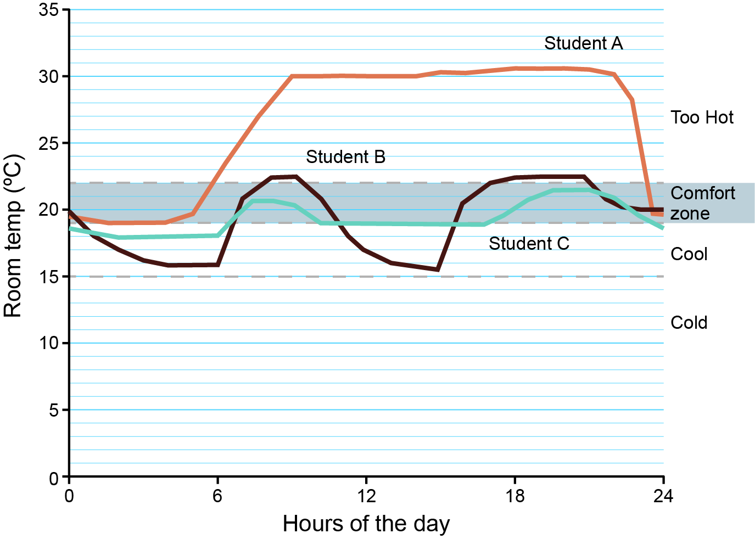
Energy usage
Three students logged the temperature of their rooms over the same 24hr period as part of a project
What are the main differences in temperature between the three homes?
What are the similarities between student B’s and student C’s data?
Which potentially uses the least energy and justify your answer?
Which home is the best insulated and why?

Slide 15
Worksheet task
Complete Task 3 on your Worksheet

Slide 16
Plenary
The bar chart shows the mass of materials used in a D&T workshop per week
What is most used material by mass?
Work out the total mass of materials used each week
What is the combined mass of metals, timbers and polymers?
What is the simplest ratio of timbers to paints and adhesives?

Slide 17
Plenary
The bar chart shows the mass of materials used in a D&T workshop per week
What is most used material by mass? Metals
Work out the total mass of materials used each week 100 kg
What is the combined mass of metals, timbers and polymers? 58 kg
What is the simplest ratio of timbers to paints and adhesives? 4 : 1

