Slide 1
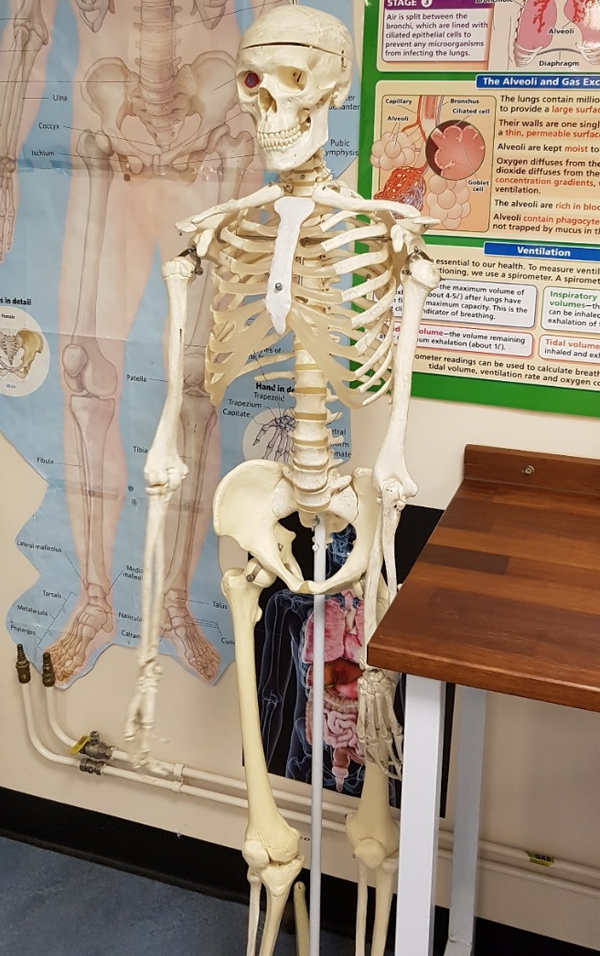
Welcome to the Biology Department!
Introducing
A level Biology

Slide 2
The following slides give an overview of the A level Biology course showing:
Topic summaries for the course
A required practical list PRESS PLAY!
An exam summary
Contact details

Slide 3
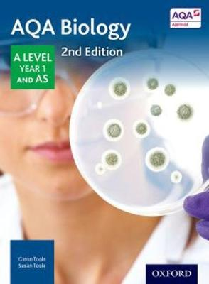
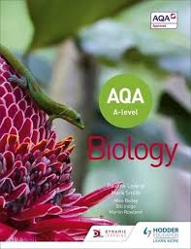
A Level details:
Pupils follow the
AQA A level
Biology course.

Slide 4
Year 1
1 Biological Molecules
1.1 Monomers and polymers
1.2 Carbohydrates
1.3 Lipids
1.4 Proteins
1.5 Nucleic acids
1.6 ATP
1.7 Water
1.8 Inorganic ions
2 Cells
2.1 Cell structure
2.2 All cells arise from other cells
2.3 Transport across membranes
2.4 Cell recognition & the immune system
3 Organisms & Exchange
3.1 Surface area & volume
3.2 Gas exchange
3.3 Digestion & absorption
3.4 Mass transport
4 Genes & Diversity
4.1 DNA, genes & chromosomes
4.2 DNA & protein synthesis
4.3 Genetic diversity: mutation and meiosis
4.4 Genetic diversity & adaptation
4.5 Species & taxonomy
4.6 Biodiversity within a community
4.7 Investigating diversity

Slide 5
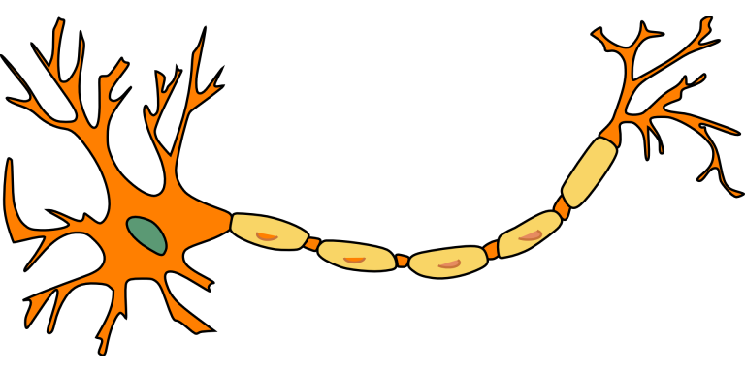
Year 2
5 Energy Transfer
5.1 Photosynthesis
5.2 Respiration
5.3 Energy & ecosystems
5.4 Nutrient cycles
6 Response
6.1 Stimulus & response
6.2 Nervous coordination
6.3 Muscles
6.4 Homeostasis
7 Genetics, Populations, Evolution & Ecosystems
7.1 Inheritance
7.2 Populations
7.3 Evolution
7.4 Populations in ecosystems
8 The Control of Gene Expression
8.1 Mutation
8.2 Gene expression
8.3 Genome projects
8.4 Gene technology

Slide 6
Practical skills:
4. Investigation into the effect of a named variable on the permeability of cell-surface membranes
5. Dissection of animal or plant gas exchange or mass transport system or of organ within such a system
6. Use of aseptic techniques to investigate the effect of antimicrobial substances on microbial growth
7. Use of chromatography to investigate the pigments isolated from leaves of different plants, eg leaves from shade-tolerant and shade-intolerant plants or leaves of different colours
8. Investigation into the effect of a named factor on the rate of dehydrogenase activity in extracts of chloroplasts
9. Investigation into the effect of a named variable on the rate of respiration of cultures of single-celled organisms
10. Investigation into the effect of an environmental variable on the movement of an animal using either a choice chamber or a maze
11. Production of a dilution series of a glucose solution and use of colorimetric techniques to produce a calibration curve with which to identify the concentration of glucose in an unknown ‘urine’ sample
1. Investigation into the effect of a named variable on the rate of an enzyme-controlled reaction
2. Preparation of stained squashes of cells from plant root tips; set-up and use of an optical microscope to identify the stages of mitosis in these stained squashes and calculation of a mitotic index
3. Production of a dilution series of a solute to produce a calibration curve with which to identify the water potential of plant tissue
Notes:
Science

Slide 7
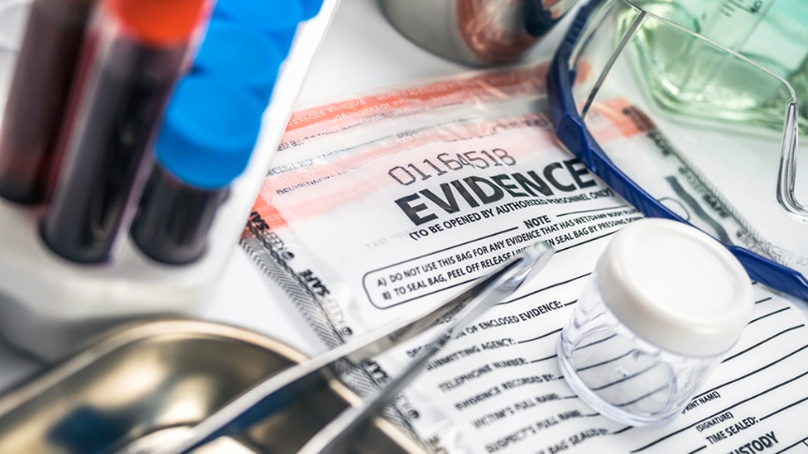
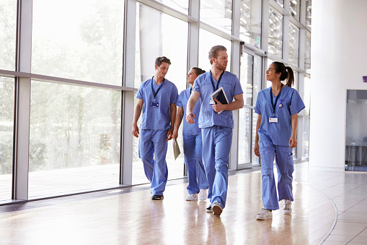
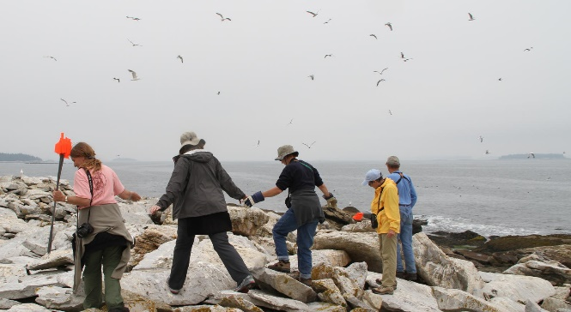
Notes:
Music

Slide 8
Exam skills:
Pupils sit 3 terminal exam papers:
Paper 1: Examines topics 1-4
Paper 2: Examines topics 5-8
Paper 3: Examines topics 1-8 including relevant practical skills
Required practical work is assessed for a range of competencies

Slide 9
More information:
If you have any further questions please do get in touch!
Pupils – chat to your teacher
Parents – please email:
treynolds@warminsterschool.org.uk

