Slide 1
Lesson 5: App development
Year 8 – Programming – Mobile app development
Notes:
Last updated: 10-05-2021
Resources are updated regularly — the latest version is available at: ncce.io/tcc.
This resource is licensed under the Open Government Licence, version 3. For more information on this licence, see ncce.io/ogl.

Slide 2
Lesson 5: App development
Objectives
In this lesson, you will
Use a block-based programming language to include sequencing and selection
Use user input in a block-based programming language
Use variables in a block-based programming language
Reflect on and react to user feedback

Slide 3
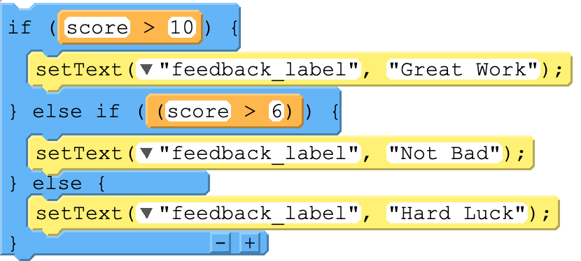
Selection
Starter activity
1
These two blocks of code have the same purpose, which is to provide feedback to the user at the end of a game.
What would each block of code do if the user scored 7?
What is the difference between the two blocks of code?
2

Slide 4
Selection
Starter activity
Would selection improve your app?
If so, where might you use it?

Slide 5
Think big! What’s your plan?
Activity 1
Step 1 .
Get into your pairs from last week and:
Open your project on code.org
Open your Project Diary at the Milestone 1 slide
Step 2 .
In your pairs, read over what you achieved last lesson and what you said you could achieve this lesson
Discuss your plan of action for this lesson with your partner
Notes:
Image source: https://pixabay.com/photos/office-business-colleagues-meeting-1209640/

Slide 6
Pair programming reminder
Activity 2
While developing your project, you and your partner will take turns to be the driver and the navigator.
You will swap roles regularly as directed by your teacher.
The driver: Your role is to control the keyboard and mouse and place the code blocks into the correct places.
The navigator: Your role is to help support the driver by watching for any mistakes, reading the instructions to the driver, or seeking support if needed.

Slide 7
App development
Activity 2
How to be successful with pair programming:
Teamwork
Driver: focus on the code and workspace
Navigator: watch the code being entered by the driver, look at previous work and examples, and research the problem
Work through your decomposed steps.
Keep an eye on the success criteria! .

Slide 8
Preparing for feedback
Activity 3
How will you be able to measure whether or not the app has met the project brief?
What you will need: .
Your app needs to be open and ready to run.
Your Project Diary should be open at the Feedback slide.
Update the table to make sure all your success criteria have been added.
1
Your project will first of all be judged by the success criteria that you have set.
2
3

Slide 9
Giving feedback
Activity 4
Read the success criteria.
Open and run the app.
Look again at the success criteria and write ‘yes’ or ‘no’ in the ‘Met?’ column.
Write constructive feedback to support the learners, letting them know what they could do to help meet the success criteria.
Complete the final box with what you think will be the most popular part of the app.
Remember:
The app you review is unlikely to be finished.
Feedback is meant to be constructive and supportive. Be kind, not critical.

Slide 10
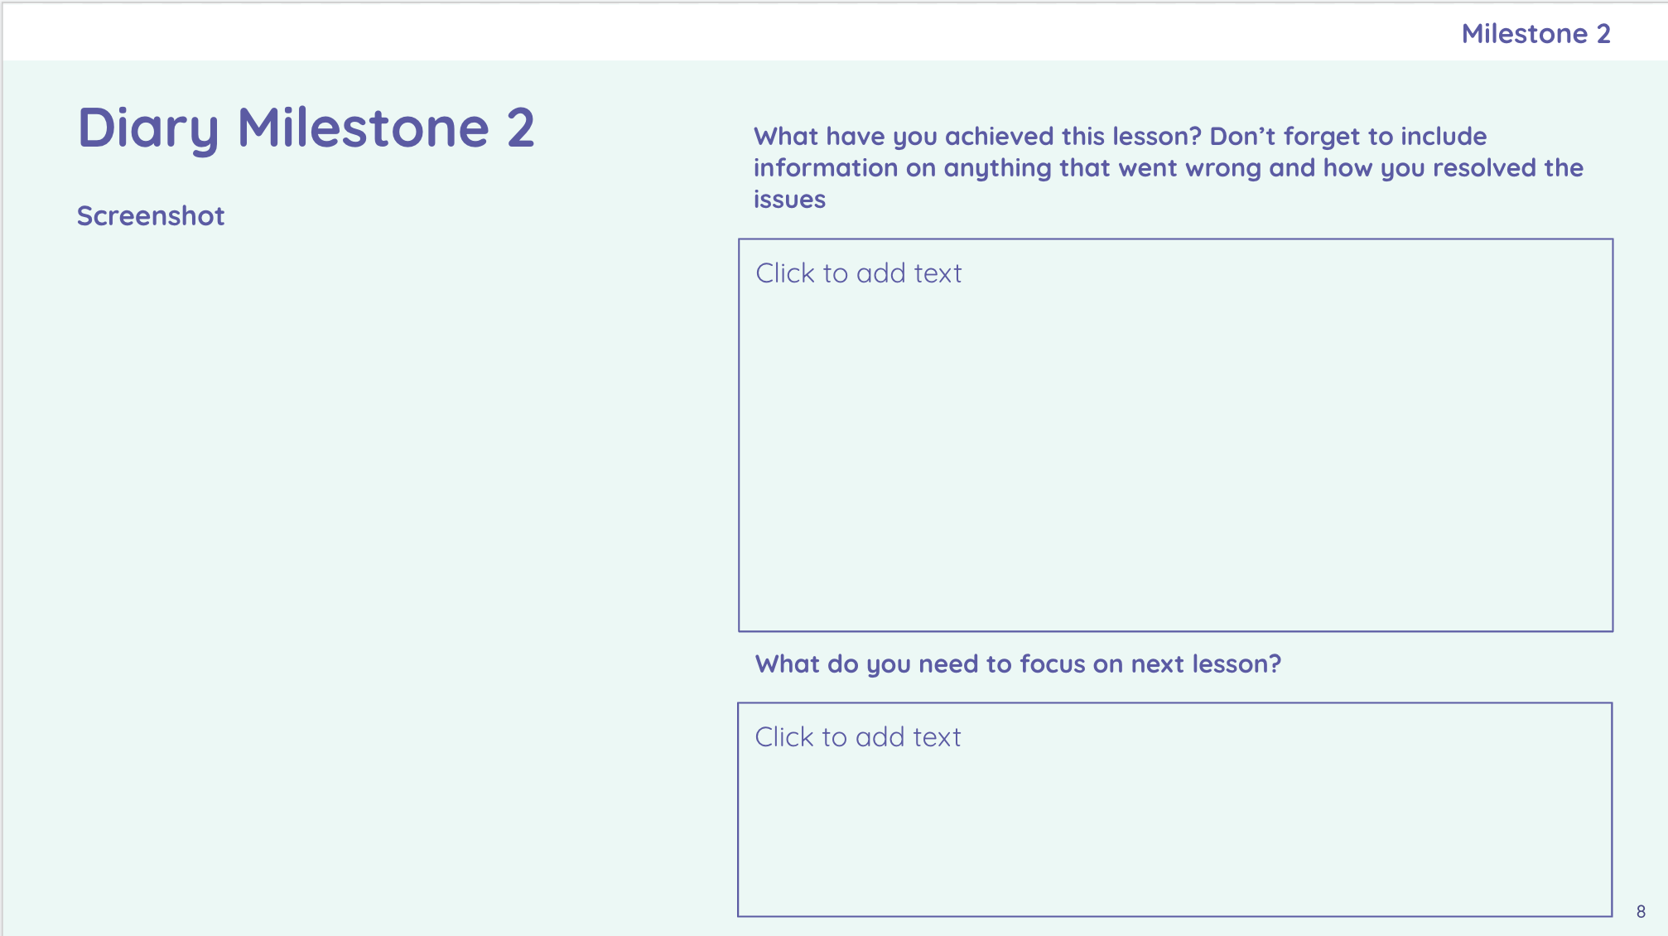
Your Project Diary: Milestone 2
Activity 5
In your pairs, you now need to reflect on what you have achieved this lesson.
Add a screenshot of your code or design window.
Describe what you have achieved this lesson and any problems you had to overcome.
Write down what you need to focus your attention on in the next lesson.
Notes:
Instruct the learners to open their project diaries and navigate to the slide “Diary Milestone 1”. They will need to place their screenshot and writing on this slide

Slide 11
Next lesson
Summary
In this lesson, you...
Developed your app further
Reviewed your classmates’ apps and gave constructive feedback
Next lesson, you will…
Respond to the feedback and finalise your apps
Submit the project and take the final unit assessment

