Slide 1
Copyright
Computer crime and cyber security
3rd Edition

Slide 2
Objectives
Learn about Copyright law, what it says and what it means
Look at examples of copyright infringement
Understand the damage that illegal copying does to individuals, companies and society
Compare copyright infringement with plagiarism

Slide 3
Copyright law
Copyright law protects the owner of a creative work from having it illegally copied
When you see the symbol and text, e.g.
© Copyright D Morris 2018
This means that you are not allowed to copy or redistribute this work

Slide 4
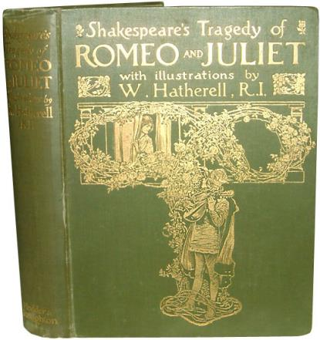
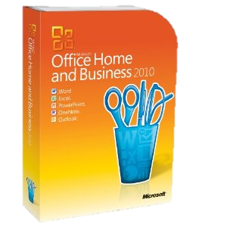
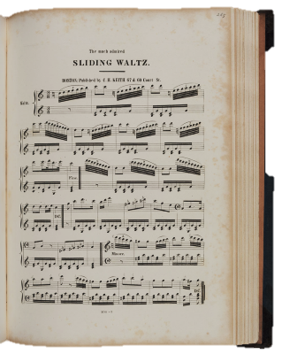
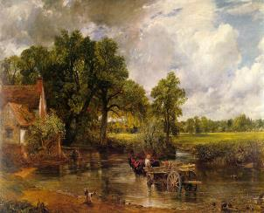
What is a creative work?

Slide 5
How long does copyright last?
In the UK, copyright lasts for the author’s lifetime plus up to 70 years after the author dies
However, if you record a performance of, say, a symphony by Mozart (who died in 1791), the performance itself is copyright

Slide 6
Online copyright infringement
Types of infringement may include:
You receive an email with a copy of a copyrighted song, and you forward this to all your friends
You pay a fee to join a file-sharing network that is not authorised to distribute copyrighted material. Then you download unauthorised copies of music or films you want
You add a music track from a CD or MP3 to a home video and publish it on YouTube

Slide 7
When is it OK to download music or a movie?
Streaming sites such as Spotify and Amazon Prime allow their members to download music and video content for personal use
Users pay a subscription
Download will expire after set length of time
Buy the CD and get the MP3 version for free

Slide 8
What’s the harm?
Music theft or “piracy” is stealing from all those in the music industry – the songwriters, recording artists, audio engineers, computer technicians, producers, publishers and others
It is estimated that the illegal downloading of films, TV programmes and music could mean the loss of 30,000 British jobs
Many artists have signed up with sites such as iTunes and Spotify to help deter piracy of their material

Slide 9
How do people get caught?
Every online computer has an “IP address”
This is like a computer fingerprint
Internet service providers (BT, Virgin, Sky) will send out advisory letters to those who download copyright material

Slide 10
What the artists say… Lady Gaga
http://www.goliath.com/music/10-musicians-who-are-pro-music-piracy/
…seems to accept music piracy and is content to make money from performing live, she has said “You know how much you can earn off touring, right? Big artists can make anywhere from $50 million for one cycle of two years’ touring. Giant artists make upwards of $100 million. Make music—then tour. It’s just the way it is (music piracy) today.”

Slide 11
What the artists say… Elton John
http://thehollywoodmag.com/rip-gooveshark-which-celebs-are-mourning-and-which-are-happy-about-the-sites-demise/
“I am of the view that the unchecked proliferation of illegal downloading (even on a “non-commercial” basis) will have a seriously detrimental effect on musicians, and particularly young musicians and those composers who are not performing artists”

Slide 12
Plagiarism
Plagiarism means copying someone else’s work and presenting it as your own
This could be ideas, words, images, music etc.
It has a lot in common with copyright infringement but is not the same thing
In general terms, plagiarism is an ethical offence and copyright infringement is a legal one

Slide 13
Worksheet 4
Complete the worksheet task

Slide 14
Software to detect plagiarism
Universities, publishers and other institutions use software to detect plagiarism
The software compares, for example, a student essay with millions of online documents to check for a marked similarity to any other work

Slide 15
Plenary
You have learned:
about copyright law, what it says and what it means
of examples of copyright infringement
the damage that illegal copying does to individuals, companies and society
the difference between copyright infringement and plagiarism

