Slide 1
Protecting personal data
Computer crime and cyber security
3rd Edition

Slide 2
Objectives
Be aware of who might hold personal data about you
Discuss the need for various organisations to hold data about you
Be aware of the possibility of identity theft
Know how to minimise the chance of identity theft

Slide 3
Who holds personal data about you?
What data do each of these organisations hold about you?
Your school
Your doctor
Your email provider
Name some other organisations that hold data about members of your family

Slide 4
What information does Google hold about you?
If, for example, you use Google Chrome or have a Gmail address, Google typically holds:
your name, birthday, all your contact names and addresses, your calendar, what mobile devices you use, all your emails, the web addresses you have typed, the sites you have searched or bookmarked and the images you have looked at …
You can check what data Google holds about you on Google Dashboard

Slide 5
Can anyone legally hold data about you?
No – there are rules and regulations about collecting and holding personal data
If a company, school, club or other organisation wants to hold personal data about you, it has to register with the Information Commissioner's Office (ICO.org.uk)

Slide 6
Information watchdog investigates ‘charity data sales’
Personal data is being shared, swapped and sold between charities and other organisations
This can result in unwanted requests for money from charities
Most at risk are vulnerable adults
Need to take care with ‘opt-in’ and ‘opt-out’ clauses

Slide 7
Worksheet 3
Complete the questions in Task 1 on the worksheet

Slide 8
General Data Protection Regulations (GDPR)
Formerly the Data Protection Act, this EU ruling specifies the rules about collecting and holding data
These include:
The data must be accurate and up to date
You have a right to see what data is held about you
The data must be protected from unauthorised access

Slide 9
Identity theft
If criminals can access your personal data, they can use it to steal your identity
They could apply for a job, a bank account or a loan, pretending to be you!
What else could they do if they have your name, address, birthdate and other personal information?

Slide 10
Worksheet 3
Complete Tasks 2 and 3 on the worksheet

Slide 11
Data harvesting tools
Using legal and freely available data harvesting tools, information can be gathered about individuals
A name, a social media profile and an email address can easily be collected
When you upload a photo to some sites, the GPS coordinates of your location may be included as a GeoTag by default
Combine that with a message “Here’s me at home having a birthday supper” and what data can be collected?

Slide 12
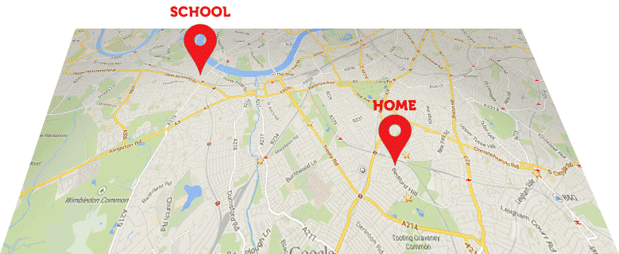
We know where you live!

Slide 13
Protect your identity, don’t be the weak point!
Turn location sharing OFF when posting photos on social media
Don’t include personal data such as date of birth, address, phone number in your profile
No password clues: comments or photos of your favourite movie, or pet dog

Slide 14
Who can see my stuff?
Social media sites provide tools to help protect your identity
Use them
Be aware of your privacy settings
Don’t add people to your network of “friends” unless you actually know and trust them
Restrict viewing of your newsfeed, never make it public
Beware of ‘shoulder surfing’ – protect your passwords and PINs from ‘casual viewers’ and hidden cameras

Slide 15
Plenary
You have learned:
who might hold personal data about you
why there is a need for various organisations to hold data about you
to be aware of the possibility of identity theft
how to minimise the chance of identity theft

