Slide 1
The Camera Obscura
Pre-A Level Photography

Slide 2
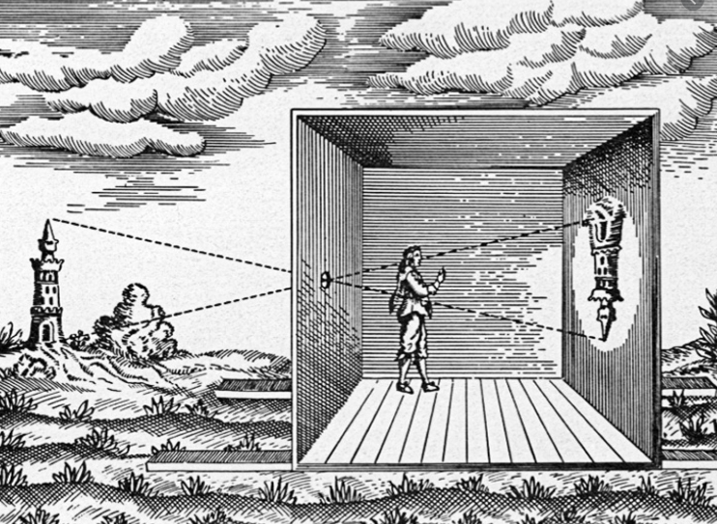
The word “camera” comes from camera obscura, which means "dark chamber" and is the Latin name of the original device for projecting an image of external reality onto a flat surface.
The modern photographic camera evolved from the camera obscura.

Slide 3
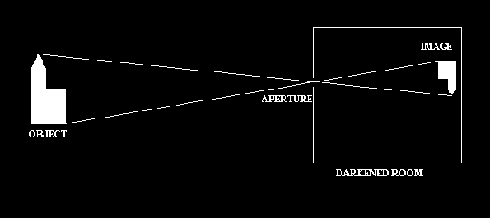
How it Works
The Camera Obscura is an ancient optical device. In its most basic form it is, quite simply, a dark room with a small hole in one wall. On the wall opposite the hole, an image is formed of whatever is outside. This image is upside-down (inverted) and back to front (laterally transposed).
The size of the hole has a great effect on the picture that is being projected. A small hole produces a sharp image, which is dim, while a larger hole produces a brighter picture which is less well focused.
This happens because light travels in straight lines, a property known as the rectilinear propagation of light.
http://www.amazingcameraobscura.co.uk/howitworks.htm

Slide 4
Using this link answer the questions
Q1. Camera obscura means?
Q2. Which century was it first used?
Q3. Who wrote the Book of Optics ?
Q4. Leonardo da Vinci talks about camera obscura in his “Codex” What was the name of this book?
Q5. What year did German astronomer Johannes Kepler uses term “camera obscura” ?
http://www.photographyhistoryfacts.com/photography-development-history/camera-obscura-history/

Slide 5
Health and Safety
When using scissors, cut in a direction away from your body and fingers, hands, arms, and legs. Do not attempt to catch a dropped pair of scissors. Let the scissors fall and then pick them up. Use scissors in well-lighted work areas.
Never look at the Sun directly or using any optical device, the Sun's rays can cause permanent damage to your eyes and even blindness.
Check your camera obscura for any sharp edges and cover with masking tape if needed before looking through it.

Slide 6
Pre-A Level Photography Success Criteria
ALL | Read the history of the Camera Obscura. Answer the questions on page 3 Attempt to make a Camera Obscura and document the process
MOST | Read the history of the Camera Obscura. Answer the questions on page 3 Successfully build your own Camera Obscura and document the process Record images using your phone
SOME | Read the history of the Camera Obscura. Answer the questions on page 3 Successfully build your own Camera Obscura and document the process Record multiple images using your phone Annotate your work with comments and reflections
Task1.
Read the article about the Camera Obscura and answer the questions on page 3
Task2.
Using the video and any resources you find on the internet attempt to construct your own Camera Obscura.
Task3.
Create a Power-Point to document the process using images and text.
Task4.
Reflection – answer these questions
Name the 3 most interesting things you have learned
How well do you feel you have approached this task.
How will you improve the way you work in the future

