Slide 1
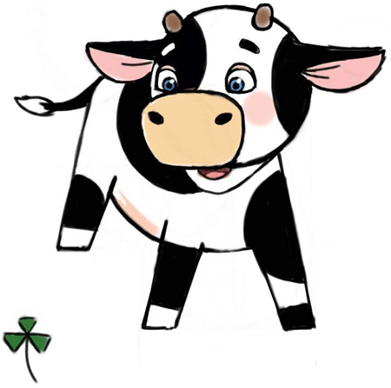
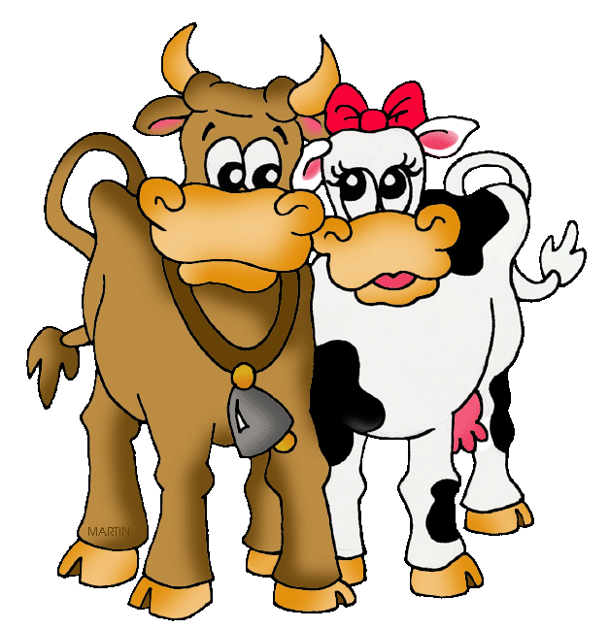
Biology Topic 4 Summary Sheet
CB4a – Human Evolution
When things change over time with better-adapted variations we call it EVOLUTION. Fossils e.g. bones, teeth can show us how organisms changed over time.
CB4b – Darwin's Theory
Charles Darwin came up with the theory of evolution.
We can think about Darwin’s ideas as a series of stages:
Genetic variation: characteristic of individuals vary
Environment change: conditions change e.g. temperature, competition
Natural Selection: survival of the fittest
Inheritance: variations passed on to offspring
Evolution: natural selection occurs over and over
and new species evolve with better adaptations.
Ardipithecus ramidus - ARDI
Australopithecus aferensis- LUCY
Homo habilis
Homo erectus
Homo sapiens
1960s: Mary and Louis Leakey discovered fossils of a more human-like species. They decided it was closely related to modern humans (Homo sapiens) so gave it the same first word for its binomial name Homo habilis
1984: Richard Leakey discovered a complete Homo erectus fossil. This proved that humans evolved in Africa.
CB4e – Genes in Agriculture and Medicine
Cross breeding organisms with desirable characteristics so that their offspring will inherit these traits.
Below is an example of selective breeding.
CB4b – Darwin’s Theory
All mammals originally came from a COMMON ANCESTOR. One species of animal which evolved to possess different characteristics.
1. Increase in milk yield wanted
2. Farmer breeds the cow that has the best milk yield with a bull whose mother had the best milk yield.
3. Farmer then breeds the female offspring with the best milk yield with a male whose mother had the best milk yield.
4. Process is repeated over many generations.
They are generally bred for:
1. Disease resistant
2. Increase yield/faster growth/better flavour
3. Coping well with environmental conditions e.g. lack of water. (drought resistant)
Concerns are:
Animal welfare e.g. chickens and cows with so much meat they can hardly stand.
A lack of variety means that all can be affected by change in conditions e.g. a new disease.
CB4d – Breeds and Varieties
Artificial selection is when humans choose certain organisms because they have useful characteristics.

Slide 2
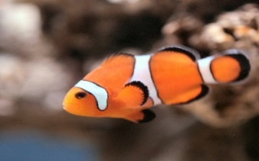
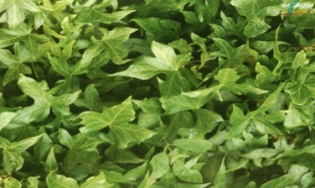
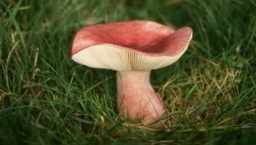
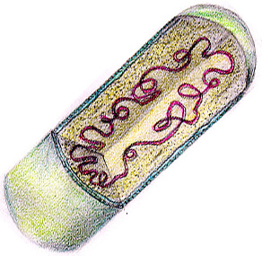
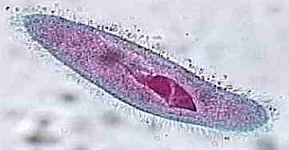
Biology Topic 4 Summary Sheet
CB4c – Classification
The analysis of the genes that organisms have has led to some scientists proposing that the classification system should now just have 3 DOMAINS:
ARCHAEA – single celled organisms, no nucleus and genes contain unused DNA sections
BACTERIA (PROKARYOTES) – single celled organisms, no nucleus but there are NO UNUSED DNA sections
EUKARYA – multicellular organisms, have a nucleus and genes contain unused sections.
CB4d – Breeds and Varieties
GENETIC ENGINEERING involves changing the DNA of one organism by inserting genes from another.
1111
Advantages | Disadvantages
Treat type 1 diabetes Stop vitamin A deficiency with Golden rice (contains beta carotene) Crops resistant to insects/drought Faster than selective breeding | Expensive Possible contamination of wild types of plants Uncertain of any long-term side effects.
1111
CB4c – Classification – the 5 kingdom system of classification
Multicellular
Cells have nuclei but no cell walls
Animals
CB4d – Breeds and Varieties
Genetic engineering of bacteria to make human insulin (Higher only).
Cut out the gene for making human insulin from a human chromosome
Do this using a restriction enzyme
Cut open the bacterium plasmid using restriction enzyme. (The plasmid
is the VECTOR as it has carried new DNA into a cell). (THIS STAGE IS
ONLY USED N THE PRODUCTION OF INSULUIN!)
Insert the gene into the plasmid. The sticky ends are complementary
and will match up. The new DNA is called RECOMBINANT DNA.
Use a ligase enzyme to join the sticky ends together.
Insert the plasmid back into the bacteria.
Multicellular, cells have nuclei and cellulose cell walls. Cells have chloroplasts for photosynthesis.
Plants
Multicellular. Cells have nuclei and cell walls but contain chitin. Feed on dead matter
Fungi
Prokaryotes
Unicellular but no nucleus
Unicellular with a nucleus
Protists

