Slide 1
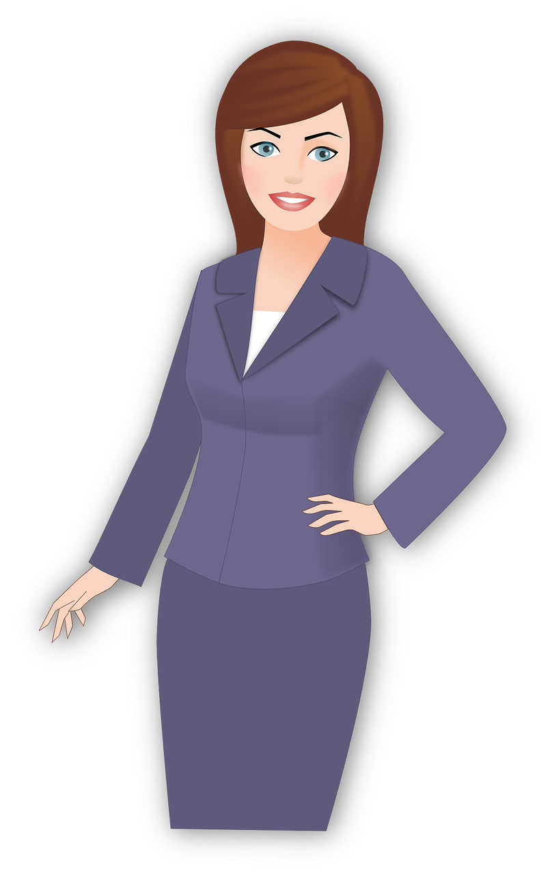
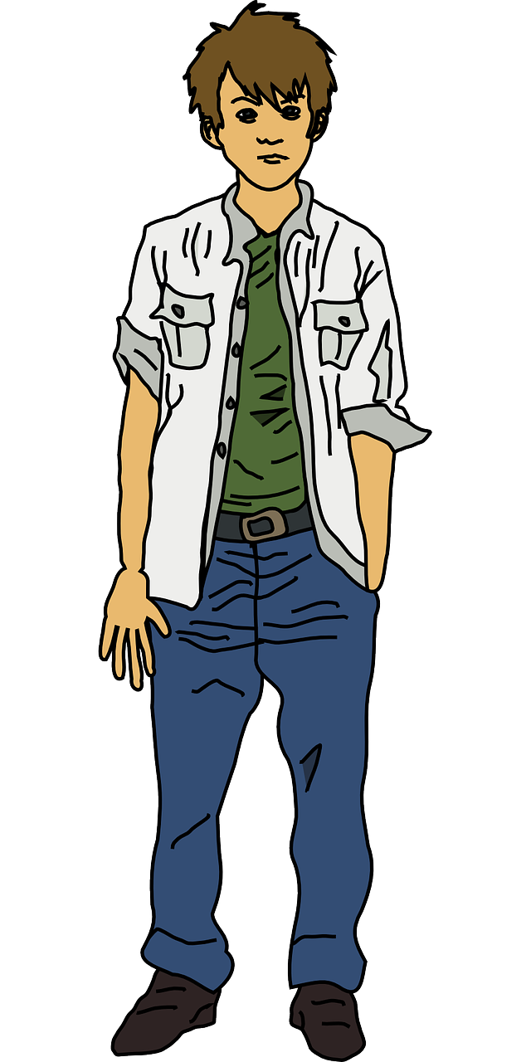
Careers: Presenting well both in person and in job applications
These two people have both turned up to an interview for the same customer-facing accountancy receptionist job.
You are the employer interviewing both of them.
Challenging: Which one do you think are you more likely to employ? Why?
More Challenging: What does this tell you about presentation skills?
Mega Challenging: What do you notice is different in the body language of the two people? Why might this be so important with regards to presentation?

Slide 2
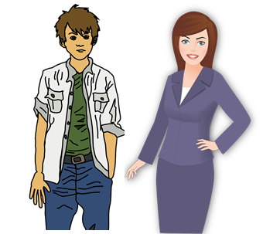
KEY WORDS:
Personal Presentation – The way we present ourselves, in how we dress, how we speak and our behaviour. We also need to
carefully think about how we present ourselves online.
Employability -how ‘employable’ you appear to be to potential employers – how much your skillset, qualifications and
personal qualities meet the vacancies you are applying for.
Learning Outcomes - Session Three:
Describe what personal presentation skills are and how these can help you make a good impression with potential employers.
Engage in activities to explore the importance of personal presentation skills and start to present ourselves professionally.
Demonstrate confidence in personal presentation skills as well as how to present the best possible in interviews and on paper.

Slide 3
We’re now going to watch a video about making a positive impression at a job interview
Task One: Investigating positive presentation skills
As we watch, make notes on one of the following areas on your sheet:
Challenge: What factors we should think about when going to a job interview?
More challenging: How we can prepare before an interview to give the best impression when we get there?
Mega challenging: Where do you think your own personal presentation strengths lie at the moment? What makes you think this?
https://www.youtube.com/watch?v=VV1cMmCKxmY

Slide 4
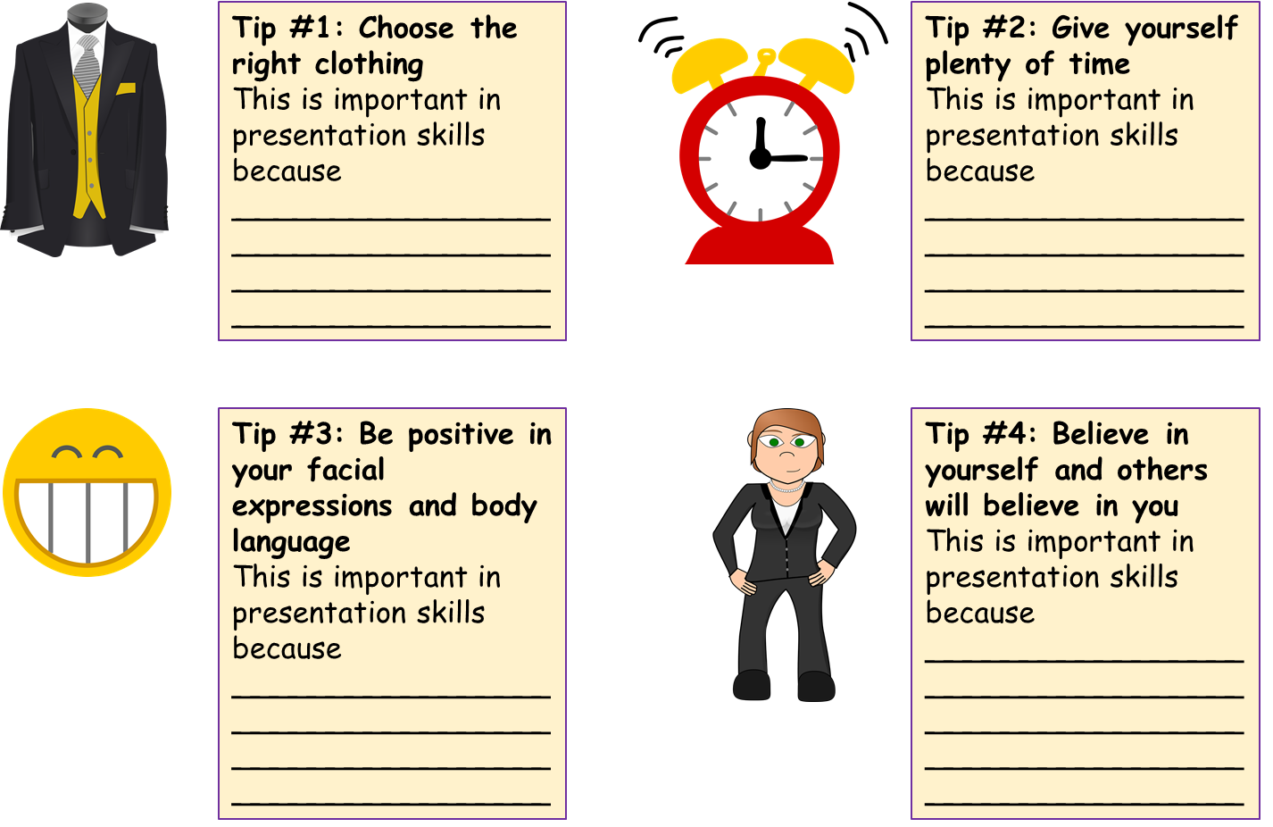
Why is it so important that employers see the best possible ‘us’?
Challenge: Complete your ideas on each of your top tips cards.
More challenging: Number each card in order of importance. Be prepared to justify your top and bottom choices.
Mega challenging: How will you or did you present these on your work experience placements? Give three examples.

Slide 5
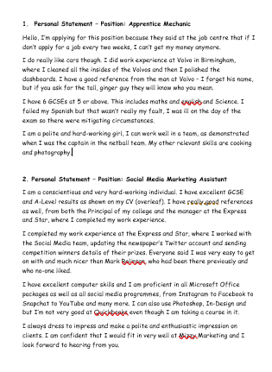
Task Two: Presenting our very best selves on paper.
We’re now going to read two cover letters from some college students who are applying for their first jobs.
Challenge: For each one, highlight or circle any statements you think are problematic and also any you think make the candidate come across well.
More challenging: For each of the above, also be prepared to explain to the rest of the class why you think this.
Mega challenging: Re-write each of the cover letters to make the candidates sound more impressive (but only based on what they’ve said – don’t lie!) Be prepared to show you work and explain what you changed.
A personal statement is a written description of your achievements, interests and skills included as part of an application for a job or a place at university or college.

Slide 6
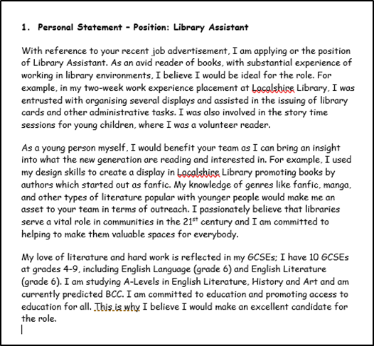
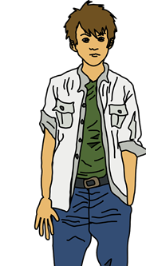
Task Two: Presenting our very best selves on paper.
We’re now going to read an example of an excellent cover letter for a job application.
Challenge: What makes this letter so much better than the other two?
More challenging: How has the writer made themselves sound appealing as a potential candidate? Explain three ways.
Mega challenging: Which part of this makes the candidate seem most appealing to an employer? Why this part in particular? How have they made their skills, qualifications and interests relevant to the position?

Slide 7
Task Three: Creating our own cover letters, for a job of our choice
Now we’ve seen what a poor and excellent cover letters look like, let’s have a go at writing our own.
When writing a cover letter, you should:
Introduce yourself, presenting your very best version of yourself.
Mention the job you're applying for and why.
Show that your skills, qualifications and experience match those needed to do the job.
Make the reader want to read your CV. Big yourself up a little.
Finish with a call to action (for example, saying you look forward to a response or job interview)
Don’t write more than one page.

Slide 8
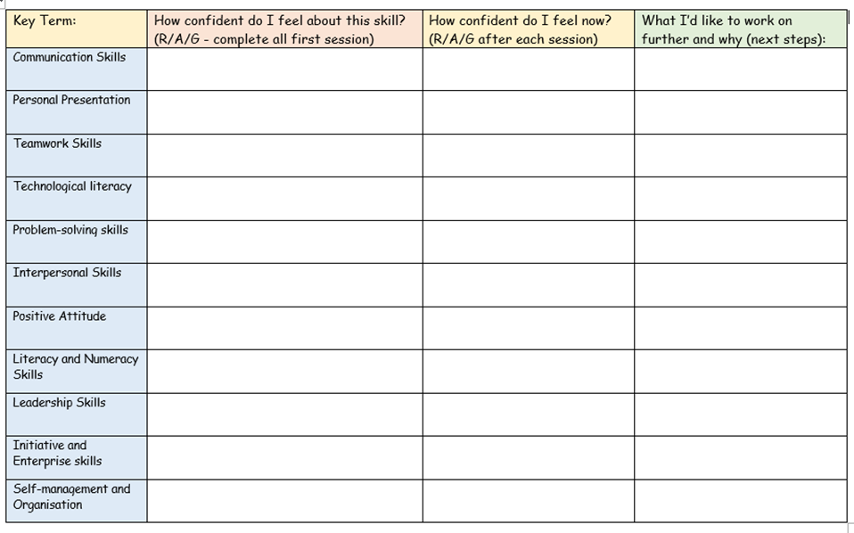
Plenary – Personal Presentation Audit:
Challenge: You will now be able to complete your employability skills competency audit for personal presentation. Label the skill as Red, Amber or Green, depending on how confident you feel about this skill now.
More challenging: Be ready to describe the reasoning behind your RAG rating to the rest of the class.
Mega challenge: Based on today’s work, explain which aspect of personal presentation you would like to work on to develop further, e.g. dressing appropriately or being punctual.
Next lesson we will be investigating which employability skills we may already have!
Created by www.ecpublishing.co.uk 2019 ©
Notes:
Created by www.ecpublishing.co.uk 2019 ©

