Slide 2
Objectives
Understand the origin and uses of AI
Understand how rules are used in AI decision making
Investigate the rules needed to solve problems including:
Classification
Navigation of a maze or road

Slide 3
AI Milestones
In which decade do you think each of the following artificial intelligence (AI) milestones happen?
The ELIZA chatbot
IBM Deep Blue beats Kasparov at chess
Computerised draughts
ALVINN self-driving car
Roomba robot vacuum cleaner
1960s
1990s
1950s
1980s
2000s

Slide 4
AI Milestones
Draughts
Self-drive
1960s
1990s
Vacuum
1950s
1980s
2000s
Chatbot
Chess

Slide 5
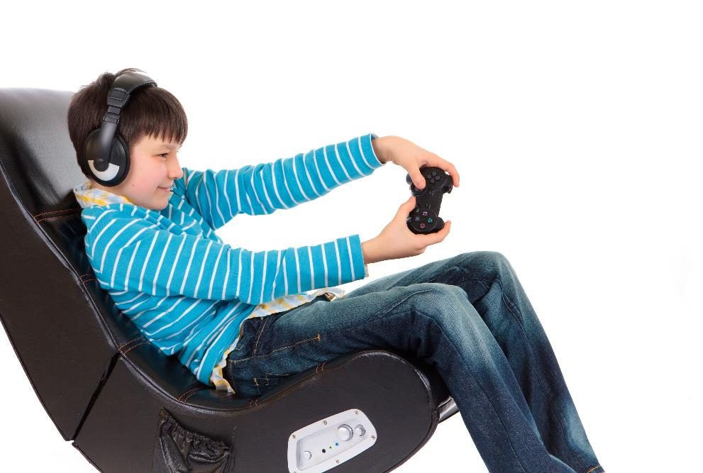
Examples of AI in use
Facial and fingerprint recognition
AI is used to detect a face or fingerprint and give access to a phone or mobile device
Language processing
Speech recognition is used by digital assistants, in online banking security and by chatbots
Gaming – computer players
Describe a computer AI player in a game that you have played

Slide 6
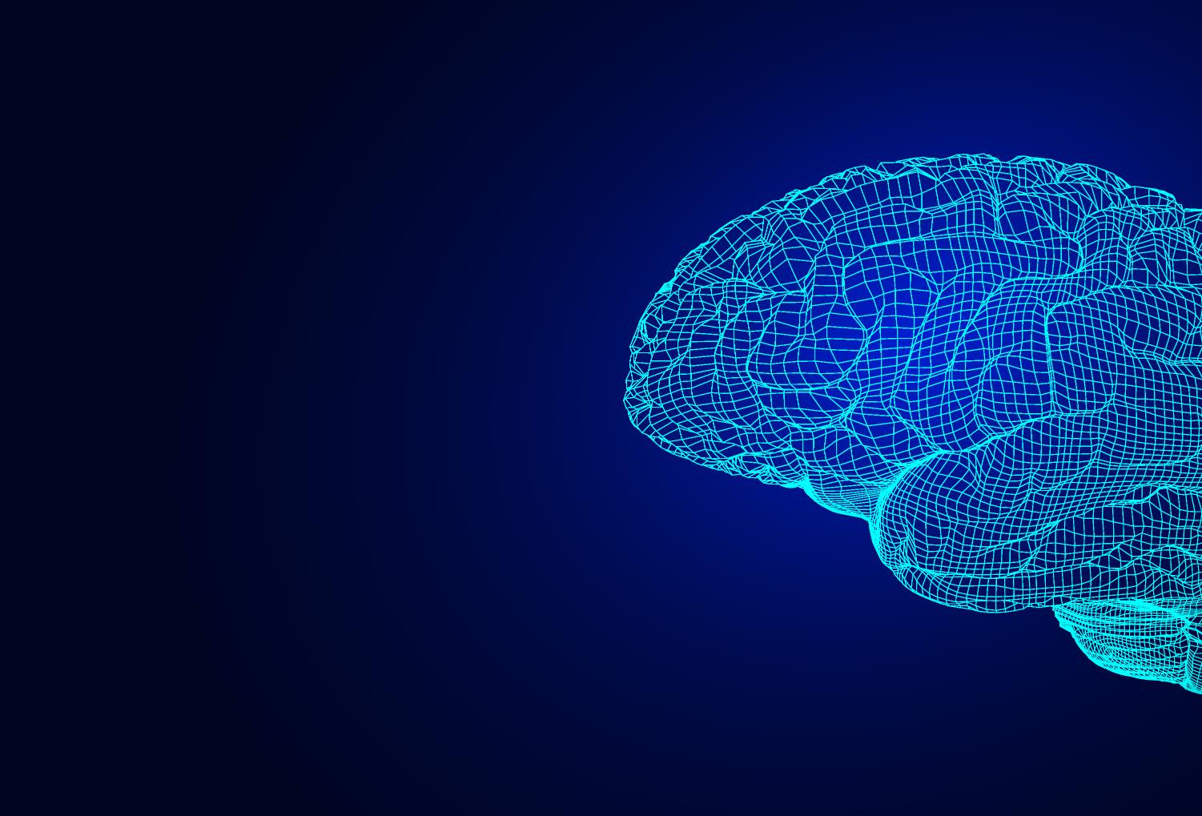
Artificial intelligence
Every year, computers become:
Faster
Smaller
Able to store more data
Better connected
What do you think artificial intelligence means?
Do you think there will come a point when computers can outperform human brains, not just at calculating, but at everything?

Slide 7
Artificial intelligence
What is artificial intelligence?
An artificial creation of human-like intelligence that can ‘think’ like humans with abilities such as learning or problem solving
Will AI ever outperform human brains?
Even the top scientists don’t yet know the answer to this
Some really difficult problems exist, such as whether a computer experience emotions such as embarrassment or kindness

Slide 8
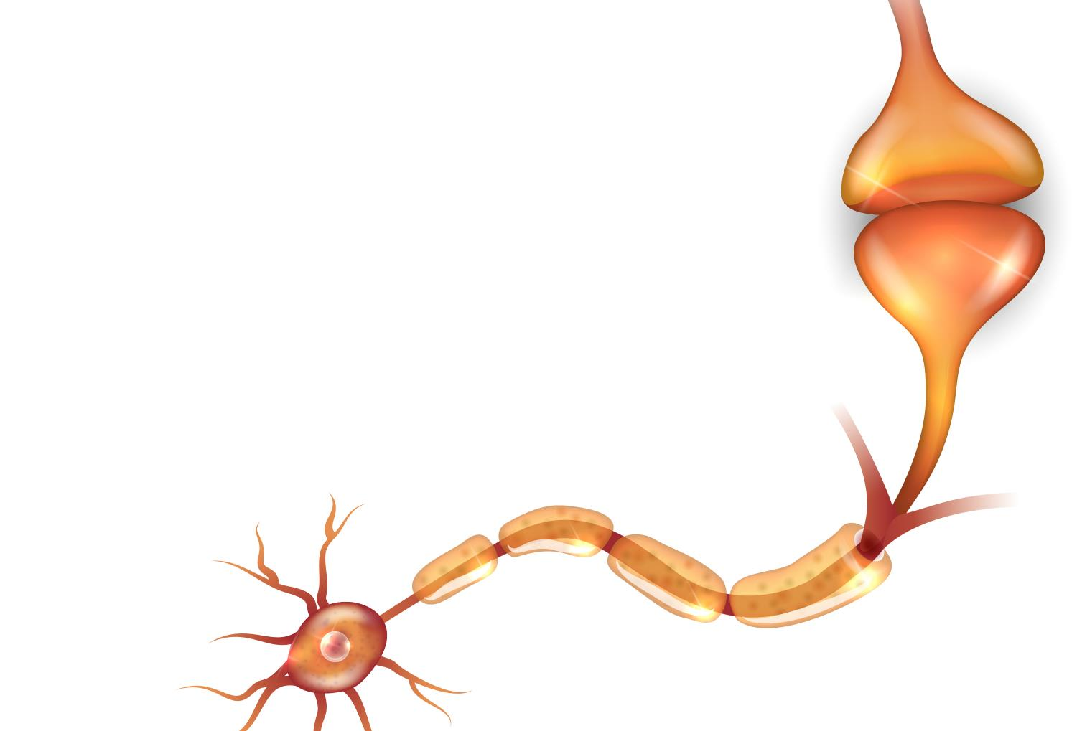
Neural networks
At the heart of AI are neural networks
Neural networks work like neurons in the brain
A neural network classifies information in the same way a human brain does
This could include classifying an animal in an image, deciding which way to turn a car, or whether an AI computer player should move towards you

Slide 9
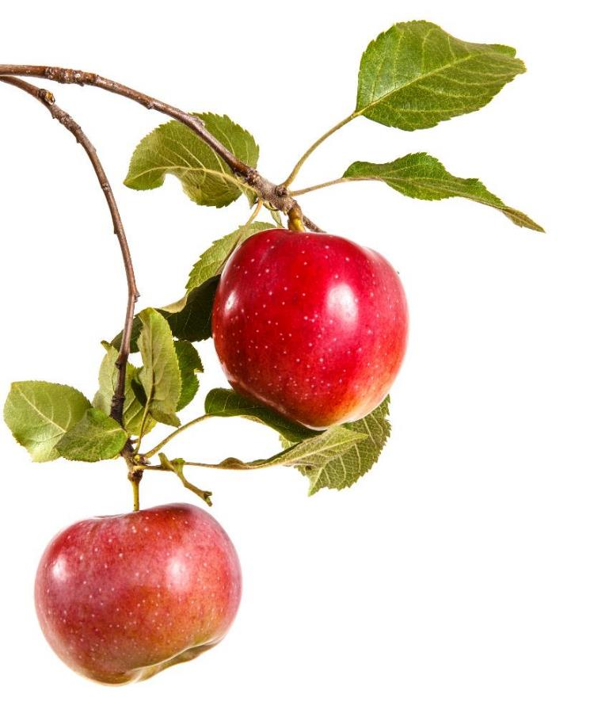
Food AI
Picking an apple seems easy to us, but it is still difficult for AI
What rules could help a robot in deciding whether something is an apple?
What rules decide if the apple is ripe?

Slide 10
Food AI
What rules could help a robot in deciding whether something is an apple?
Is it round?
Is it red?
Does it hang down from the branch?
What rules decide if the apple is ripe?
Does it reflect light? / Is it shiny?
Is it very red?
Is it large?
Is it easy for a robot to pull of the branch?

Slide 11
Worksheet 1
Complete Task 1 on Worksheet 1

Slide 12
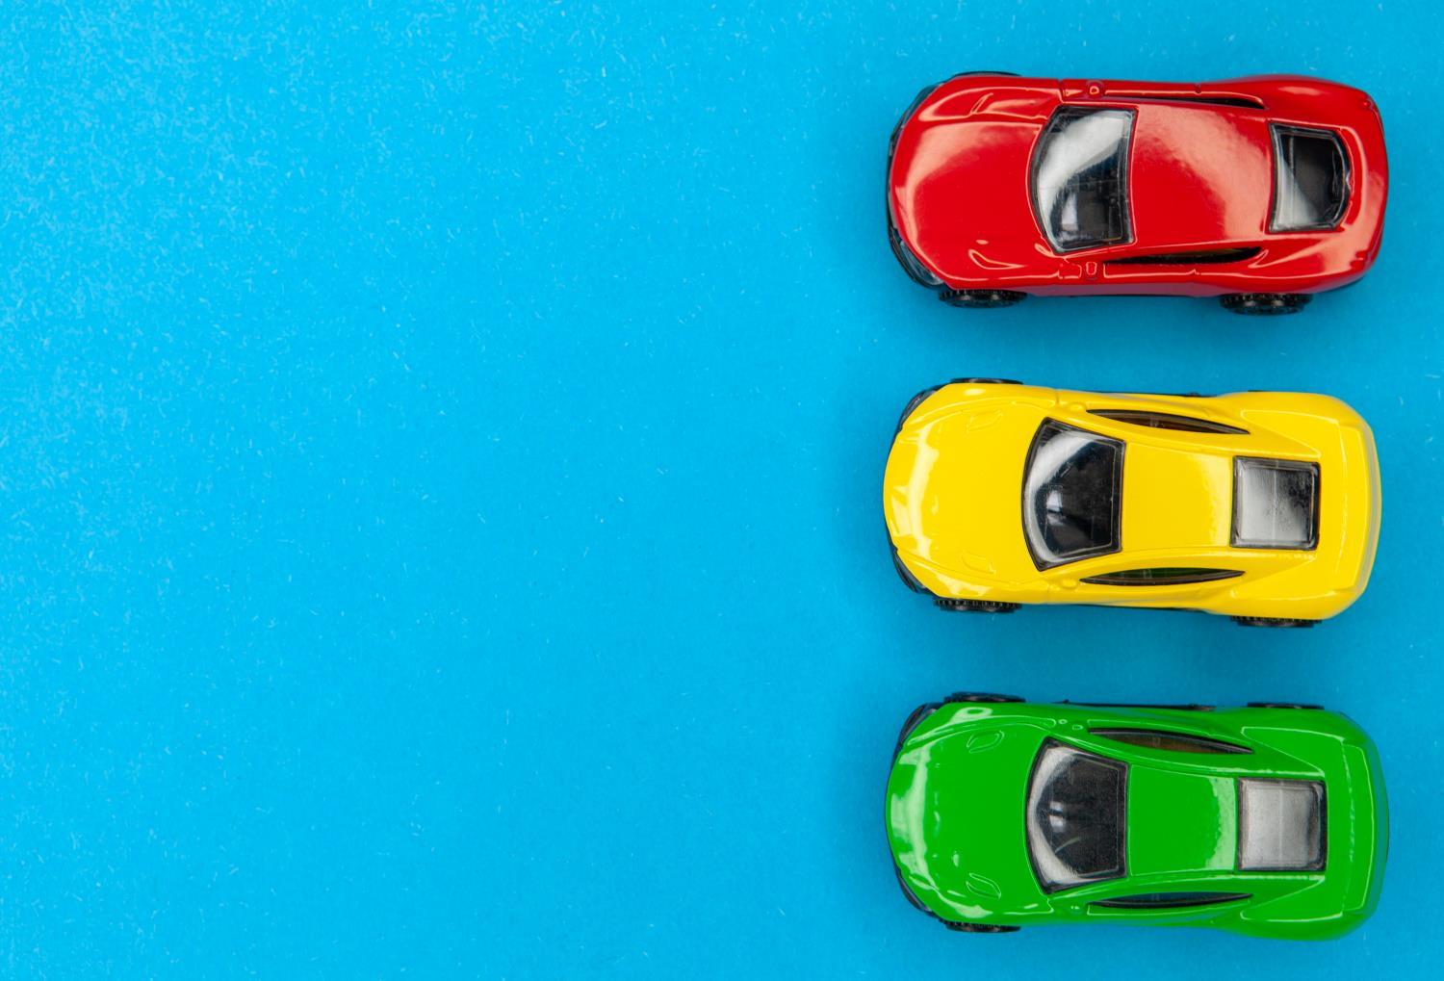
Self driving cars
Self driving cars contain very complicated sensors and AI
Imagine that you were creating a new children’s toy that could self drive around a road indoors
A small embedded computer may be added to carry out AI
A camera could then see the road, and a push button could detect if an obstacle was hit

Slide 13
Rules for turning
The toy car would need rules for its AI system
For each of the following roads, which way would you turn?
What AI rules could you give a computer to follow?

Slide 14
Rules for turning
Some suggested AI rules could be:
If road ahead go forward
If no road forward and road left then go left
If road to left and right, pick one direction randomly
If road is left, right and forwards, go forwards
If push button pressed, then stop and turn around

Slide 15
Worksheet 1
Complete Task 2 on Worksheet 1

Slide 16
Self driving decisions
The AI in a self driving car needs to consider lots of factors before making any decisions
One decision may be whether to increase or decrease speed
What other decisions may be taken?
How often do they need to be taken?

Slide 17
Self driving decisions
Some possible decisions the AI needs to make:
Decision | How often does this decision need to be made
Correct speed to drive at | Every second
Minor adjustments to stay in the correct position on the road | 0.1 seconds
Turn left / right | 0.5 seconds
Avoid an animal or pedestrian | 0.1 seconds
Avoid car in front | 0.1 seconds

Slide 18
Worksheet 1
Complete Task 3 on Worksheet 1

Slide 19
Plenary
Work with a partner to come up with ideas for each of the following:
Three uses of AI
Two rules that an AI system could use to classify good behaviour in the classroom
One meaning of the term AI
Share your ideas with the class

Slide 20
Plenary
Three uses of AI
Facial recognition, fingerprint recognition, self-driving cars, opponents in a computer game, speech recognition, robot vacuum cleaners
Two rules that an AI system could use to classify good behaviour in the classroom
Quiet when asked to be, sitting in chair (and many others)
One meaning of the term AI
Artificial intelligence – An artificial creation with intelligence like a human – it has abilities such as learning or problem solving, like a human brain has

