Slide 1
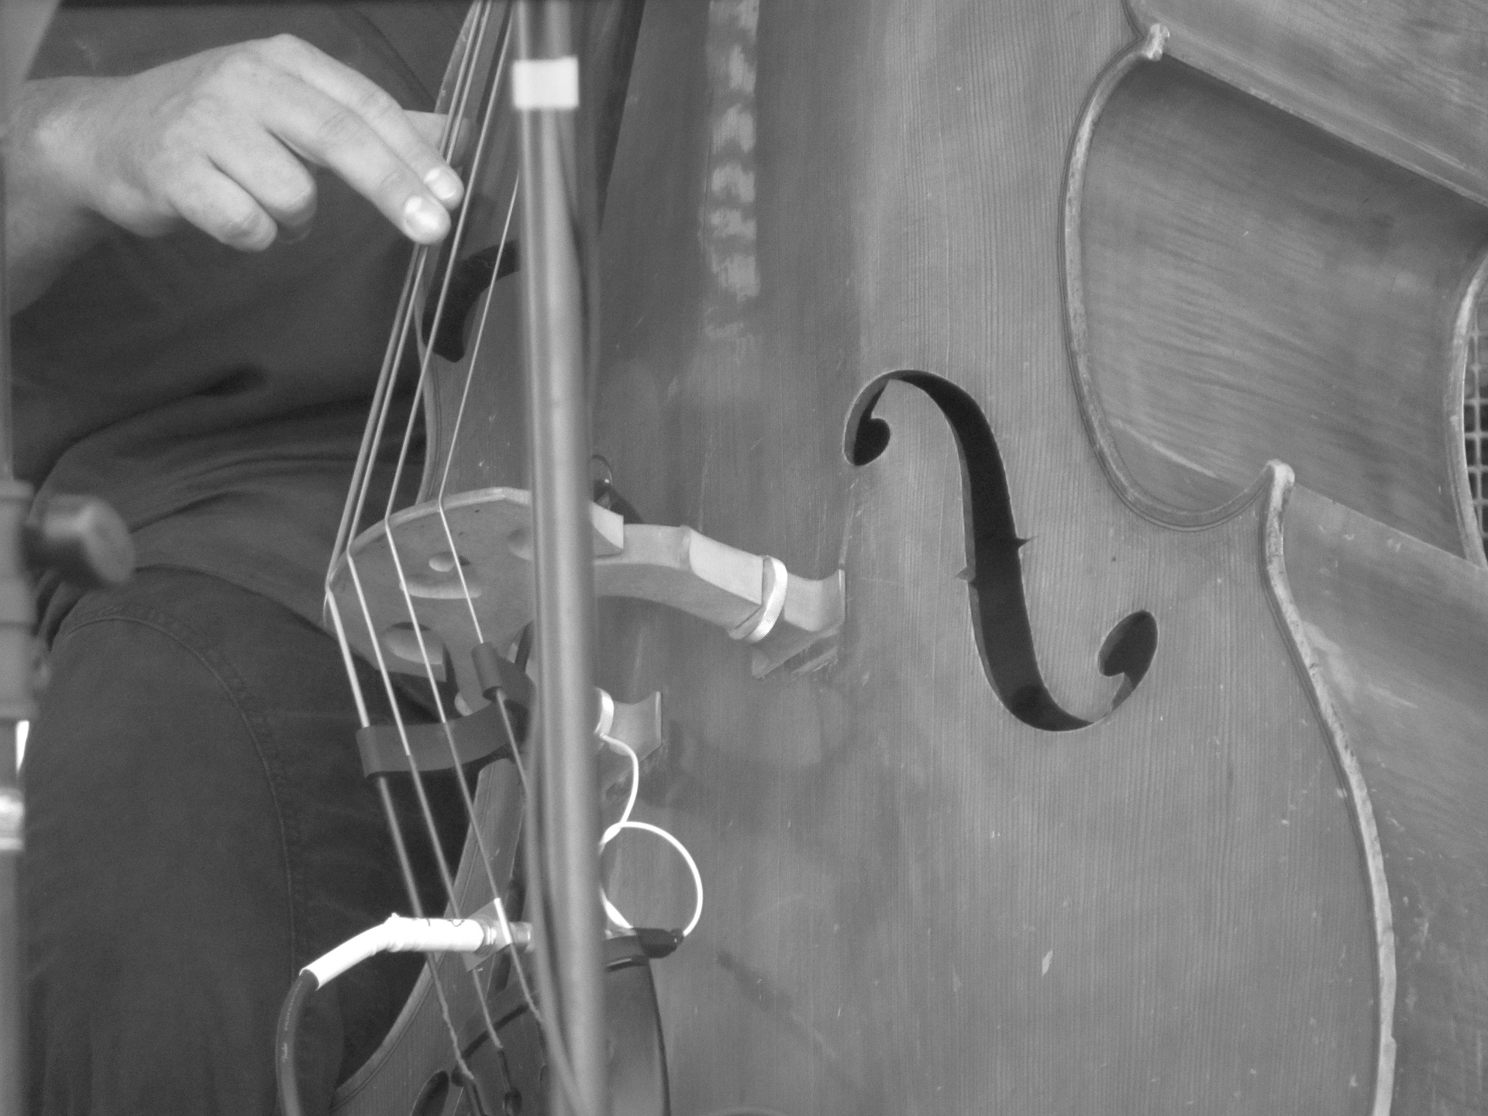
GLOSSARY TERMS give e.g for each
Bossa Nova
Samba
Glissando/Portamento
Double Stopping
Harmonics
Mordent
Acciacatura
Pause
Diminished 7th
Sylabbic
Counterpoint
Broken Chord
Rubato
Texture (H, M, P)
Structure
1-3 | Solo in Free tempo for acoustic bass guitar
4-22
23-54
55-87
88-103
104-114
COOL JAZZ
Light Tone
Relaxed Tempo
Behind Beat
Effortless Flow
Rich Harmonic Vocabulary
BOSSA NOVA
NEW TREND
Slower & more lyrical than SAMBA
Rich, Complex Harmonies
E.g Girl from Ipanema
Samba em Preludio
Commentary
Melody
Harmony
Tonality
Metre, Tempo & Rhythm
Performing Forces
Texture

Slide 2
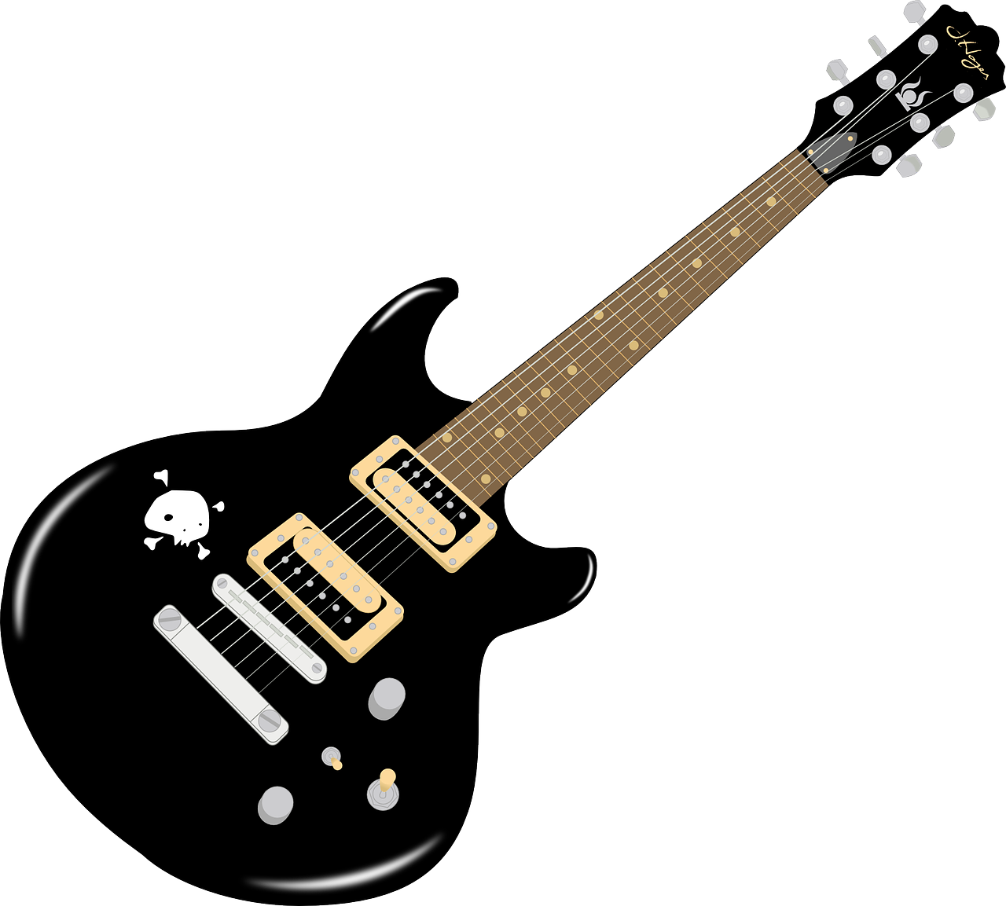
Killer Queen
GLOSSARY TERMS
Sylabbic
Bvox
Overdubbing
Close Harmony
Panning
Phase Shifter
Parallel Harmony
Transposed
Circle of 5ths
Shuffle Rhythm
Anacrusis
Middle 8
Swing Rhythm
Bell Chord
Appogiaturas
Signs and abbreviations
 | e.g b.7 | Vibrato
 | e.g b.19 | Ottova Sign
 |  | Tremolo
 |  | Pitch Bend
 |  | Slide: smooth glide from one note to next
 |  | Palm Mute: damping strings with side of hand
Melody
Harmony
Performing
Forces
Use of sequences e.g b.20
Jangle piano
Occasional inversions and 7th chords
Overdubbed guitar (Brian May)
Triangle and Wind Chimes
Mainly diatonic
Occasional chromatic chords
Melodic decoration of harmony includes prominent appogiaturas
Dominant pedal on F in the chorus at b.23-26
Extreme panning of backing vocals left b.17 right b.18)
Compound 12/8 time signature
Mainly root position triads
Guitar in parallel 3rds
Brief contrapuntal sections e.g b.62
Shuffle rhythms
Every verse and chorus starts with an anacrusis
Frequent syncopation e.g b.3
Steady 112 BPM throughout
Large range
Use of circle of 5ths
Mainly chordal e.g opening
Texture & Rhythm
Structure
Verse 1 1-14 | 6 Finger Clicks set Tempo Opening accompaniment is dry detached piano chords 12-14 could be a PRE-CHORUS | Key is E flat major but tonally ambiguous bring based on C and G B.8 Backing vocals = vocables
Chorus 14-26 | Starts with a falling 5th progression Circle of 5ths b.21 | Perfect cadence in b.17 Parallel harmonies at bar 15 (in 3 and 4 parts)
Verse 2 26-38 | Addition of a snare drum b.28 New guitar fragment b.30 Single triangle note b.29 | New backing vocals Vocal line octave lower (decorated by descending chromatic bass guitar scale)
Chorus 38-50 | Moves to B flat major
Verse 3 51-61 | Starts like v.1 but with melody on high register guitar not voice | (Chorus 69-78) is a repeat of the first chorus
Outro 79-end | Panned guitar | Contrapuntal texture Perfect cadence leads to tonic chord to end on

Slide 3
Killer Queen
GLOSSARY TERMS
Sylabbic
Bvox
Overdubbing
Close Harmony
Panning
Phase Shifter
Parallel Harmony
Transposed
Circle of 5ths
Shuffle Rhythm
Anacrusis
Middle 8
Swing Rhythm
Bell Chord
Appogiaturas
Signs and abbreviations
 | e.g b.7 | Vibrato
 | e.g b.19 | Ottova Sign
 |  | Tremolo
 |  | Pitch Bend
 |  | Slide: smooth glide from one note to next
 |  | Palm Mute: damping strings with side of hand
Texture & Rhythm
Melody
Harmony
Performing
Forces
Use of s__________ e.g b.20
Mainly chordal e.g ______________
J_______ piano
Occasional inversions and 7th chords
O__________ guitar (Brian May)
Triangle and Wind Chimes
Mainly diatonic
Occasional c___________ chords
M_______ decoration of harmony includes prominent a____________
Dominant pedal on ___ in the chorus at b.23-26
Extreme panning of backing vocals left b.____ right b.__)
C__________ 12/8 time signature
Mainly r_____ ________triads
Guitar in p_________ 3rds
Brief ___________ sections e.g b.62 (texture)
S_______ rhythms
Every verse and chorus starts with an a___________
Frequent s___________ e.g b.3
Steady 112 _ _ _ throughout
Large range
Use of circle of _____ e.g ___
Structure
Verse 1 1-14 | 6 Finger Clicks set ________ Opening accompaniment is dry _________ piano chords _______ could be a PRE-CHORUS | Key is E flat major but tonally ________ being based on C and G B.8 Backing vocals = v_________
Chorus 14-26 | Starts with a falling 5th progression Circle of 5ths b._______ | Perfect cadence in b.___ Parallel harmonies at bar _____ (in 3 and 4 parts)
Verse 2 26-38 | Addition of a snare drum b._____ New guitar fragment b._____ Single triangle note b._____ | New backing vocals Vocal line octave _______(decorated by descending _________ bass guitar scale)
Chorus 38-50 | Moves to B ________ (key)
Verse 3 51-61 | Starts like v.1 but with melody on high register _____ not voice | (Chorus 69-78) is a repeat of the first chorus
Outro 79-end | Panned ___________ | C__________ texture ________ cadence leads to tonic chord to end on

