Slide 1
Half/Full Adders
Appendix Module 2

Slide 2
Binary Addition Recap
Simple Rules of Binary Addition over 1 or 2 Bits
Notes:
Show how 0+1 = 1, 1+1= s0, C1, 1+1+1 = s1 c1

Slide 3
Binary Addition Recap
If All 0 then Sum is 0, Next Carry is 0
If there’s ONE ‘1’ then Sum is 1, Next Carry is 0
If there’s TWO ‘1’ then Sum is 0, Next Carry is 1
If there’s THREE ‘1’ then Sum is 1, Next Carry is 1
Worked Example:
TASK (2mins): Create Revision
Flash Card of the rules!
CARRY
A | 0 | 1 | 1 | 0 | 1
B | 1 | 0 | 1 | 1 | 0
SUM

Slide 4
Binary Addition Rules Recap
If All 0 then Sum is 0, Next Carry is 0
If there’s ONE ‘1’ then Sum is 1, Next Carry is 0
If there’s TWO ‘1’ then Sum is 0, Next Carry is 1
If there’s THREE ‘1’ then Sum is 1, Next Carry is 1
Worked Example:
CARRY 1 | 1 | 1 | 0 | 0 | -- / 0
A 0 | 0 | 1 | 1 | 0 | 1
B 0 | 1 | 0 | 1 | 1 | 0
SUM 1 | 0 | 0 | 0 | 1 | 1

Slide 5
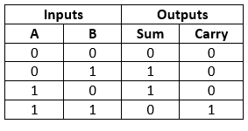
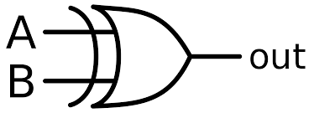
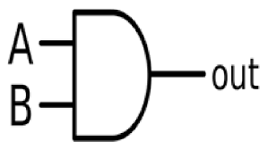
The Half Adder
Ignoring the Carry,
what sort of Logic Gate gives the “SUM” output?
What sort of Logic Gate gives the “Carry” output?

Slide 6
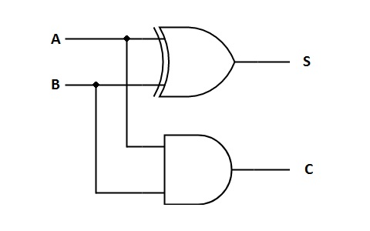
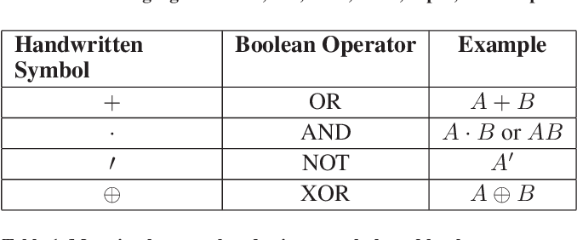
Whiteboards!
Draw the complete logic circuit and then write out the Boolean Equations for the HALF ADDER. The truth table for the HALF ADDER is shown below:
S = ?
C = ?
HINT:

Slide 7
Whiteboards!
Draw the complete logic circuit and then write out the Boolean Equations for the HALF ADDER. The truth table for the HALF ADDER is shown below:
S = A ⊕ B
C = A ● B

Slide 8
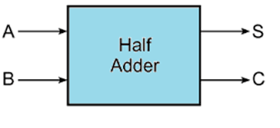
A Half Adder – Flash Card
S = A ⊕ B
C = A ● B

Slide 9
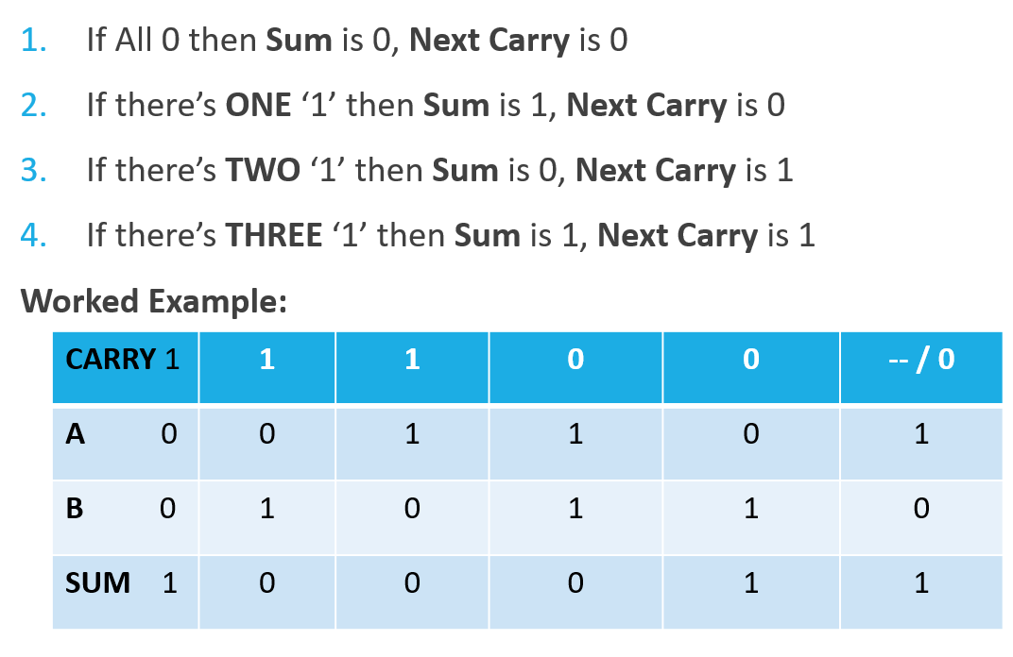
The Full Adder
Like we showed in the worked example, we need to be “aware” of the carry from the last adder…

Slide 10
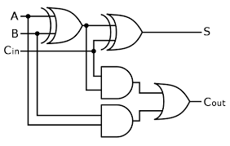
The Full Adder – Worksheet Activity (5m)
INPUTS |  |  | OUTPUTS
A | B | C_IN | SUM | C_OUT
0 | 0 | 0 | 0
0 | 0 | 1 |  | 0
0 | 1 | 0 | 1
0 | 1 | 1
1 | 0 | 0 | 1
1 | 0 | 1 |  | 1
1 | 1 | 0 | 0 | 1
1 | 1 | 1 | 1

Slide 11
The Full Adder - Activity
INPUTS |  |  | OUTPUTS
A | B | C_IN | SUM | C_OUT
0 | 0 | 0 | 0 | 0
0 | 0 | 1 | 1 | 0
0 | 1 | 0 | 1 | 0
0 | 1 | 1 | 0 | 1
1 | 0 | 0 | 1 | 0
1 | 0 | 1 | 0 | 1
1 | 1 | 0 | 0 | 1
1 | 1 | 1 | 1 | 1

Slide 12
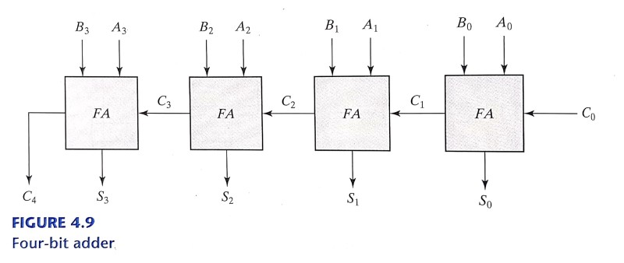
A Complete “4 Bit” Ripple Adder
INPUTS |  |  | OUTPUTS
C_IN | A | B | SUM | COUT
0 | 0 | 0 | 0 | 0
0 | 0 | 1 | 1 | 0
0 | 1 | 0 | 1 | 0
0 | 1 | 1 | 0 | 1
1 | 0 | 0 | 1 | 0
1 | 0 | 1 | 0 | 1
1 | 1 | 0 | 0 | 1
1 | 1 | 1 | 1 | 1
CARRY |  |  |  |  | 0
A |  | 0 | 1 | 0 | 1
B |  | 1 | 0 | 1 | 1
SUM
<- Using Whiteboards Complete

Slide 13
Plenary / Quiz
How many Full or Half Adders (Maybe a combination?) are needed to work on a FOUR bit wide addition? And Why?
From Memory, draw the HALF ADDER Logic Circuit

Slide 14
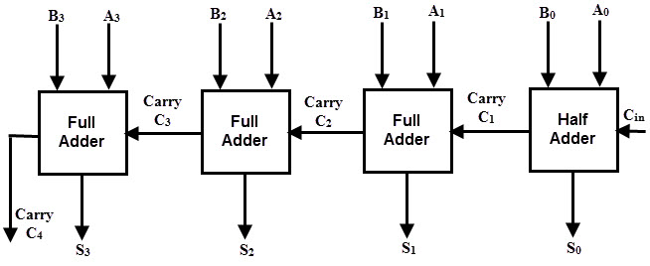
Plenary / Quiz
How many Full or Half Adders (Maybe a combination?) are needed to work on a FOUR bit wide addition? And Why?
From Memory, draw the HALF ADDER Logic Circuit:
HOMEWORK
WorkSheets from the Appendix B Adders Section

