Slide 1
Creating a financial model
Spreadsheet modelling
3rd Edition

Slide 2
Objectives
Create a financial model to predict the profit on the sale of merchandise
Make the model as realistic as possible based on known sales figures and prices
Consider ways of increasing profit to meet a given target

Slide 3
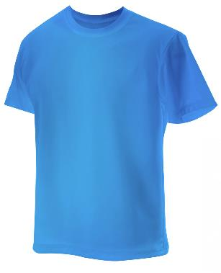
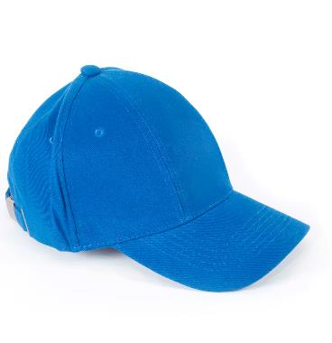
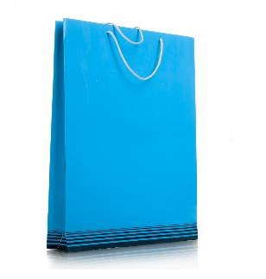
What is merchandise?
T shirts
Baseball caps
Posters
Have you any other ideas?

Slide 4
Research some products
Have you ever bought merchandise that promotes a particular artist or group?
Use the Internet to get ideas for three products you could sell for TNBT
Record your results in Worksheet 2, Table 1

Slide 5
Creating a financial model
StarCo wants to sell branded merchandise associated with TNBT to generate income, and you are in charge!
You have the sales figures from Series 1 in the USA to help you with their planning
You need to decide on what products to sell and what the prices should be
You also need to estimate likely sales quantities, based on the US figures

Slide 6
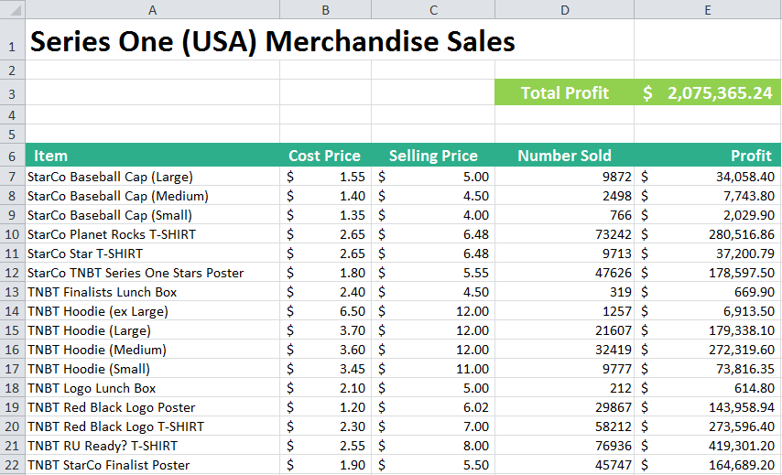
Your model will be based on sales figures from Series One (USA)

Slide 7
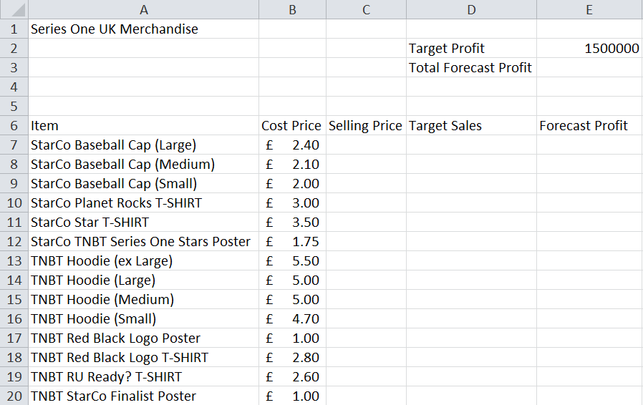
Spreadsheet for UK merchandise

Slide 8
Complete the spreadsheet
Use the instructions on Worksheet 2, Task 2 to fill in columns C, D and E
Does your total forecast profit reach the target?
Next lesson you will add the products you have selected to help StarCo hit their target
Format your spreadsheet if you have time

