Slide 1
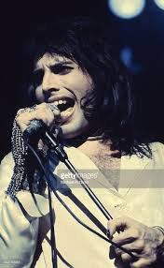
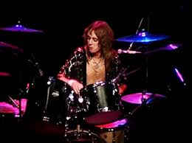
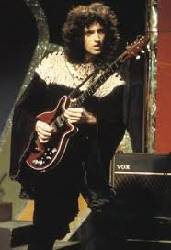
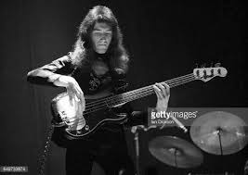
1974
Freddie Mercury
(Vocals, lyrics)
Killer Queen
By Queen
Brian May
(electric guitar)
Roger Taylor
(drum kit)
From their 3rd studio Album
Brian Deacon
(bass)

Slide 2
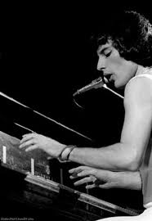
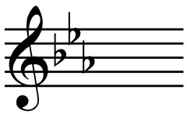
Verse 1: Bars 2 (3) – 6 (3)
4 bar long phrase
Sounds like the song starts in C minor
Anacrusis
Ambiguous tonality, however the song is in E flat major. This could reflect the Killer Queen having no clear roots.
Jangle piano & piano short detached chord accompaniment
Unusual start

Slide 3
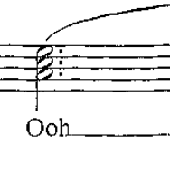
Verse 1: Bars 6 (4) - 11
5 bar long phrase
Harmonic rhythm – 2 chords per bar
Anacrusis
Metre change
Multi-tracked backing vocables harmonise lead vocals
Descending chromatic sequence (panned to left)
Bass & drum kit enter bar 6
Vibrato

Slide 4
Verse 1: Bars 12 – 14 (3)
Harmonic sequence
The 1 bar long chord sequence (which is a chord V to chord I), moves up by a 3rd
V - I
V - I
V - I
3 bar long phrase
Falsetto!

Slide 5
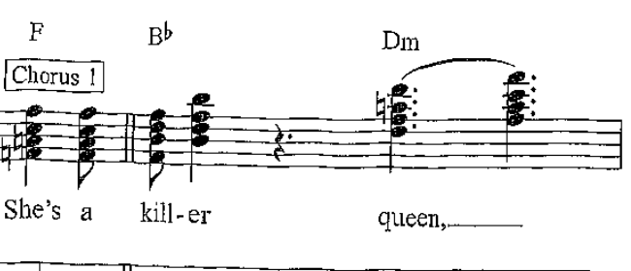
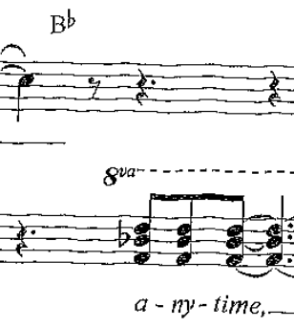
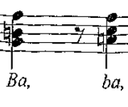
Chorus 1: Bars 14 (4) – 19 (3)
B flat major (dominant to the tonic key E flat major)
Portamento
Multi-tracked vocals produce parallel harmonies
Falsetto & Panning
Anacrusis
D minor
C major
Bvox vocables
5 bar long phrase
Flanger effect

Slide 6
Chorus 1: Bars 19 (3) – 23 (2)
Circle of fifths
A chord progression whose roots are each a 5th lower than the previous chord (usually seen as a falling 5th then a rising 4th)
Rising 4th (A is the dominant – a fifth from D)
Portamento
Rising 4th (G is the dominant – a fifth from C)
Anacrusis
Falling 5th (D is the dominant – a fifth from G)
3 bar long phrase
Vocal melody in bar 20 is taken and transposed from verse 1 bar 12. This is then repeated as a sequence in bar 21.

Slide 7
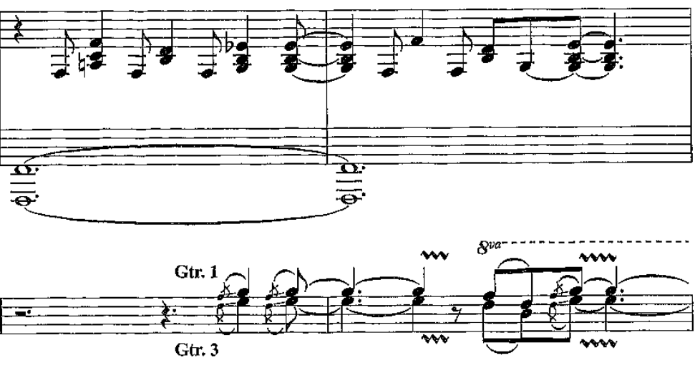
Instrumental bars 23 - 26
Piano vamp accompaniment
Tremolo on cymbal
Slide
Vibrato
3rd apart

Slide 8
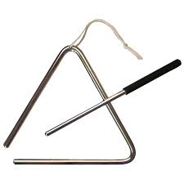
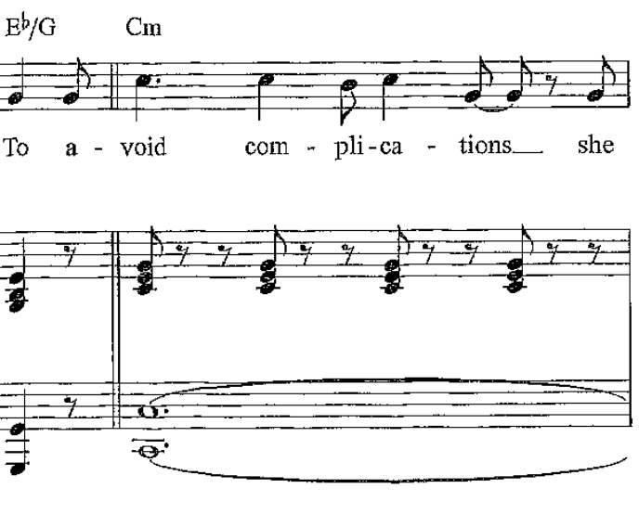
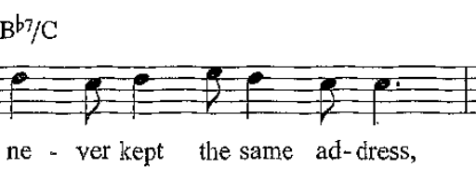
Verse 2 bars 26 (4) – 30
Anacrusis
Drum roll
Pedal note
4 bar long phrase
Bass & drum kit enter earlier in this verse compared to verse 1

Slide 9
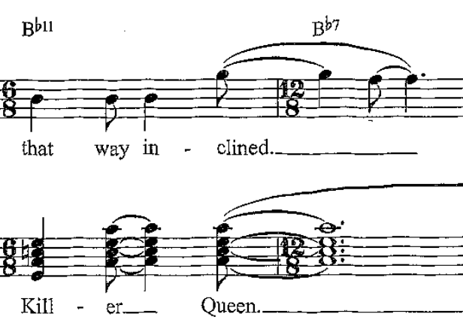
Verse 2 bars 31 – 35 (2)
5 bar long phrase
Metre change
Multi-tracked 4 part bvox
Descending chromatic sequence (panned to left)

Slide 10
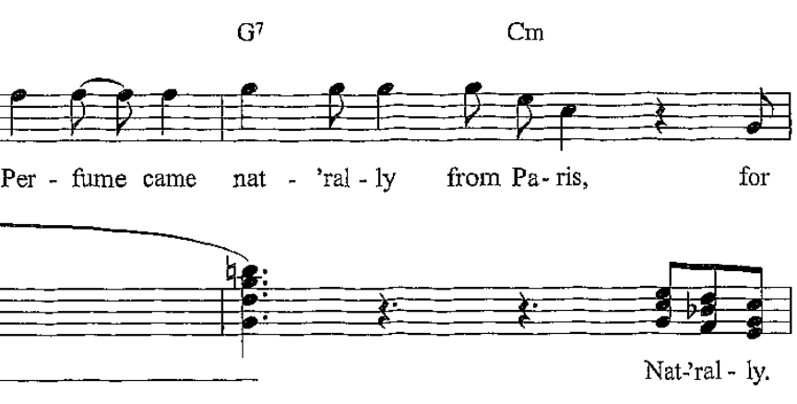
Verse 2 bars 35 (3) – 38 (30)
3 bar long phrase
Harmonic sequence (same as Verse 1)
V - I
V - I
V - I
Spoken lyrics to add dramatic effect

Slide 11
Chorus 2: Bars 38 (4) – 43
B flat major (dominant to the tonic key E flat major)
Same as Chorus 1 but slightly shorter as only uses the first 5 bar phrase leading to…
Portamento
Anacrusis
D minor
C major
Falsetto & Panning
Bvox vocables
5 bar long phrase
Flanger effect

Slide 12
Guitar solo bars 44 – 46(3)
Guitar takes over from vocals (Chorus 2– Verse 3)
4 bar long phrase
Cm instead of C harmony (as in the chorus)
Mimics part of the chorus (bar 20 & 21).

Slide 13
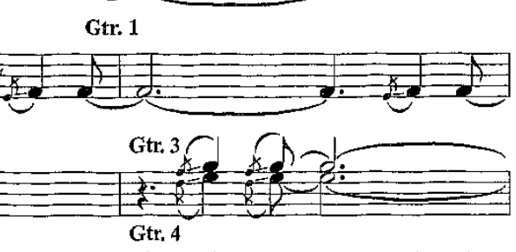
Guitar solo bars 46(3) - 50
Pitch bend – a small slide in pitch away from the note and back again.
3 bar long phrase
Slide
Multi-tracked guitar parts
3rd apart
Slide
Use of syncopation in Gtr. 3 & 4

Slide 14
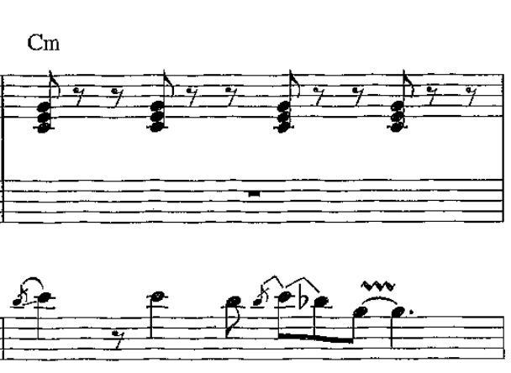
Guitar solo bars 50 - 54
4 bar long phrase
Uses same chord sequence as the beginning of the verses
The melody here is an embellished (slides, vibrato and pitch bends) version of the verse. There are some additional notes and rhythmic changes also.

Slide 15
Guitar solo bars 55 - 59
5 bar long phrase
Continues to use the same chord sequences as the verses
Bell chords
3 Gtr. parts come together
Imitation

Slide 16
Guitar solo bars 59 – 61(3)
Extended imperfect cadence (I – V)
I - V - V
2 bar long phrase

Slide 17
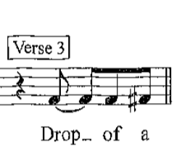
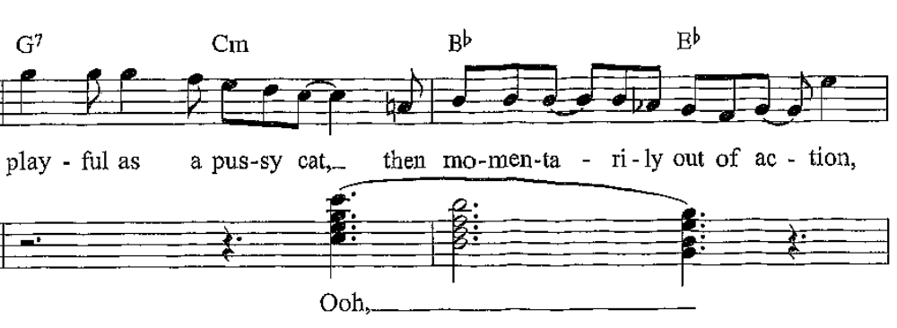
Verse 3 bars 61 (4) – 64
3 X 1 bar long phrase
Anacrusis
Response
Wah-wah effect

Slide 18
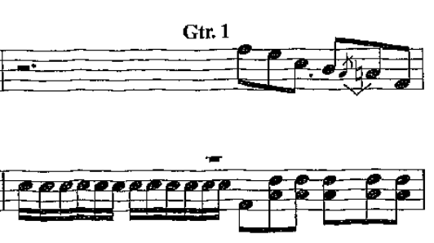
Verse 3 bars 67 - 69
3 bar long phrase
Climax of the song on ‘wild’ = 4 part falsetto vocals followed by response by instruments
Snare drum semi-quavers

Slide 19
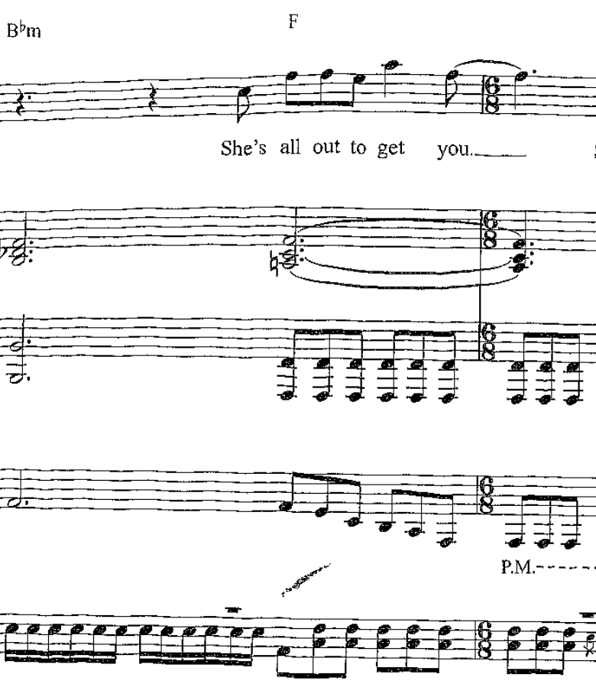
Verse 3 bars 67- 69
1 bar long phrase
Metre change
Palm mute

Slide 20
Chorus 3: Bars 69 (2) - 74
B flat major (dominant to the tonic key E flat major)
Portamento
Same as previous choruses with an extra bar.
Anacrusis
D minor
C major
Falsetto & Panning
Bvox vocables
5 bar long phrase
Flanger effect

Slide 21
Chorus 3: Bars 74 (4) – 78
Circle of fifths
A chord progression whose roots are each a 5th lower than the previous chord (usually seen as a falling 5th then a rising 4th)
Rising 4th (A is the dominant – a fifth from D)
Portamento
Rising 4th (G is the dominant – a fifth from C)
Anacrusis
Falling 5th (D is the dominant – a fifth from G)
3 bar long phrase

Slide 22
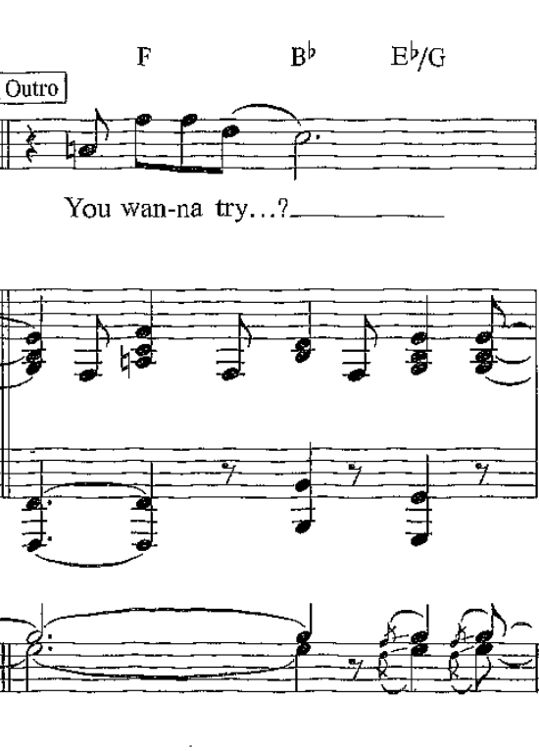
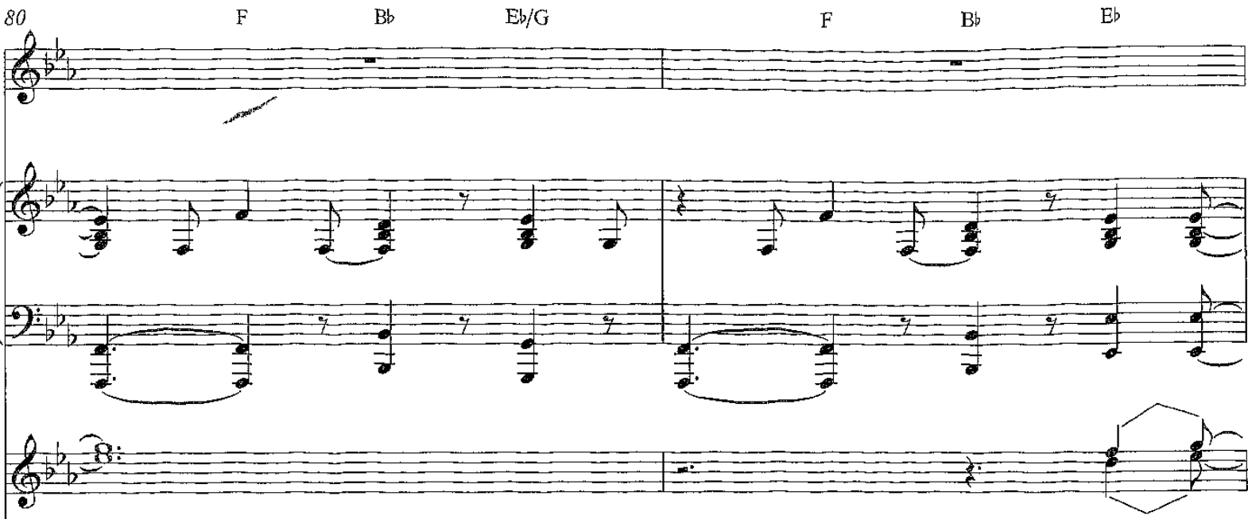
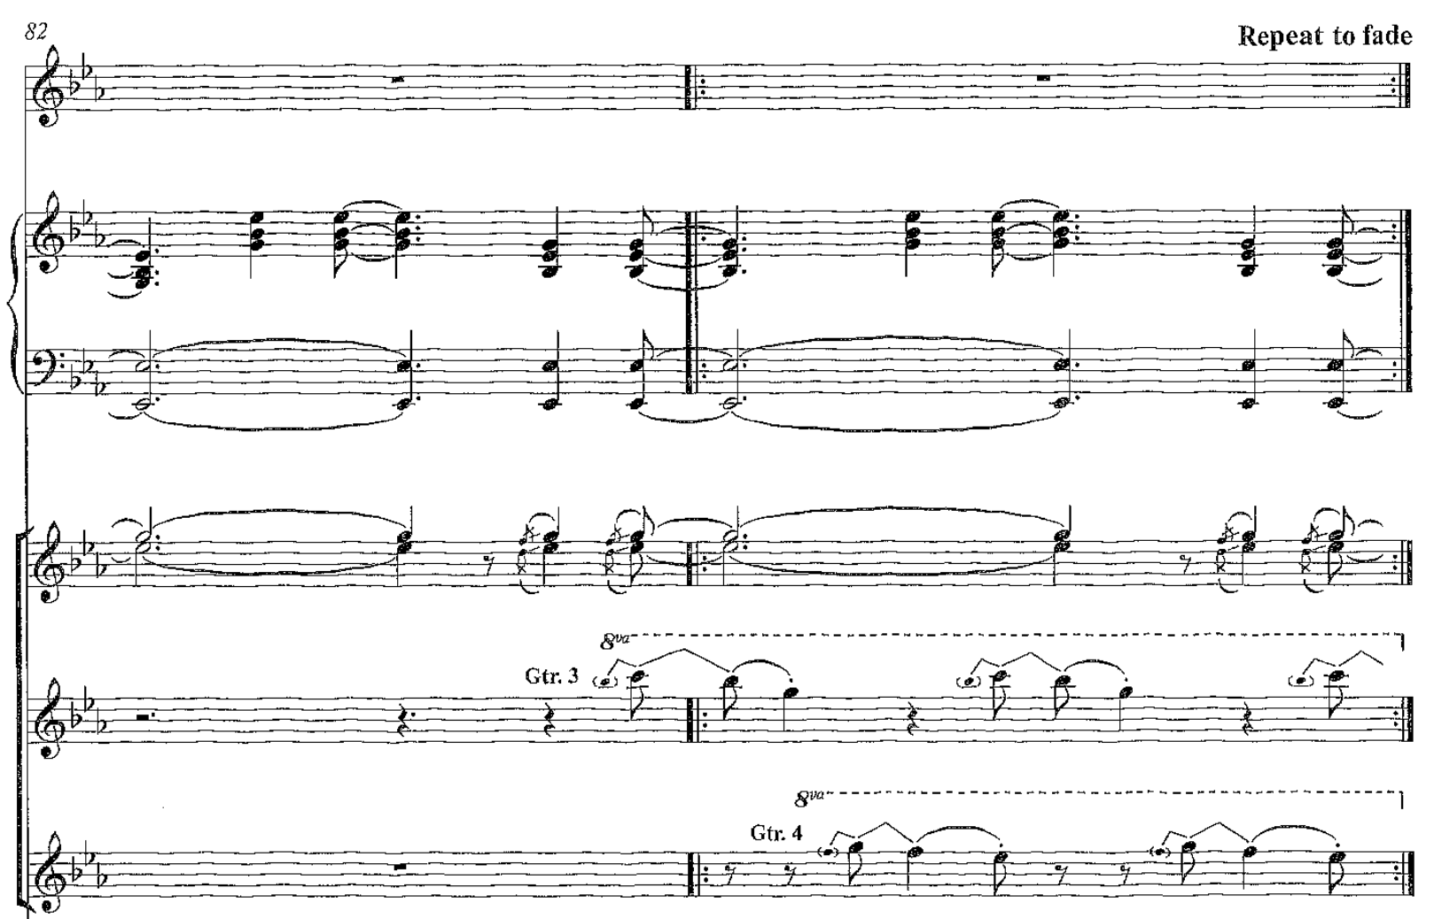
Outro: Bars 80 - End

