Slide 1
Computer models
Spreadsheet modelling
3rd Edition

Slide 2
Objectives
Understand what is meant by the term computer model, and compare different types of model
Understand that spreadsheets can be used to build financial models
Revise spreadsheet basics: entering text, numbers and formulae
Use relative and absolute referencing
Format cells, insert a graphic

Slide 3
Computer Models
Computer models are often used to predict and investigate how real-life devices or processes might behave in different situations

Slide 4
Real-life computer models
Engineers use models to predict the effects of extreme weather and earthquakes on designs for new buildings and bridges
Aircraft manufacturers use models to test the aerodynamics of new designs
Weather forecasters use models of the atmosphere to predict the weather
Businesses use financial models to investigate ways of making more profit

Slide 5
Spreadsheet modelling
Spreadsheets are often used to model real-life situations
They can help predict the likely outcome of certain decisions
“What if” I reduce the price of my product?
“What if” I increase the amount I spend on advertising?

Slide 6
Introducing … The Next Big Thing
The Next Big Thing (TNBT) is a talent show that launched in the USA last year
It was so successful that the producers are planning to launch it in the UK
They need to do some financial planning and modelling to make sure they make a good profit
You are going to build a spreadsheet to help them with their plans

Slide 7
Worksheet 1
Open the Word document ‘Worksheet 1 TNBT Series 1 Voting Figures’ and save onto your computer.
Open the Excel spreadsheet ‘TNBT Series 1 USA Voting’ and save onto your computer.
Follow the instructions for number 1 and 2 on the worksheet and then re-join the class.

Slide 8
Formulae and functions
You can put text, a formula or a function in a spreadsheet cell
Start a formula or function with an = sign
= C12*0.55
= SUM(D12:D21)
In cell C12, enter a formula to calculate the income from Phone votes in Week 1. You could use the formula is =B12*0.55
You can copy and paste text, formulae and functions to other cells

Slide 9
Absolute referencing – Votes
Change the formula in cell C12 to B12*$B$4
The $ signs tells Excel to use the figure in B4 all the way down column C when you copy the formula from cell C12. (It has nothing to do with US dollars in this context)
$B$4 is known as an Absolute (unchanging) cell reference. Look at the formula in C21

Slide 10
Formatting tools
You can format the spreadsheet in different ways
Change the font properties
Change the alignment and number format of cells
Merge and centre cells
Add a graphic

Slide 11
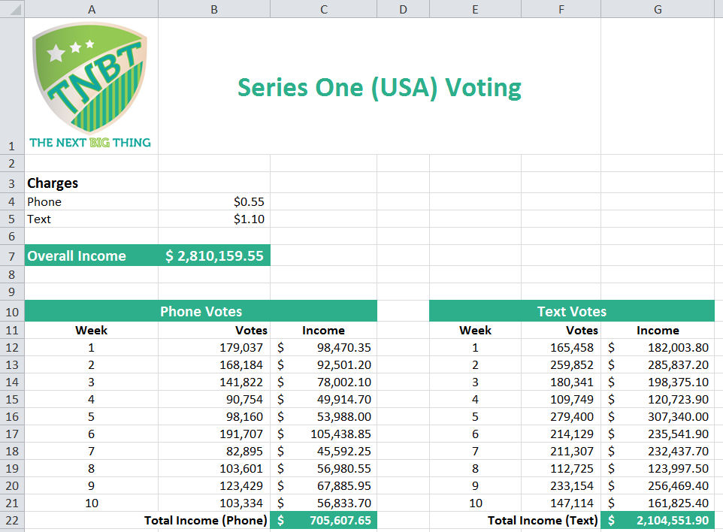
What formatting has been used here?

Slide 12
Formatting
Now complete Task 2

Slide 13
The spreadsheet as a financial model
A spreadsheet is a useful tool for trying out different scenarios and seeing what the consequences would be
These are called “what if” scenarios
Now try Task 3 on Worksheet 1

Slide 14
Trying out different options
What would you have to charge for text votes to give an overall income of $3,500,000?
Which cell(s) do you need to change to find out?

