Slide 1
IB English Literature
Mrs Parrack

Slide 2
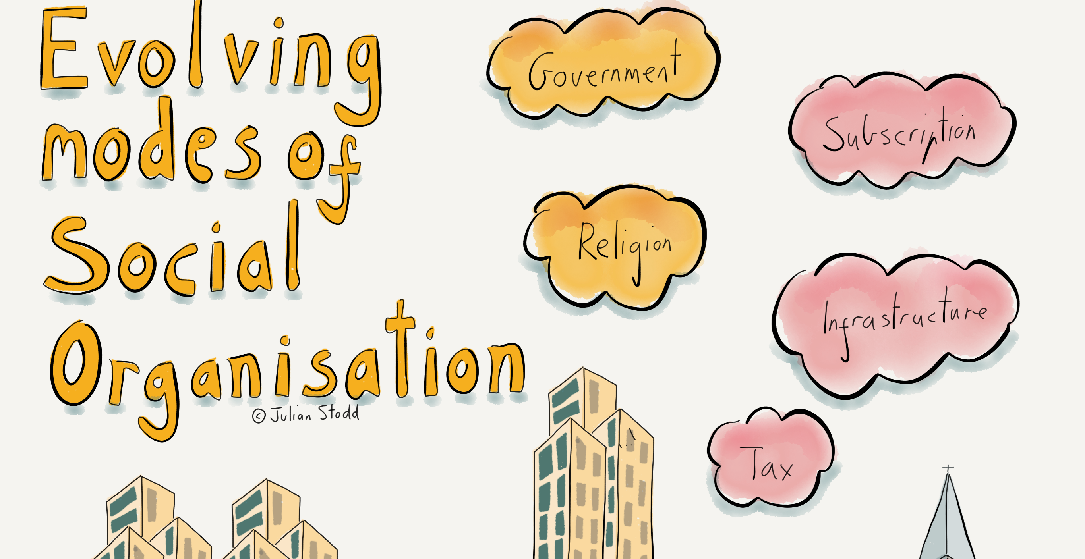
IB English Language B
Miss Croot

