Slide 1
Cambridge
IGCSE
Computer Science
Section 1
Sound
Data representation
5

Slide 2
Objectives
Understand how sound is sampled and stored in digital form
Be able to represent a short sound file in binary
Explain how sampling intervals and resolution affect the size of a sound file
Explain the trade-off between file size and the quality of playback
Understand the concept of MIDI file format, MP3 and MP4 files

Slide 3
Analogue to Digital conversion
Analogue sound signals are continuous
Digital signals are discrete
Sound is digitized by repeatedly measuring and recording the sound wave
\

Slide 4
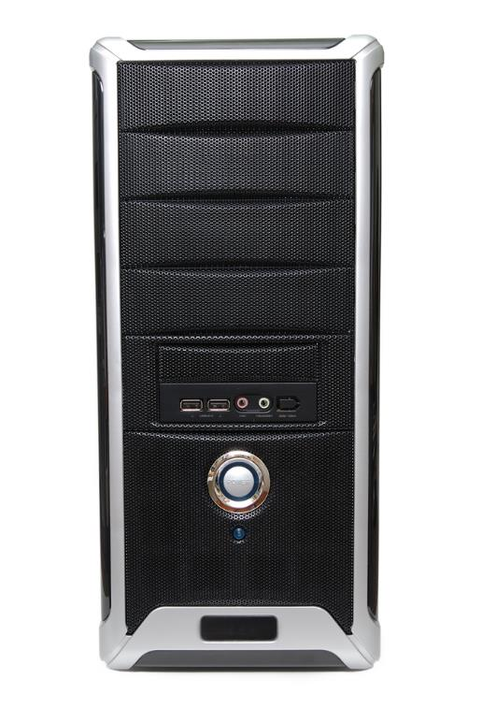
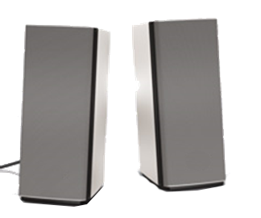
Analogue to digital convertors
Sounds must be converted into a digital form in order to be stored and processed by a computer
An ADC or DAC is used to process the input or output
Analogue to Digital
Digital to Analogue

Slide 5
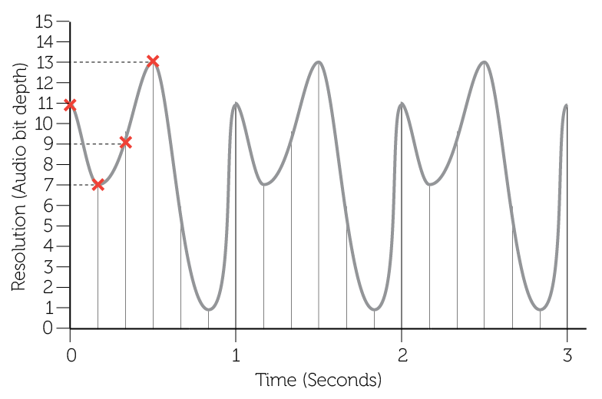
Sound sampling

Slide 6
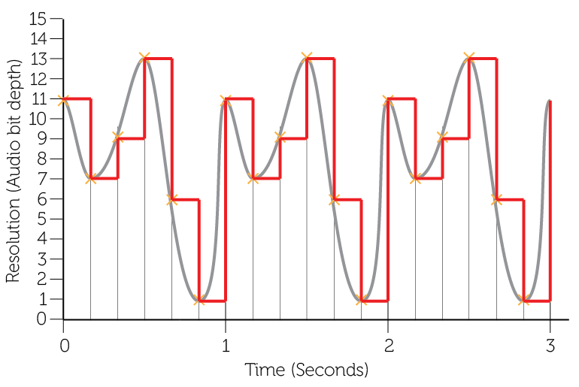
Sound sampling

Slide 7
Worksheet 5
Now do questions 1-3 on the worksheet

Slide 8
Digitized sound quality
Recording quality improves:
the more frequently we sample the sound
the more accurately we record the wave height
Increasing sampling rate and resolution means recording more data points
What happens to the size of the sound file?

Slide 9
Worksheet 5
Now do questions 4-10 on the worksheet

Slide 10
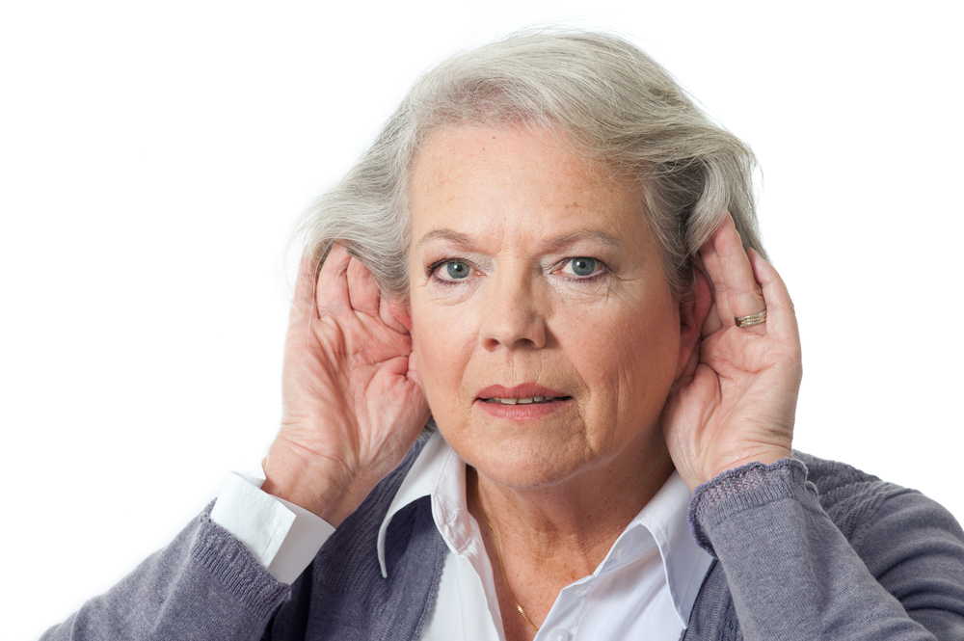
Our hearing range
Between 20-20,000 Hz
Varies depending on age
Take the test!

Slide 11
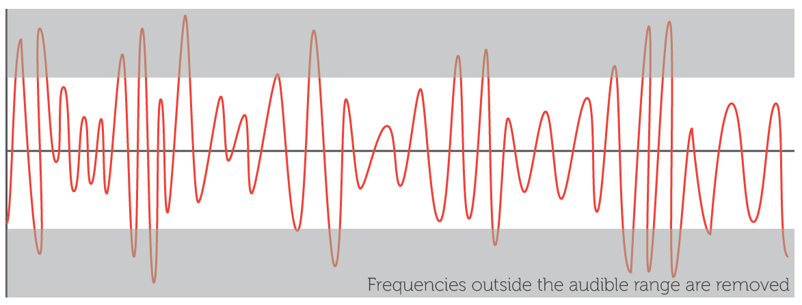
Lossy compression – MP3
Lossy compression removes the sounds in the frequency ranges that we can’t so easily hear or that least affect the perceived playback quality
Lossy compression leaves out some data – this can affect the sound quality

Slide 12
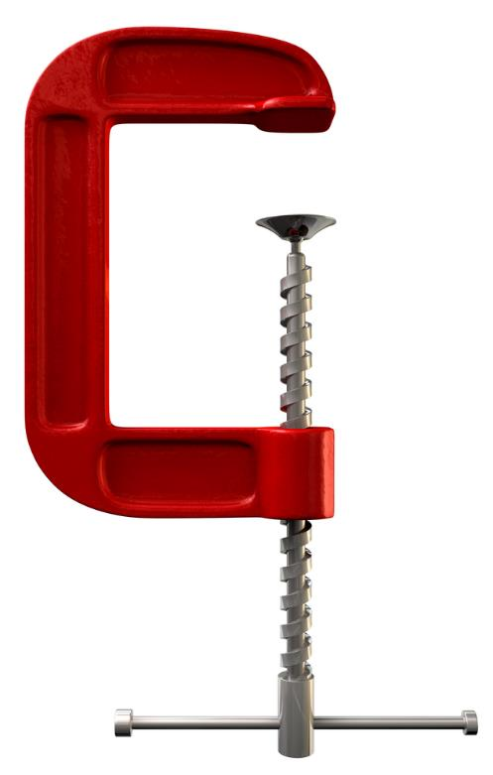
Lossless compression
Lossless compression leaves out repeated data and instead makes a note of how many times it is repeated
E.g. 10 x 5 takes less space to store than
5+5+5+5+5+5+5+5+5+5

Slide 13
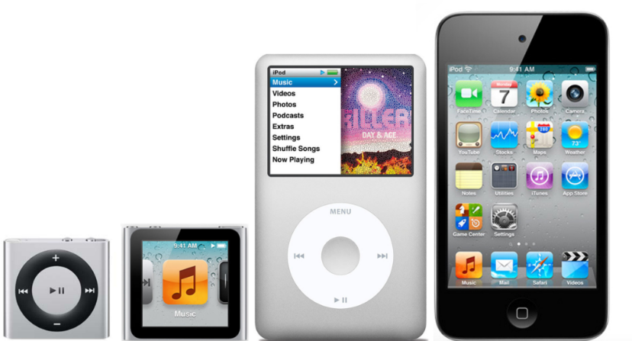
File formats available
.WAV – uncompressed files
.FLAC or .M4A lossless compression, slightly smaller files
.MP3 – Lossy compression, much smaller files

Slide 14
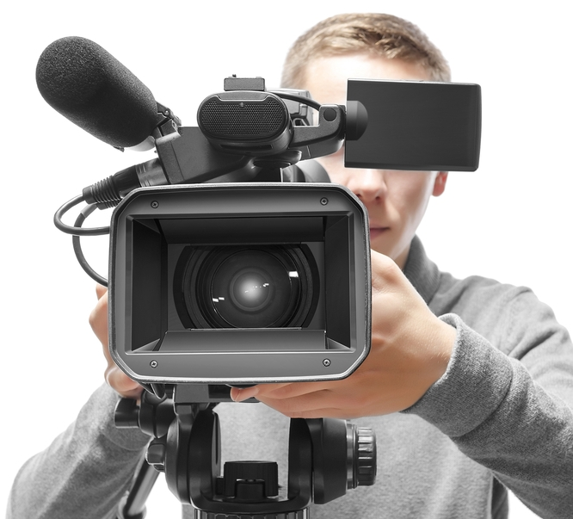
MP4 file format
MP4 is a digital multimedia format most commonly used to store video and audio
It can also be used to store subtitles and still images
It allows different multimedia streams (video, audio, text) to be combined into one file

Slide 15
MIDI files
MIDI stands for Musical Instrument Digital Interface
A MIDI file:
is not a recording of a live music source
is a set of instructions for digital instruments to play synthesised sounds
can be used to synchronise an orchestra of digital instruments to play simultaneously
uses up to 1000 times less disk space than a conventional recording
is commonly used for mobile phone ringtones

