Slide 1
Conditional formatting and validation
Spreadsheet modelling
3rd Edition

Slide 2
Objectives
Create a seat booking system for a live show
Use validation techniques to ensure that only valid data can be entered
Use conditional formatting to show which seats have been booked
Use a Countif function in calculations of seat sales

Slide 3
The Finalists’ Tour
In a tour of the country, the TNBT stage will set up in various locations
The seating plan shows three different categories of seats: Premium, Standard and Economy
Discounts of 25% and 50% will be given for students and children under 12

Slide 4
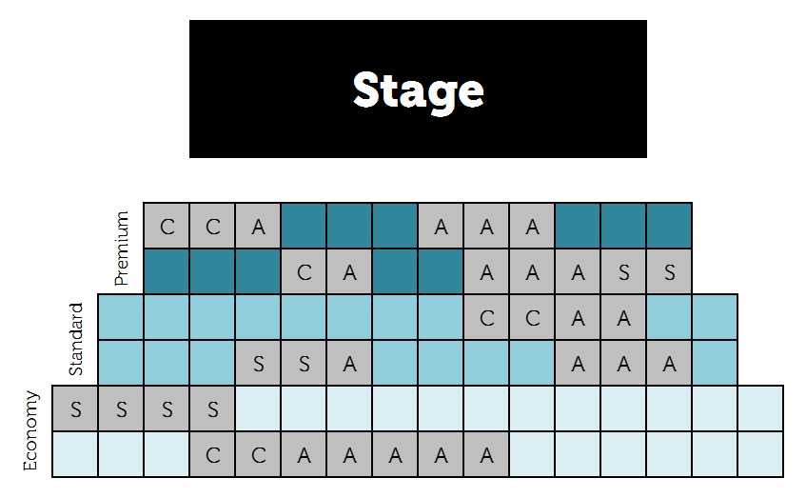
Model of a Seating Plan

Slide 5
Starting your seat booking system
Open Worksheet 4
In Task 1, you will:
Open the spreadsheet Seating Plan Starter
Merge and centre the cells that represent the stage
Format the seating plan, using different colours for different grades of seat
Use conditional formatting to turn a cell grey when the seat has been sold

Slide 6
Validation
“The checking of data, on input, by software to make sure it is sensible or reasonable”
Types of validation:
Range check
Type check
Length check
Format check
Presence check

Slide 7
Task 2: Data validation
In Task 2, you will:
Add data validation to all the seat cells
Create an error message which will be displayed when the user enters anything other than A, S or C
Test out the validation

Slide 8
Task 3: Number of seats sold
Task 3 involves the use of the COUNTIF function
COUNT all cells in a range IF they contain an A
=COUNTIF (range, “A”)
Can you name the range E9:P10 on your spreadsheet (e.g. PremiumSeats), and use the name in the COUNTIF formula?
How many Premium seats are there? And how many remain unsold?

Slide 9
Task 4: Calculating seat revenue
Students and children receive a discount of 25% and 50% respectively, on seat prices
First you need to calculate what each type of customer (adult, student or child) pays for a particular seat (Premium, Standard or Economy)
Then you can use Number of Seats sold in each category to calculate revenue

Slide 10
Some other spreadsheet features
Inserting comments – you can right-click a cell and insert a comment in any cell
Shrinking your spreadsheet – use the slider bar at the bottom of the screen to make your spreadsheet fit on the screen
Getting help – click the lightbulb icon in the menu at the top of the screen

