Slide 1
GEOGRAPHY A LEVEL
WHY EVERYONE SHOULD STUDY GEOGRAPHY AT A LEVEL

Slide 2
The Guardian newspaper states:
Studying geography arms graduates with a mix of skills employers want to see: Geography students generally do well in terms of their relatively low unemployment rates. You could attribute this to the fact that the degree helps develop a whole range of employability skills including numeracy, teamwork through regular field trips, analytical skills in the lab and a certain technical savviness through using various specialist computing applications. Also, the subject area in itself cultivates a world view and a certain cultural sensitivity. These all potentially help a geographer to stand out in the labour market

Slide 3
THE MAIN INGREDIENTS
The EDEXCEL A LEVEL course is split into 8 topics
These are assessed in 3 exams
The exams are predominantly essay based
There is also a non examined assessment (NEA) which is worth 20% of the A level and requires a report of roughly 4000 words

Slide 4
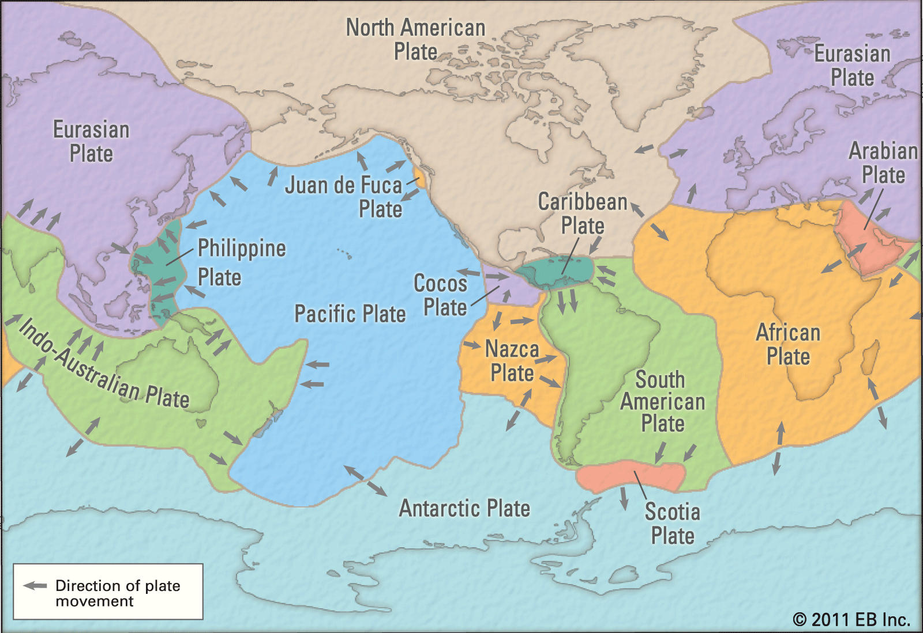
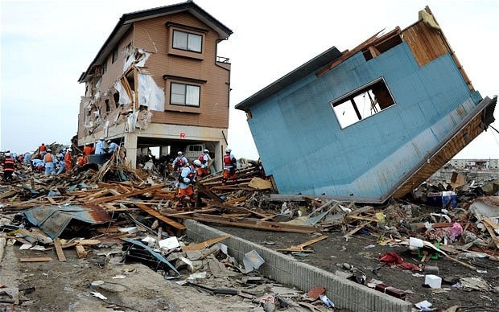
PAPER 1 – ‘BROADLY PHYSICAL GEOGRAPHY’
TECTONIC HAZARDS
COASTAL PROCESSES
CARBON CYCLES AND IMPLICATIONS
HYDROLOGICAL CYCLES AND IMPLICATIONS

Slide 5
PAPER 2 – ‘BROADLY HUMAN GEOGRAPHY’
REGENERATING PLACES
GLOBALISATION
SUPERPOWERS
HEALTH, HUMAN RIGHTS AND INTERVENTION

Slide 6
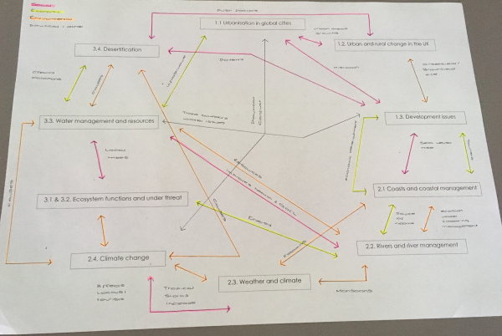
PAPER 3 –SYNOPTIC AND DECISION MAKING
This paper is all about linking up all the aspects of geography covered.
It is applied to an example which is delivered in a resource material in the exam.

Slide 7
SKILLS THAT ARE INTERTWINED
Maths
Literacy
Problem solving
Decision making skills
Computer literacy
Group work and team work
GIS skills

Slide 8
So, why should everyone study Geography A Level?
“The study of geography is about more than just memorizing places on a map. It's about understanding the complexity of our world, appreciating the diversity of cultures that exists across continents. And in the end, it's about using all that knowledge to help bridge divides and bring people together.”
Barack Obama, 2012

