Slide 1
Parson’s problem
Starter activity
Lesson 4 Activity 1
Notes:
Last updated: 11-05-21
Last updated: 11-05-21
Resources are updated regularly — the latest version is available at: ncce.io/tcc.
This resource is licensed under the Open Government Licence, version 3. For more information on this licence, see ncce.io/ogl.

Slide 2
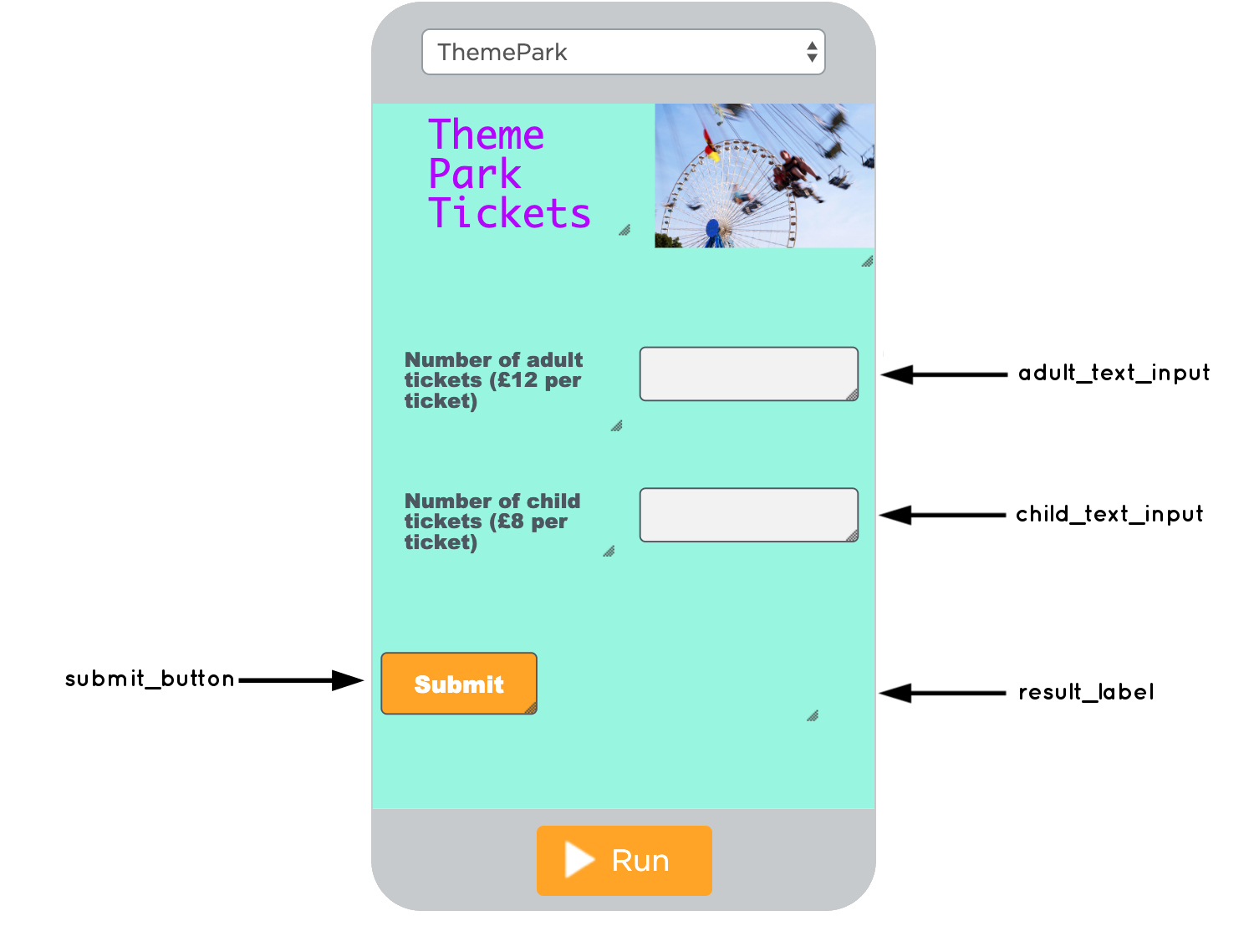
Theme park tickets app
Activity 1
The purpose of this app is to allow the user to enter in the number of adult and child tickets required.
Once the user selects the submit_button, the data will be captured and processed and total will be displayed in the result_label.

Slide 3
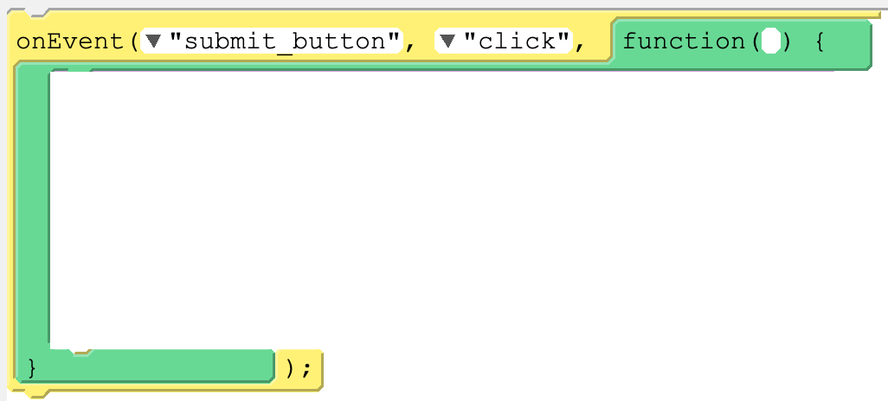
Place the blocks in the correct order to form a working segment of code.
Activity 1

